Slide 1

IMPROVING GRAIN YIELD PREDICTION VIA UNMANNED AERIAL SYSTEM HEIGHT ESTIMATES WITHIN GENOMES TO FIELDS
POSTER : 201
Steven Anderson¹, Seth Murray¹, Lonesome Malambo², Anjin Chang³, Marcin Jurek⁴, Sorin Popescu², Jinha Jung³, Dale Cope⁵, and Alex Thomasson⁶
(1) Department of Soil and Crop Sciences, Texas A&M University, College Station, TX, (2) Department of Ecosystem Science and Management, Texas A&M University, College Station, TX, (3) School of Engineering and Computer Sciences, Texas A&M University - Corpus Christi, Corpus Christi, TX, (4) Department of Statistics, Texas A&M University, College Station, TX, (5) Department of Mechanical Engineering, Texas A&M University, College Station, TX, (6) Department of Biological and Agricultural Engineering, Texas A&M University, College Station, TX

Slide 2
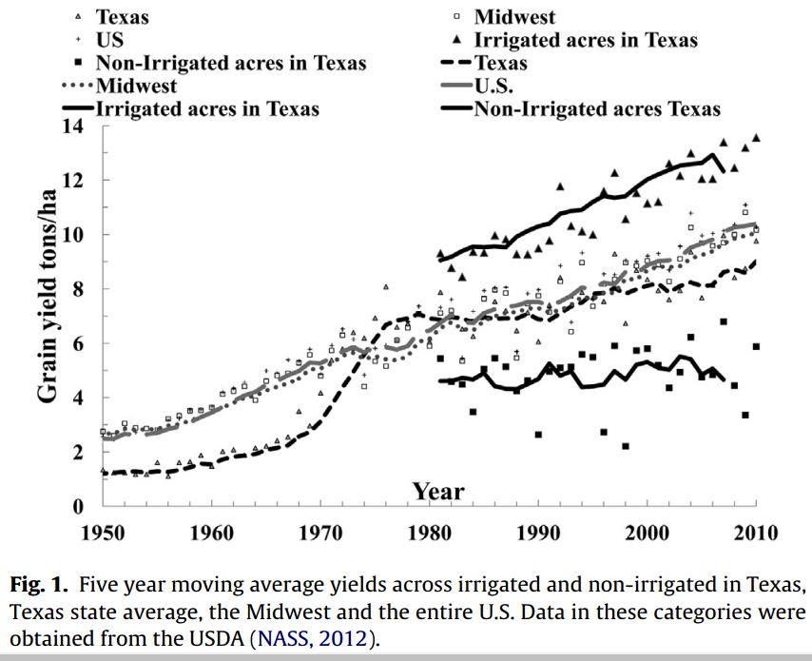
Plant height in Texas maize is highly correlated to yield
  313.6 M bushels total (~2%)
    ~14.6 billion bushels in US
  $3.5 billion dollar industry
    & 22,000 Jobs in TX high plains.
  Exports $157 million
  dollars (~5%)
  IOWA
  2.5 Billion Bu (2018; ~18 %)
U.S. /Midwest
Texas
Grain yield (tons/ha)
 | Plant height (cm)
Texas | 0.61***
High Plains | 0.19***
Rest of Texas | 0.46***
Barrero et al. 2013, Field Crops Research

Slide 3
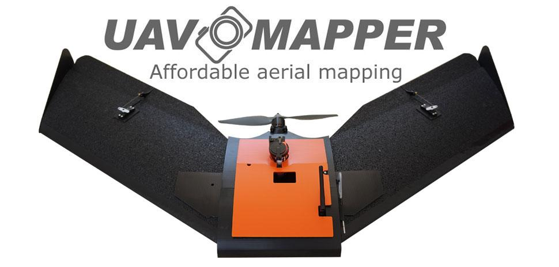
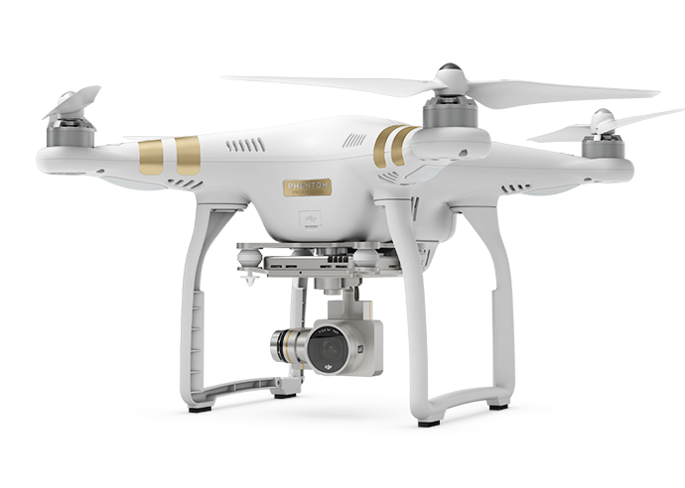
UAS PLATFORMS
Tuffwing UAV Mapper
Flight Altitude: 120 m
Resolution: ~2 cm/pixel
Sensor: Sony a6000 (RGB)
MicaSense RedEdge (Multispec)
SfM Software: Agisoft Photoscan
DJI Phantom 3
Flight Altitude: 25 m
Resolution: ~1 cm/pixel
Sensor: 1/2.3” CMOS (RGB)
SfM Software: Pix4D

Slide 4

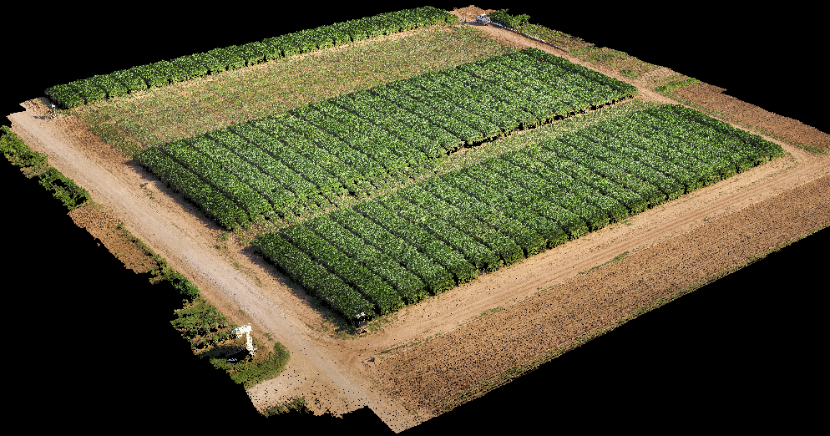
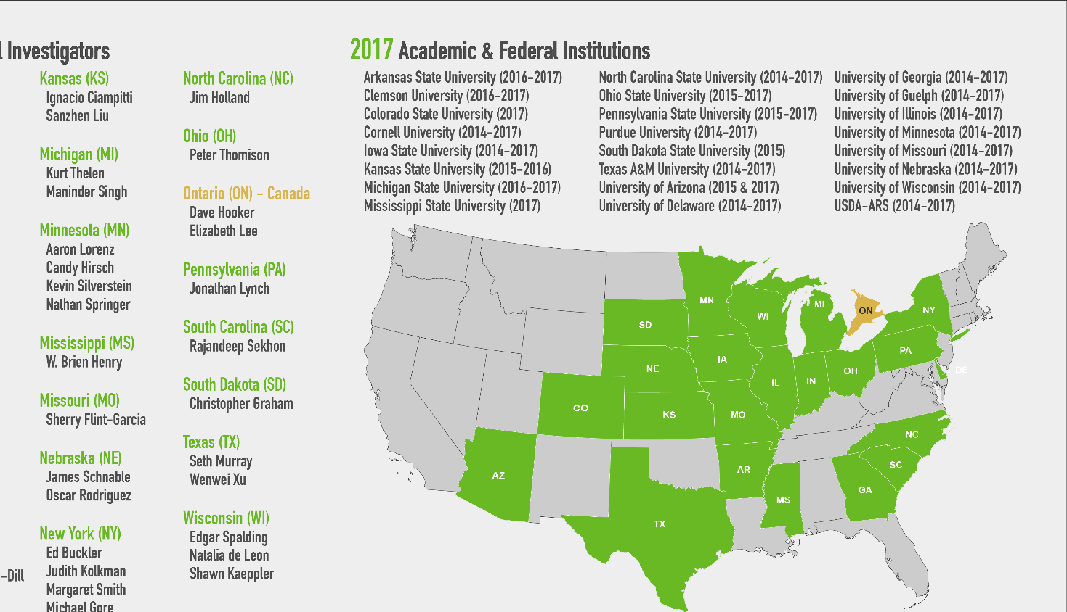
UAS Evaluation;
College Station, TX
  2017 - 2019
  RCBD; 250 Hybrids, 2 Reps/Trial
  G2FE
    Optimal Planting Date
    Irrigated
    Optimal Fertilization
  G2LA
    Delayed Planting
    Irrigated
    Fertilizer
  DG2F
    Optimal Planting
    Non-Irrigated
    Less Fertilizer
Alkhalifah et al., 2018

Slide 5
Steps to obtain and analyze UAS field phenotyping data
Fly UAS to collect pictures
with GPS and IMU tag
Process images
Identify 2D key points
Calibrate images
Optimize camera parameters
Georeference and match images
Structure from motion SfM makes 3D point cloud from 2D keypoint matches
Place ground control points GCPs in field
Structural
Height Extraction Pipeline
Extract
Orthomosaic
and DSM
Spectral correction
(if necessary)
Identify
ground /
generate DTM
Adjust heights by DTM
(CSM)
Extract
data by plot
Identify
plots
Statistical
analysis
Spectral
Estimate genotypic values → Determine measurements repeatability & value

Slide 6


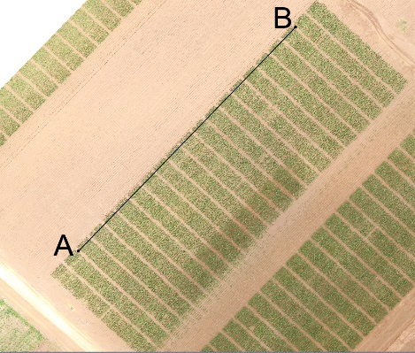
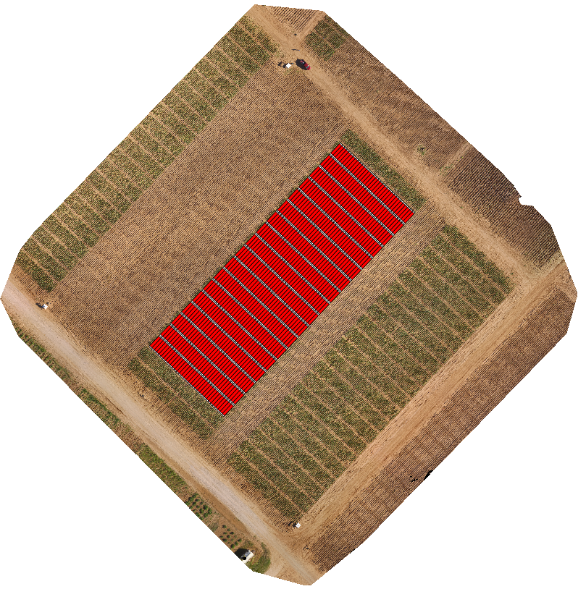
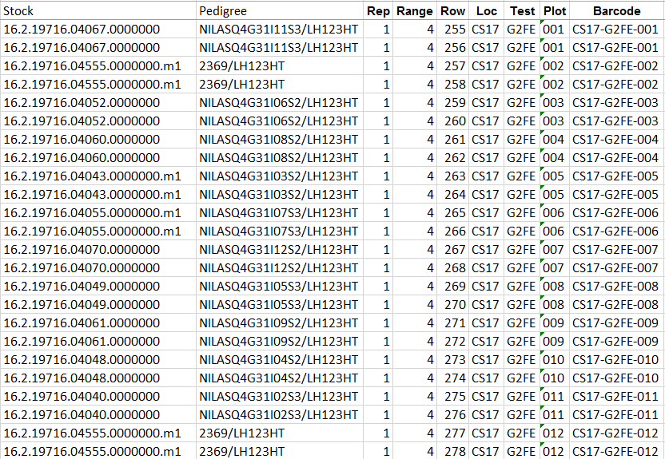
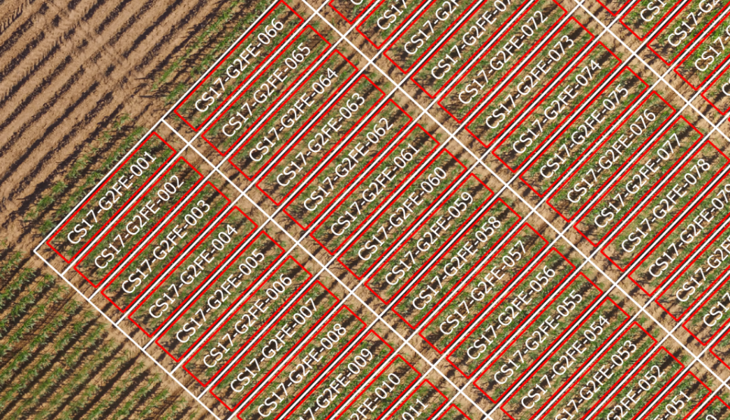
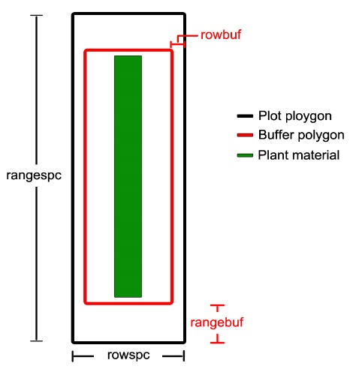
R/UASTools
https://github.com/andersst91/UAStools
AB-line UTM Coordinates
R/UAStools::
plotshpcreate
Experimental Field Design
Plot
Dimensions

Slide 7
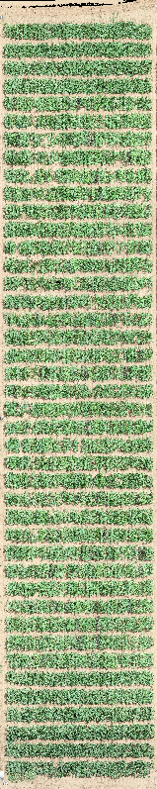
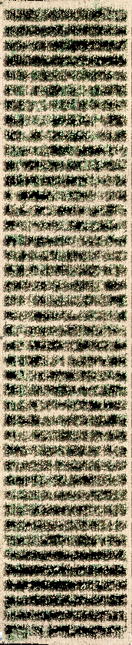
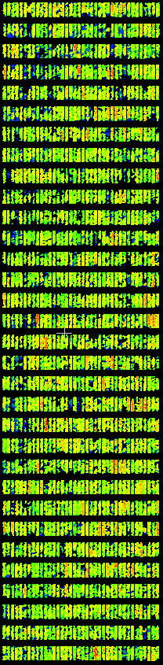
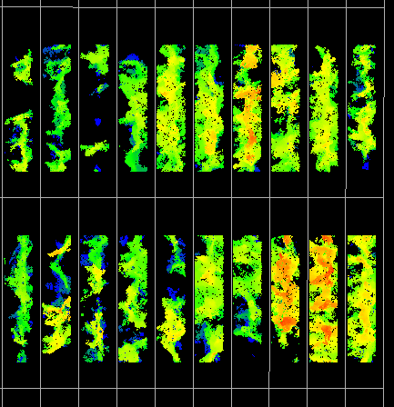
Above Ground Height Adjustment
Original
Point Cloud
(DSM)
HRI Filtered
Ground
Points
(DTM)
Above Ground
Height
(CSM)
-
=
Plot Level Heights

Slide 8
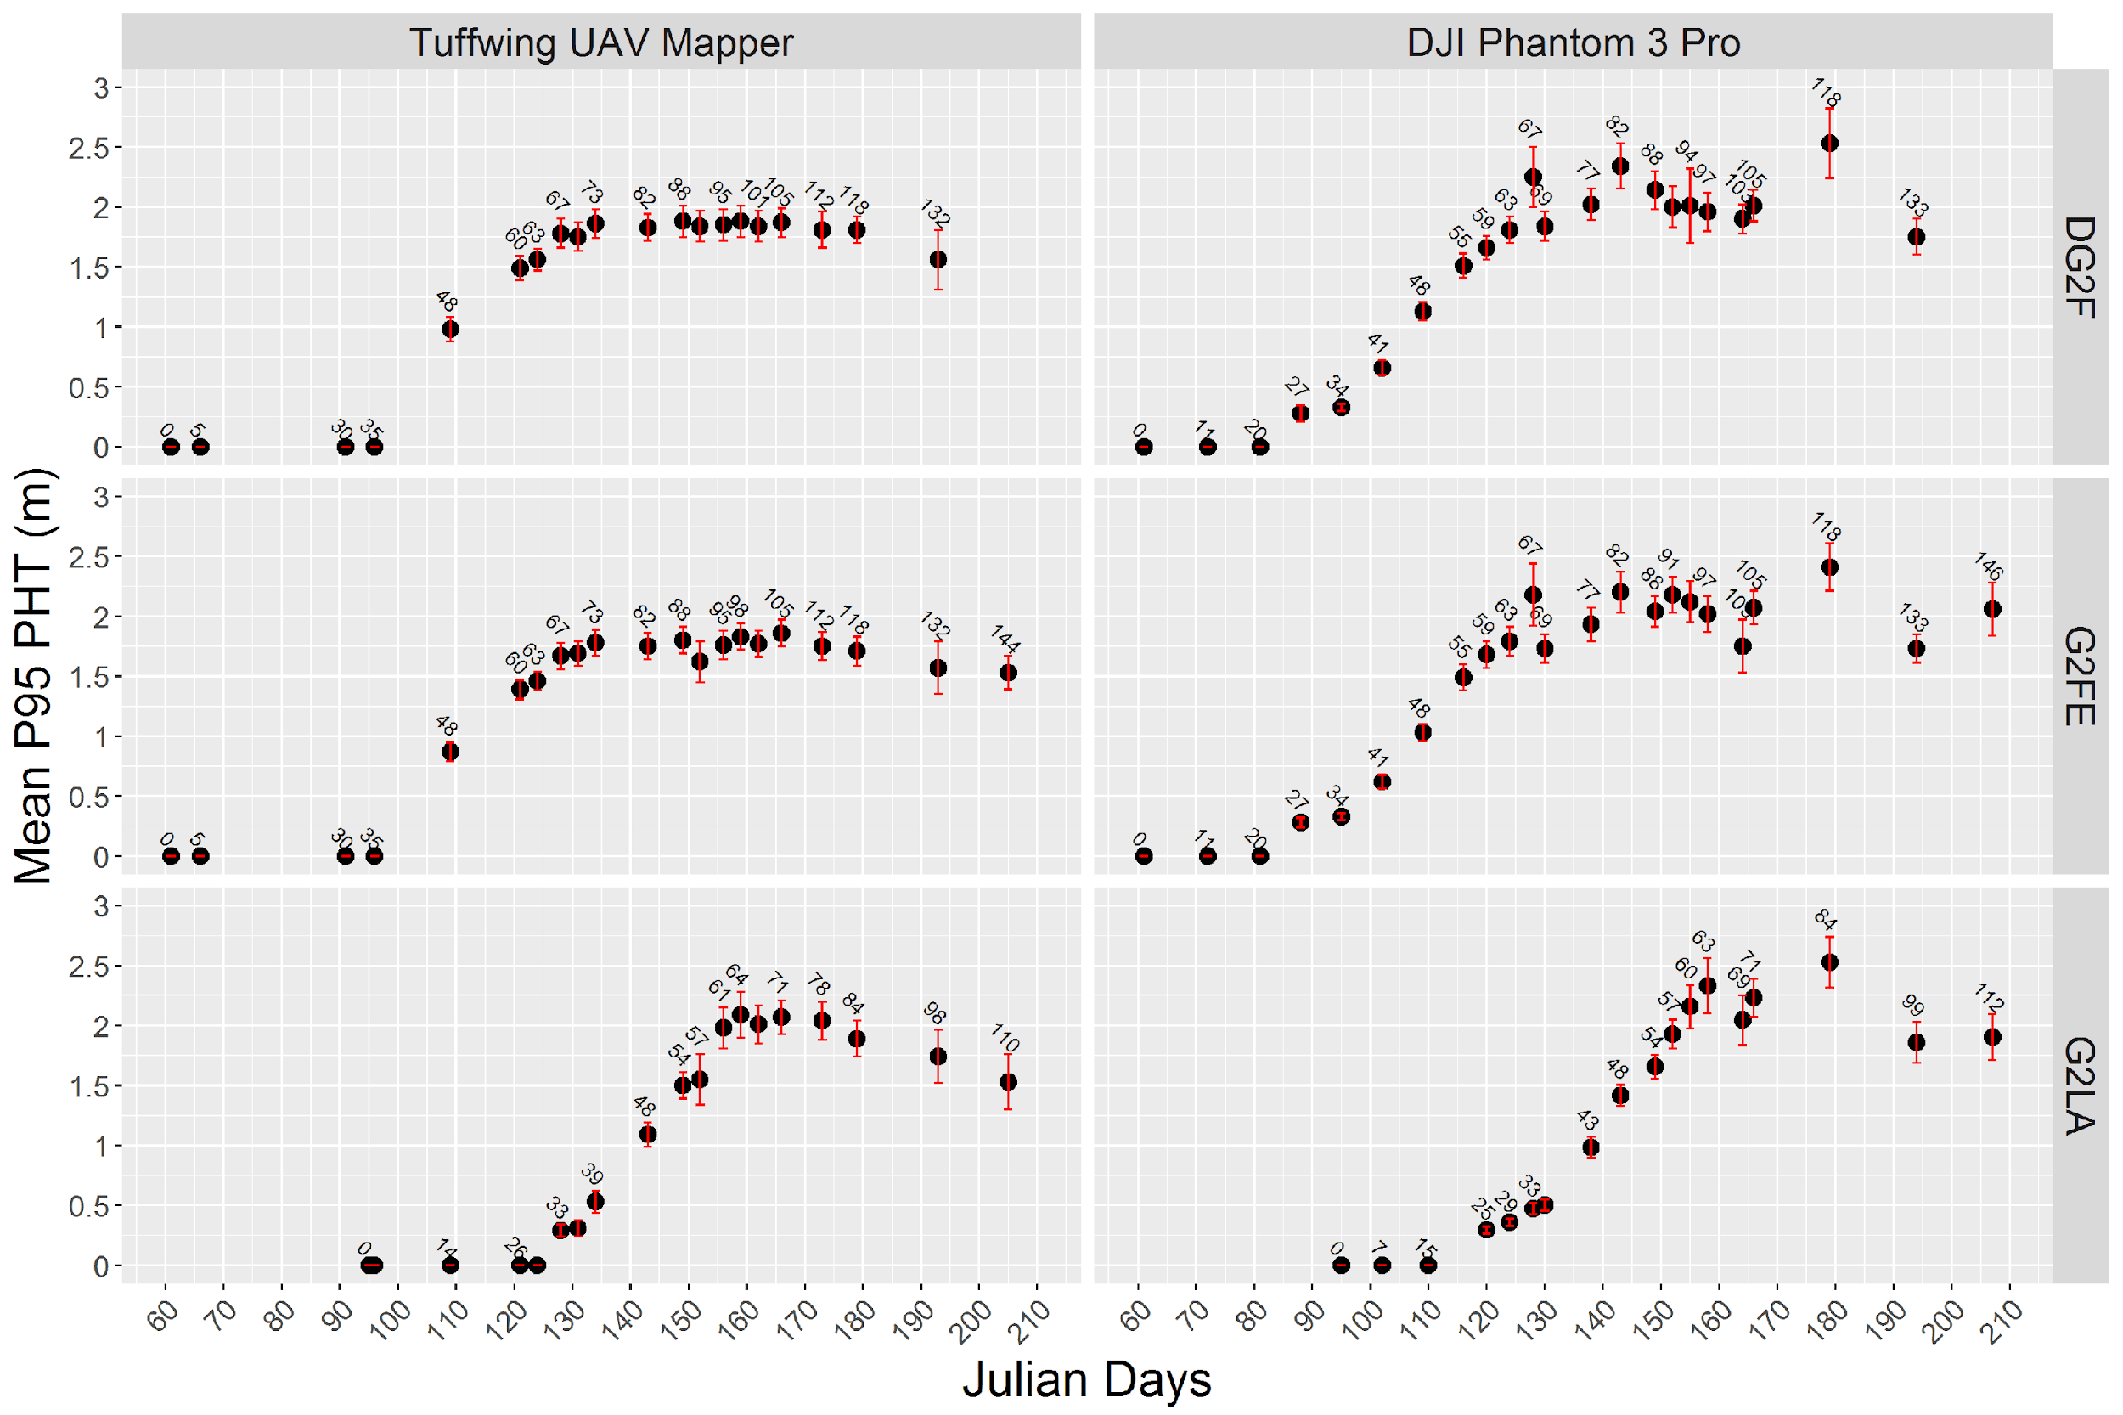

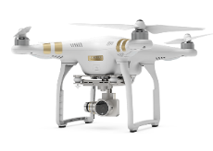
Summary of Growth

Slide 9
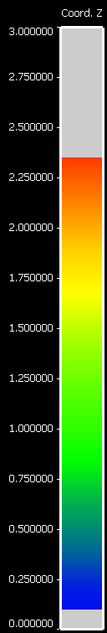

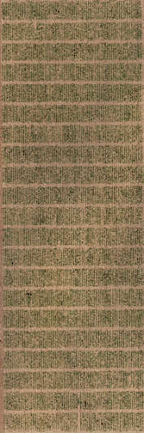
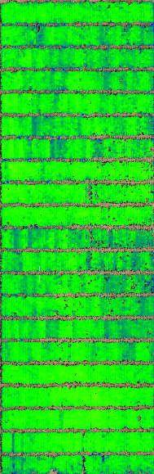
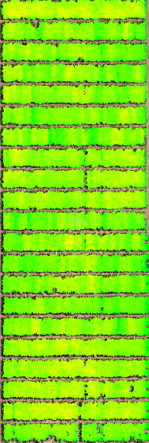
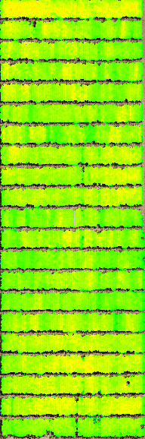
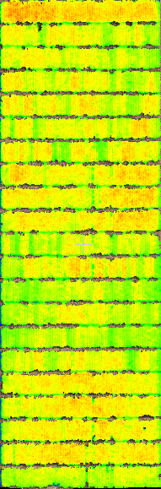
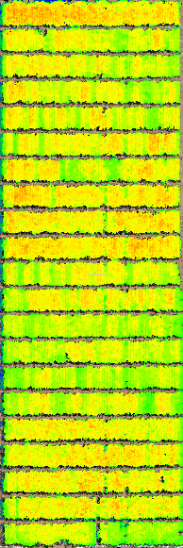
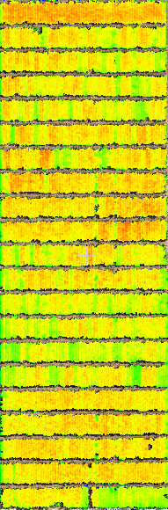
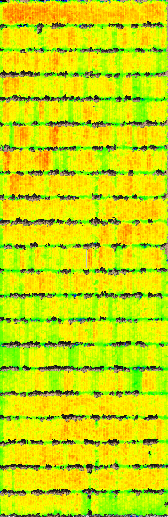
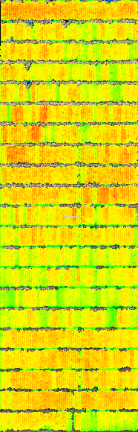
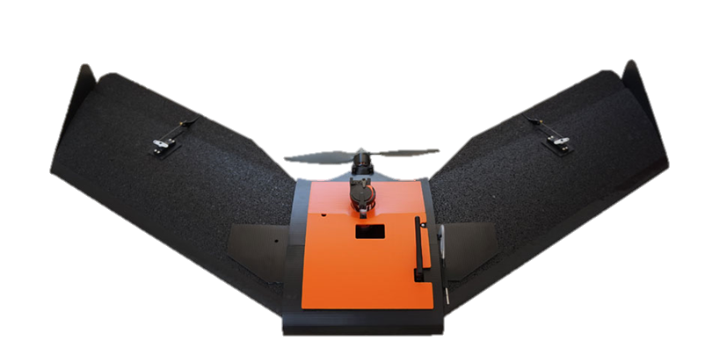
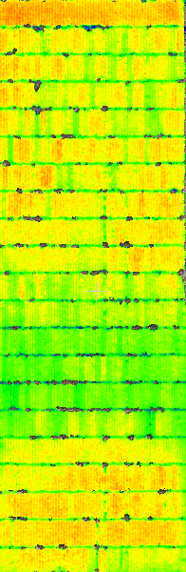
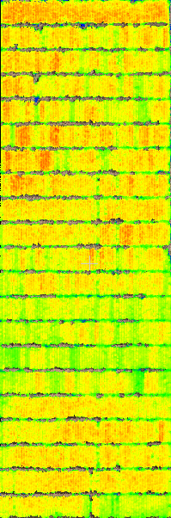
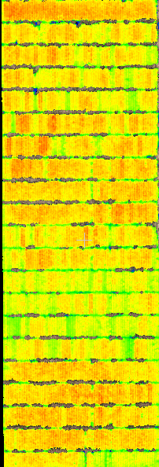
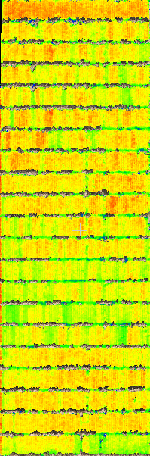
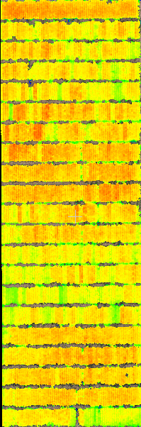
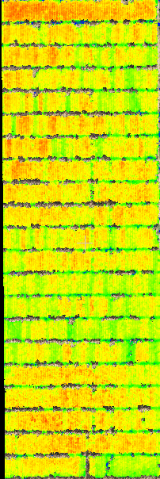
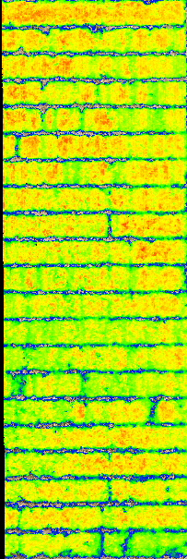
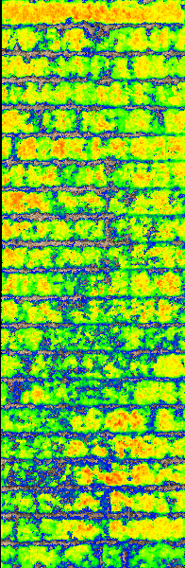
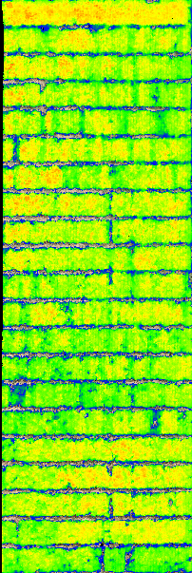
Tuffwing Temporal Heights (G2FE)
5
35
48
60
63
67
70
73
82
88
91
95
98
101
105
112
118
132
146
Notes:
CS17-G2FE

Slide 10
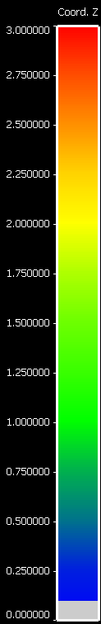
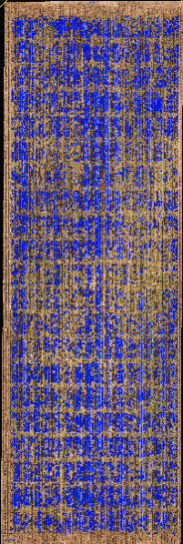
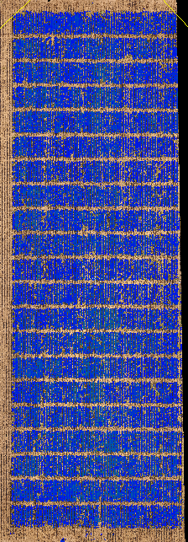
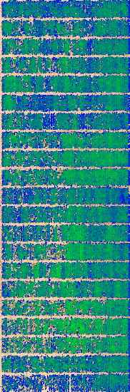
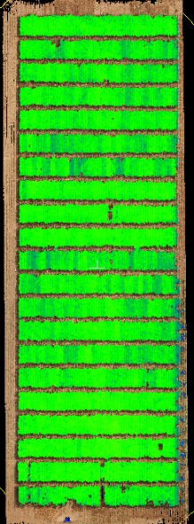
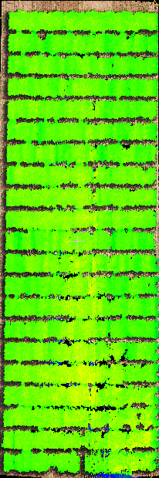
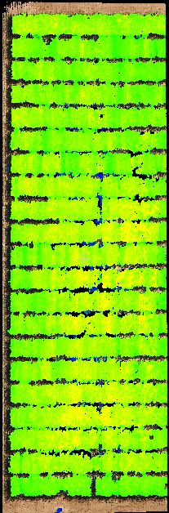
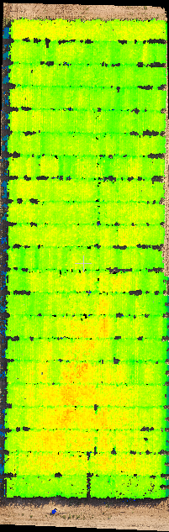
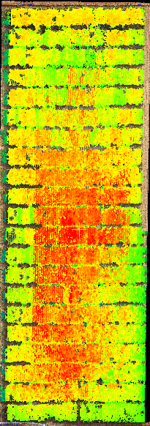
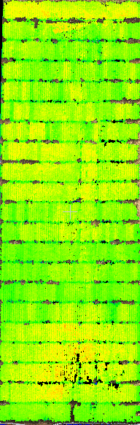
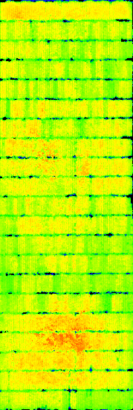
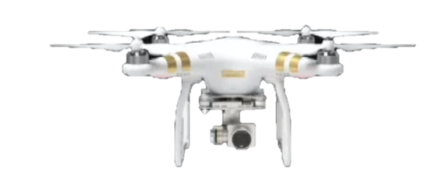
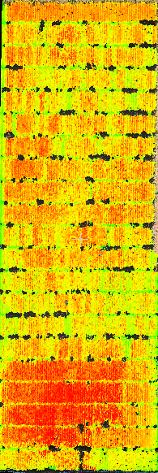
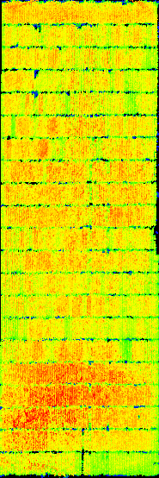








DJI Phantom Temporal Heights (G2FE)
27
34
41
48
55
59
63
67
69
77
82
88
91
94
97
103
105
118
133
146
Notes:
CS17-G2FE

Slide 11



Temporal Growth Models by Pedigree

Slide 12




0

Slide 13


Variance Components and Repeatability

Slide 14



Nonlinear Logistic Function
Verhulst (1838)
x₀ = Inflection Point,
L = Asymptote
k = Growth Rate
https://stat.ethz.ch/R-manual/R-devel/library/stats/html/SSlogis.html

Slide 15

Grain Yield Correlation and Prediction
~50-100% improved grain yield correlation.
~400% improved prediction of grain
yield variance (R²).
~50-150% improved selection accuracy
  Top 10% yielding hybrids
Logistic parameters remove the necessity to capture the most informative flight date.
 | Tuffwing UAV Mapper |  |  | DJI Phantom 3 Pro
 | DG2F | G2FE | G2LA | DG2F | G2FE | G2LA
Plant Height | 0.28** | 0.25*** | 0.23*** | 0.28** | 0.25*** | 0.23***
UAS Flight Date | 0.45*** | 0.42*** | 0.43*** | 0.41*** | 0.36*** | 0.47***
Asymptote | 0.44*** | 0.42*** | 0.42*** | 0.44*** | 0.38*** | 0.45***
Growth Rate | -0.46*** | -0.42*** | -0.34*** | -0.30*** | -0.13*** | -0.13**
Inflection Point | 0.46*** | 0.42*** | 0.18 | 0.42*** | 0.36*** | 0.15*

Slide 16
Closing Remarks
Higher resolution imaging ≠ more informative data sets
Nonlinear function eliminates the need to identify specific flight dates for prediction, creating a robust prediction model.
Parameters of logistic function effectively summarized temporal UAS flight data while maintaining:
  Improved grain yield correlation
  Improved prediction of grain yield variance
  Improve relative rank precision and selection accuracy
Quality UAS data provides opportunities to analyze growth patterns of crops in ways previous not possible.

Slide 17











Acknowledgements
Murray group
Nathalia Cruzato
Colby Ratcliff
Jacob Pekar
David Rooney
Shakirah Nakasagga
Holy Lane
Alper Adak
Dr. Yuan Yuan Chen
Dr. Fabian Echeverria
Dr. Nancy Wahl
Dr. Scott Wilde
Grant Richardson
Many past students and student workers!
TAMUS UASAG Team
Corpus Team
Jinha Jung
Anjin Chang
Committee
Seth Murray
Sorin Popescu
Bill Rooney
Nithya Rajan
Lonesome Malambo
Dale Cope
Alex Thomassson
Cody Bagnall
Ian Gates
Andrew Vree
N. Ace Pugh
David Horne
Misty Vidrine
+ Many others!
And many collaborators across other projects not presented
Funding: USDA-NIFA-AFRI Award No. 2017-67013-26185, USDA-NIFA Hatch funds, Texas A&M AgriLife Research, the Texas Corn Producers Board, the Iowa Corn Promotion Board and the Eugene Butler Endowed Chair in Biotechnology
Texas A&M College of Agriculture and Life Sciences
Tom Slick Senior Graduate Research Fellowship

Slide 18

Questions Poster 201
https://github.com/andersst91/UAStools

