Slide 1
G2F Mission and Outlook
Natalia de Leon
University of Wisconsin, Madison
Tucson, AZ
February 6th, 2019

Slide 2
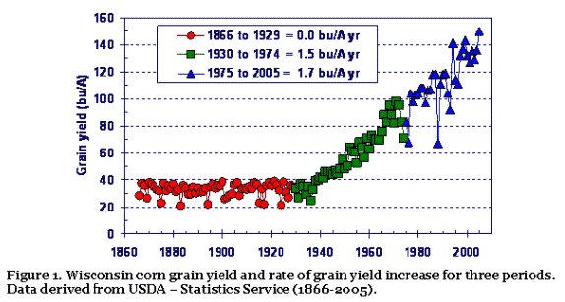
Plant Improvement Has Been a Successful Endeavor
Wisconsin corn grain yield and rate of gain yield increase for three periods. Data derived from USDA – Statistics Services (1866-2005) http://corn.agronomy.wisc.edu/WCM/W177.aspx

Slide 3
NCGA National Corn Yield Contest: http://www.ncga.com/for-farmers/national-corn-yield-contest :
2017 (USDA) average corn yield nationally: 176.6 bushels/acre
NGCA Corn Contest had 5 entries above 400 bushels/acre in 2017 (1 in 2018)
2017 no till/strip till, irrigated winner harvest 542 bushels/acre in 2017 (Charles City, VA)
Recommendations:
  “Be best friend with your crop”, “walk your field”, ”farmers are great observers”
  plant when conditions are appropriate and use appropriate seed spacing
  plants need to germinate between 4 to 12 hours from its neighbor plant
  constant plant and soil sampling to monitor status
  winner corn was harvested at 19% moisture with ear leaf still green
What resources, tools, processes can help increase efficiency of breeding outcome for specific conditions/situations?

Slide 4

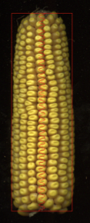
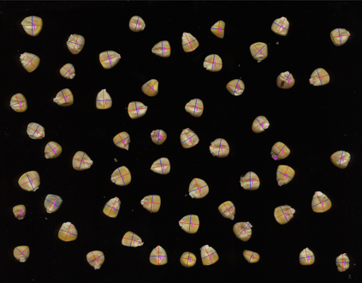
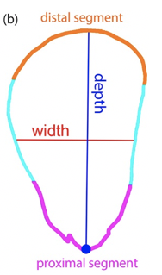
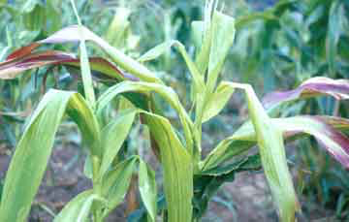
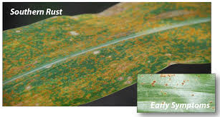
Increasing Granularity and/or Efficiency in the System:
P = G + E + G x E
E.g.: Yield
Virus susceptible, rust resistant
Cultivar A
X
X
X
Phenotype
Cultivar B
WEATHER
+
SOIL
+
MANAGEMENT
+
MICROBES, ETC
Rust susceptible, virus resistant
DNA
RNA
PROTEIN
Environment
archive.is/lg8Ce
Wyffels.com

Slide 5
Aspirational Objectives:
Leverage the National Plant Genome Initiative investment in genome data with new phenotyping tools to deliver new products to farmers
Desired Outcomes:
  Identify phenes and genes that control variation for plant performance in diverse environments (“GxE” Project)
    Develop and identify new sources of genetic variation
  Improve our ability to predict plant performance to enhance agronomic production, accelerate plant breeding, and support business and policy interests
  Enhance and organize the broader research community
    Integrated and annotated public data sets
    Development of data management resources
    Facilitate synergies and interactions within the community

Slide 6
Genetic Modelling and Allele Characterization (NA Context):
Core Inbred pool
ex-PVP and public breeding inbreds
New Allele Sources
GEM selects
Particular lines from cooperators (yield component traits)
Donations from industry screening
Other sources
Stiff Stalk
ex-PVP
Public
Non-Stiff Stalk
ex-PVP
Public
Iodent
ex-PVP
Public
Model per se allelic effects
  Prediction of breeding crosses
  Prediction of “ideal” inbreds
Hybrid Prediction
Traits of focus
GxE
Integrating phenotyping, etc.
Determine how to characterize alleles in the context of Core Inbred Pool
    Genetic context
    Recombination/resolution
    Managed biotic and abiotic stress targets

Slide 7
Germplasm Resources:
Molecular information allows us to determine what is different but not necessarily what is useful
Can we characterize available alleles well enough to determine the value of exotic alleles or specific allelic combinations for productivity?
Longer term: Develop a germplasm generation infrastructure that provides useful resources to the community over time

Slide 8
Evaluation Across Environments:
Yield (as example of a complex trait) is improved in relation to a target population of environments (TPE) or set of conditions for which cultivars are selected for
Multi-environment trials (MET) provide relevant information for identifying and estimating GXE patterns and mechanisms to manage it
Managed environments can help isolate and identify the effect of specific stresses
High Intensity Phenotyping Sites (HIPS): sites where specific tools, conditions or processes are used on a smaller (common set of materials) to assess utility
Notes:
Small grains, soybeans, in the US, Australia and Europe

Slide 9
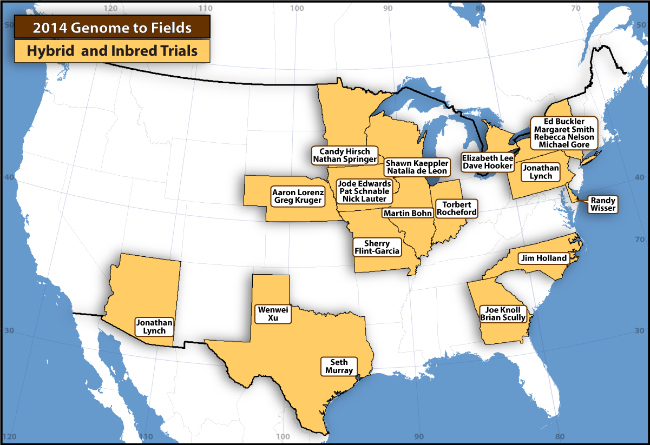
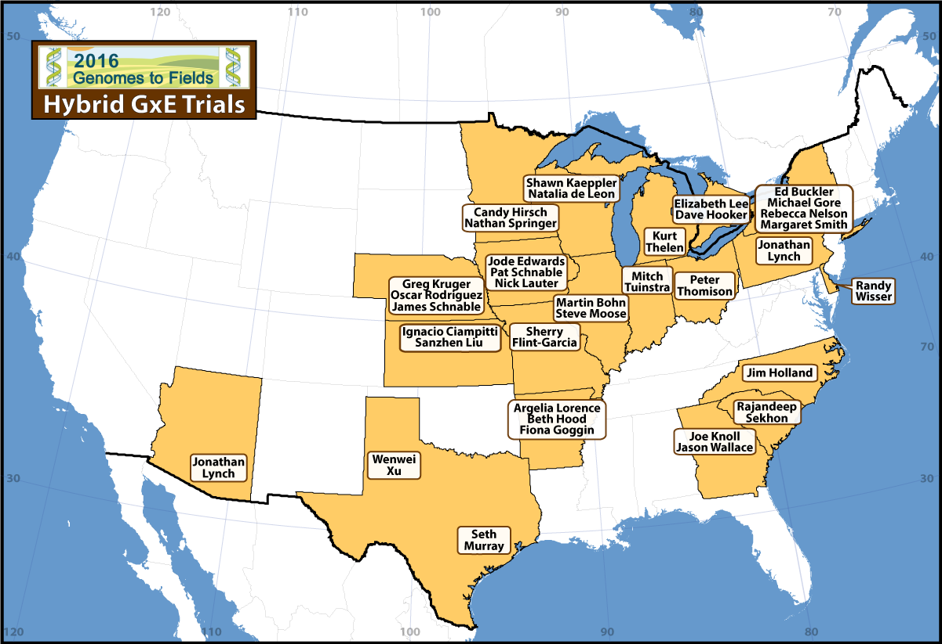
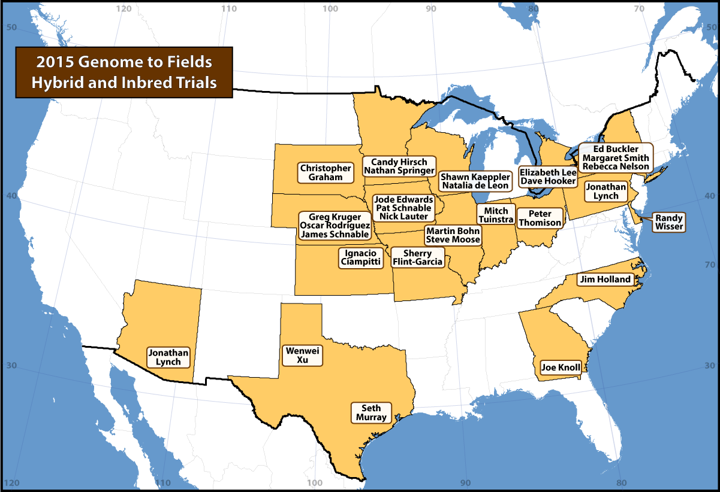
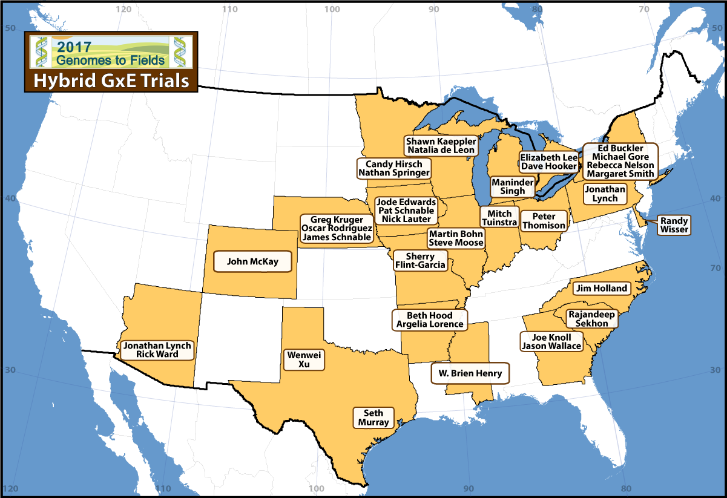
G2F G X E Project
2014
2016
2015
2017

Slide 10
Predicting Genotypes vs Predicting Environments:
Unknown Genotypes in Known Environments
Known Genotypes in Unknown Environments
CV0

Slide 11
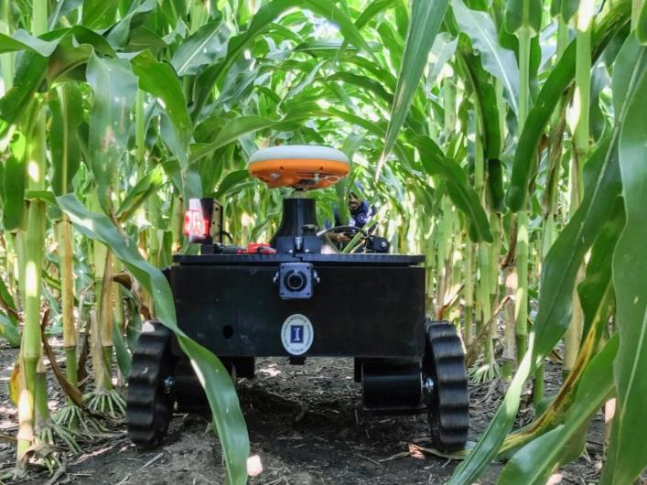
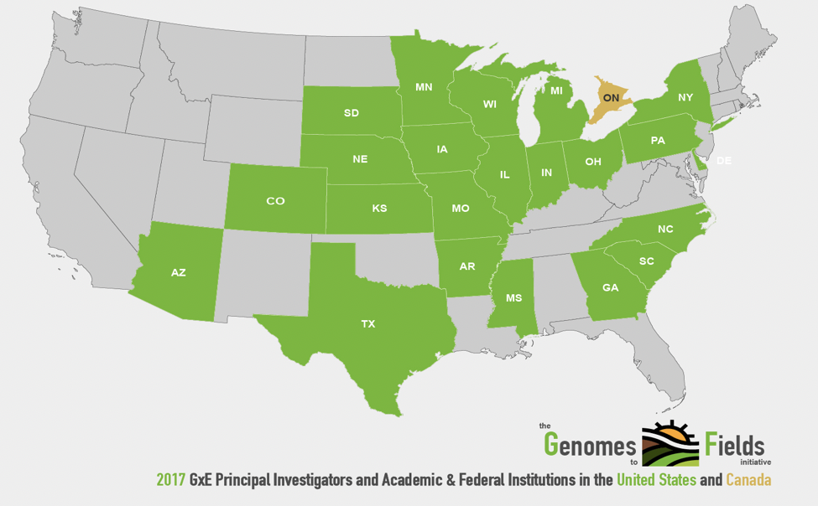
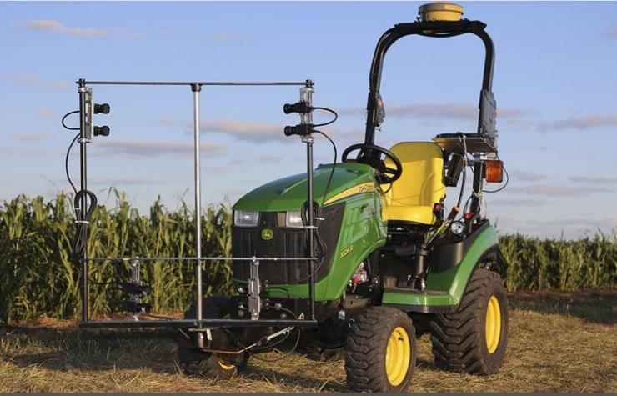
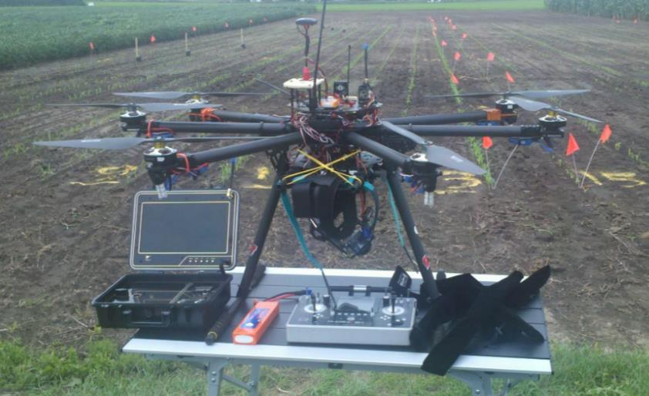
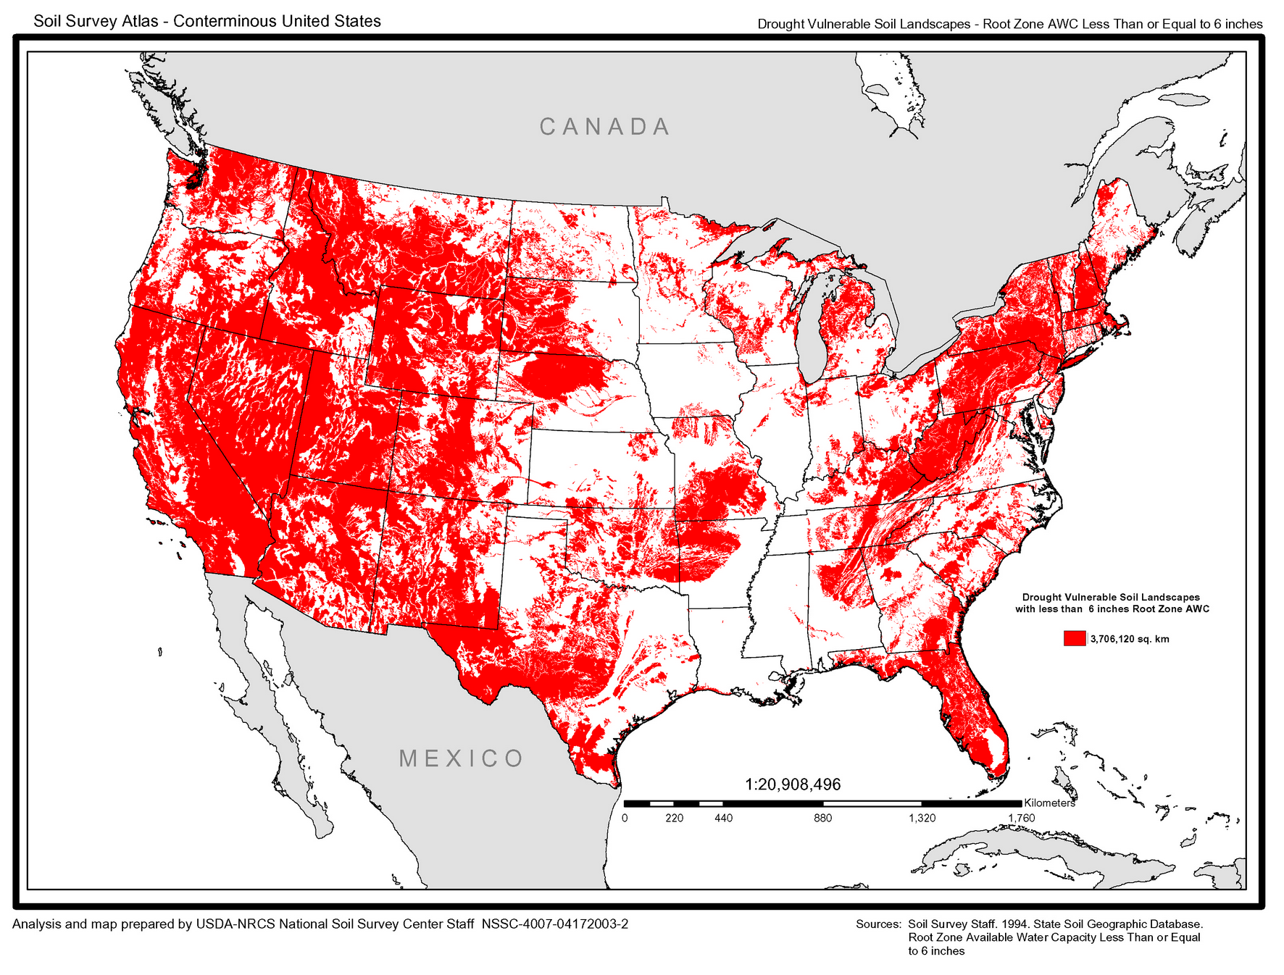
Dissection of Environments:
Important features: water, light, temperature and nutrients
TerraSentia
Schnable, Tang, ISU
Controlled environments
Spalding, U Wisc

Slide 12
Final Remarks:
Public sector is benefiting from infrastructures such G2F that allow the development, deployment and testing of new technologies that enhance genetic evaluation
Advances in technologies allow increased level of granularity that further our understanding of context and interactions
Big challenge is to appropriately evaluate their utility for genetic dissection and incorporation into genotype to phenotype models – data vs information
Standards become important and resources for data management are developing
Development of appropriate computing infrastructure is key
Unique mission of public sector is the training of future plant scientist in a relevant context

