Slide 1
Phenome2019 - G2F Workshop
Tucson, AZ
February 6th, 2019

Slide 2
WELCOME!
Participants:
  62 national
  18 international
  63 public sector
  17 private sector
Logistics:
  Agenda
  Lunch
  Discussion: Image Analysis Tools and Needs

Slide 3

ACKNOWLEDGMENTS:
Naser Alkhalifah – University of Wisconsin
Sally Muller – University of Wisconsin
Teresa Myers – ASPB Meetings Coordinator
All G2F Cooperators and Collaborators
All Presenters and Participants
G2F Executive Committee:
  Ed Buckler – ARS & Cornell University
  Natalia de Leon – University of Wisconsin
  David Ertl – Iowa Corn Promotion Board
  Shawn Kaeppler – University of Wisconsin
  Jonathan Lynch – Penn State University
  Pat Schnable – Iowa State University
  Nathan Springer – University of Minnesota

Slide 4
A publicly initiated and led research initiative to catalyze and coordinate research linking genomics and predictive phenomics
Consequence of the mobilization of a community to accomplish the goals of moving crop improvement to the next level
Long term goal: to develop knowledge, tools and technologies that sustainably improve plant productivity
In the short to medium term, our deliverable is generation and sharing of data (and follow up analysis) that help develop that knowledge, tools and technologies

Slide 5
Opportunities:
G2F has focused on developing a flexible and distributed infrastructure that can adjust to address emerging problems
Importance of sharing unique resources and data
Develop standards and data accessibility tools
Work at a scale that instigates interest from interdisciplinary collaborators way beyond the plant sciences
Develop a framework for effective interdisciplinary training

Slide 6

Genomes To Fields Sponsors

Slide 7
The Genomes to Fields (G2F): GxE Project Description
Naser AlKhalifah
University of Madison – WI
Wednesday, February 6th, 2019

Slide 8
Overview
The G2F: GxE Project
  Overview
  Scale and Scope
  Data Types Collected
Data Release Timeline and Access
Database Development and Additional Projects
  MSI & IAA
  Additional projects
Questions

Slide 9
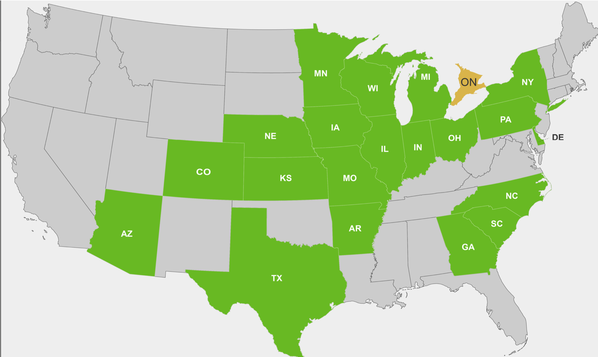
The G2F – GxE Project
Project within the Genomes to Fields (G2F) umbrella
A research network of more than 30 principal investigators
Involving 20 universities and research institutions.
Objective – Understanding the functions of plant genes and specific alleles across environments.

Slide 10
Scale and Scope
2014 – Present:
The GxE Project has evaluated more than 180,000 field plots.
Trials where conducted across 162 unique environments in the United States and Canada.
879 unique corn hybrids where tested to date.
 | 2014 | 2015 | 2016 | 2017 | 2018
No. of Experiments | 23 | 28 | 40 | 43 | 40
No. of Unique Locations | 19 | 24 | 34 | 38 | 31
No. of States/Provinces | 13 | 16 | 19 | 23 | 22
No. of Principle Investigators | 19 | 25 | 29 | 32 | 28
No. of Plots | 12,678 | 13,650 | 19,360 | 21,186 | 27,298
No. of Unique Inbreds | 380 | 553 | 313 | 295 | 295

Slide 11
GxE Project: Data Types Collected
Metadata
Hybrid Agronomic & Performance Traits
Weather Data/Characteristics
Genotyping by Sequence (GBS)
Soil Sampling

Slide 12
Field/Plot Metadata
Experiment Information:
Field, Farm, & City Names
Soil Taxonomic ID
Weather Station Information:
Serial Number
GPS Coordinates
Date Place in Field
Date Removed from Field
Plot layout and Planter Information:
Field GPS Coordinates
Previous Crop
Date Planted and Harvested
Plot length, alley length, row spacing
Number of Kernels per plot
Type of planter
Agronomic Information:
Application or treatment applied
Product or nutrient type
Date of Application

Slide 13
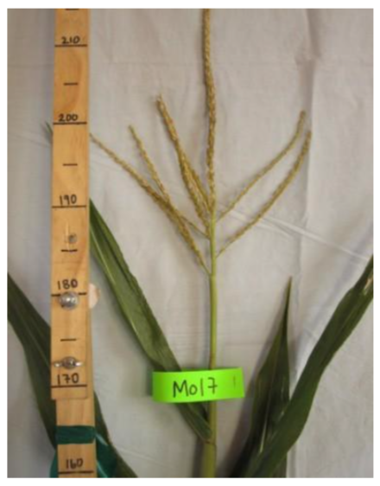
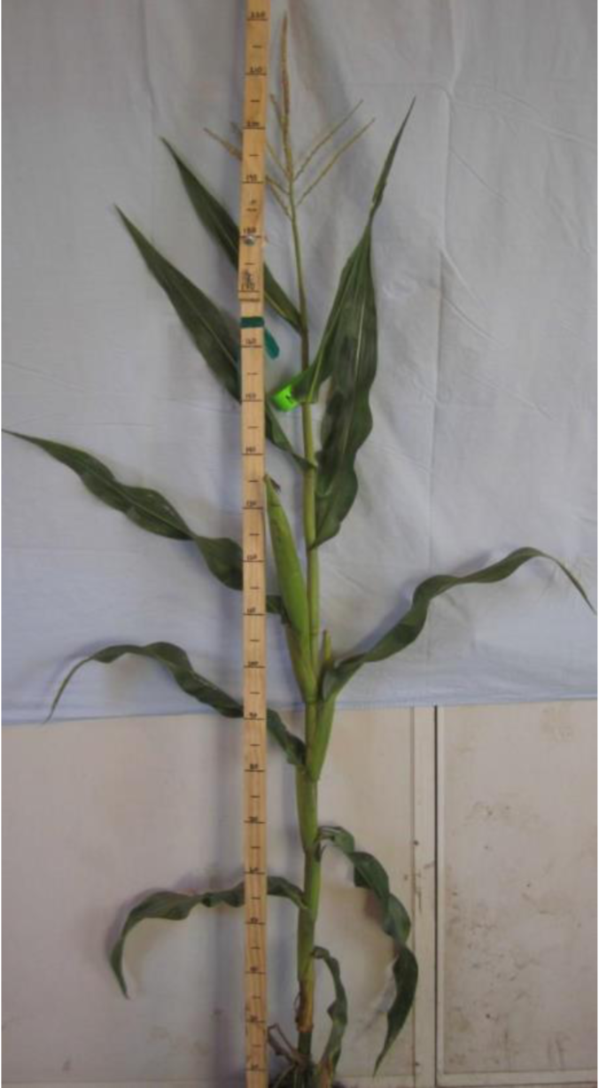
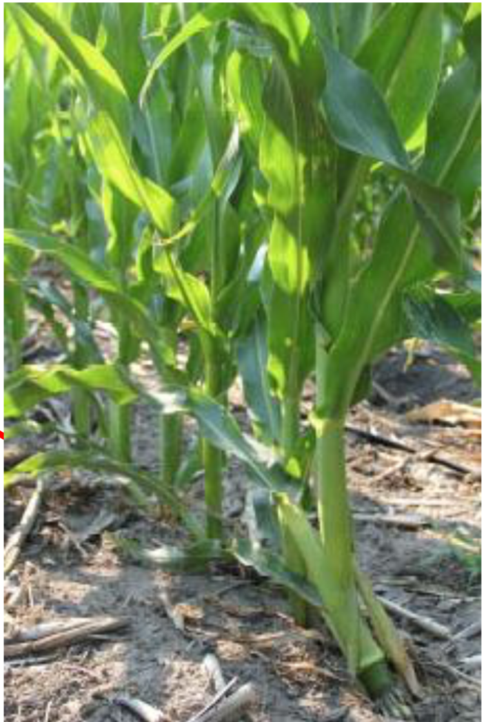
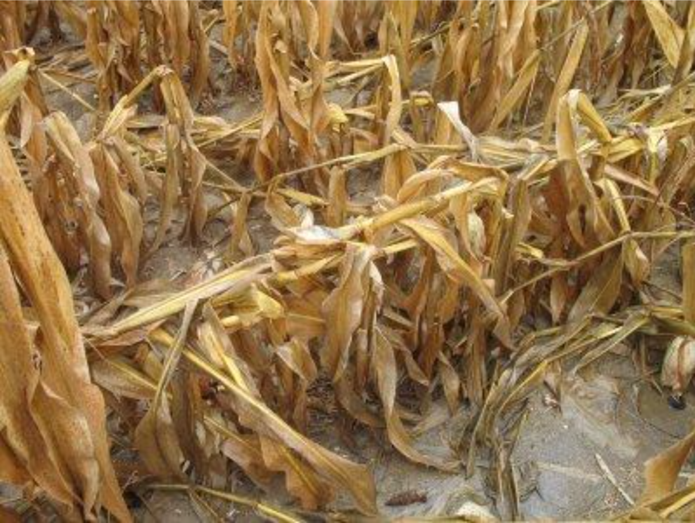
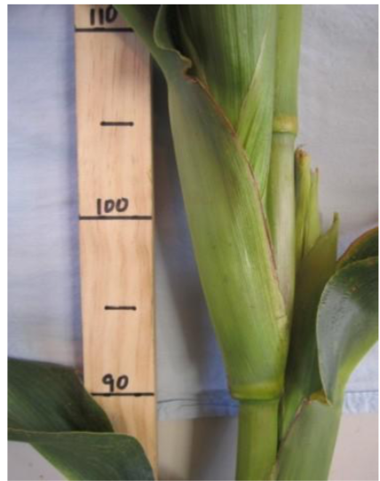
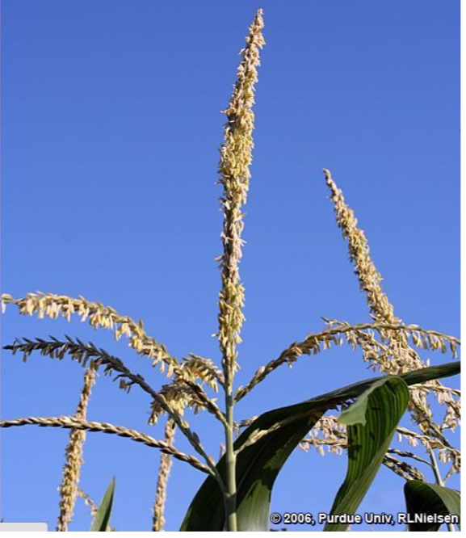
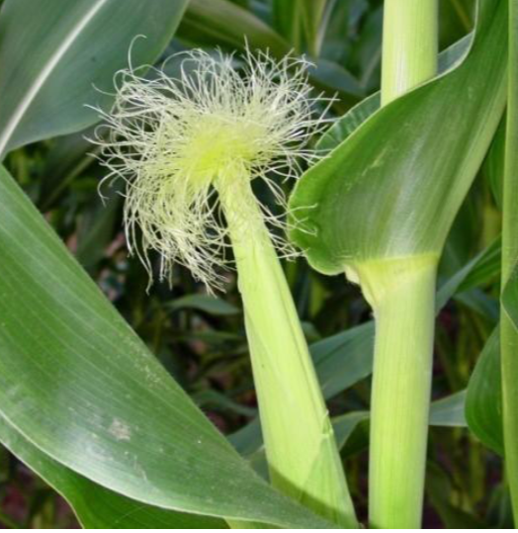
Hybrid Agronomic and Performance Traits
Yield Component Traits:
Grain Yield
Plot Weight
Test Weight
Grain Moisture
Plant and Ear Height
Root and Stalk Lodging
Anthesis and Silking

Slide 14
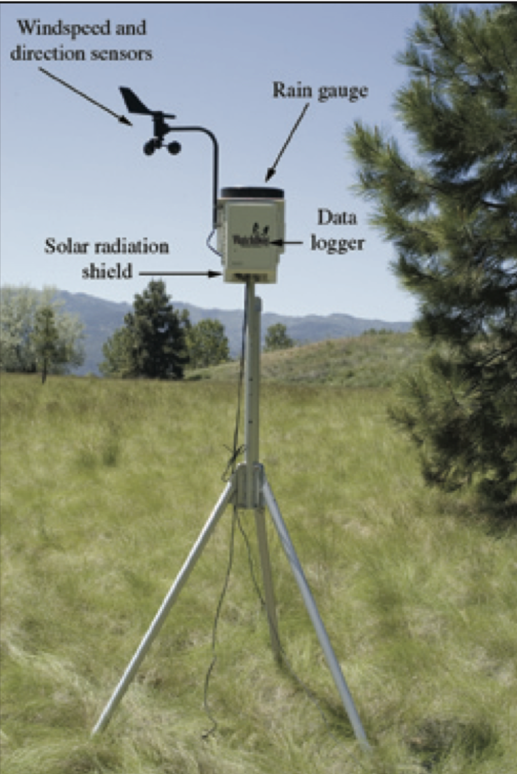
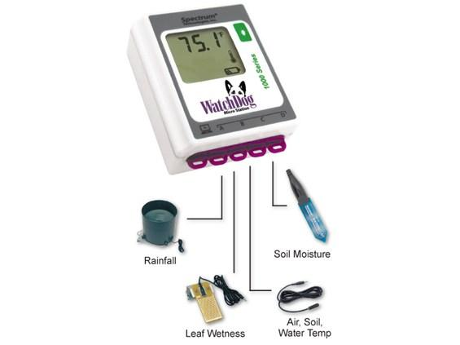
Weather Data
Main Weather Station
Wind Speed and Direction
Precipitation/Rainfall
Solar Radiation
Soil Moisture and Temperature
MicroStation

Slide 15
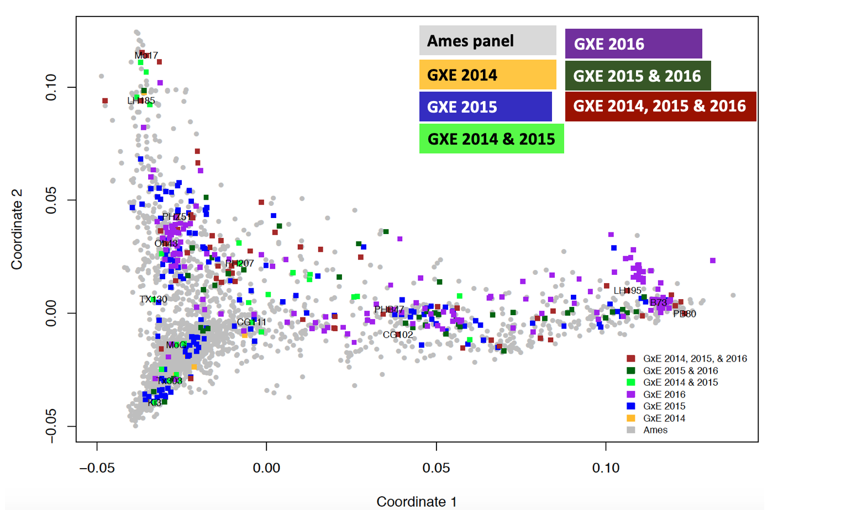
Genotyping by Sequence (GBS)
Genotyping by Sequence (GBS)
1,000 diverse inbred lines
Representing a substantial proportion of variability present in the USA national maize inbred seed bank.

Slide 16
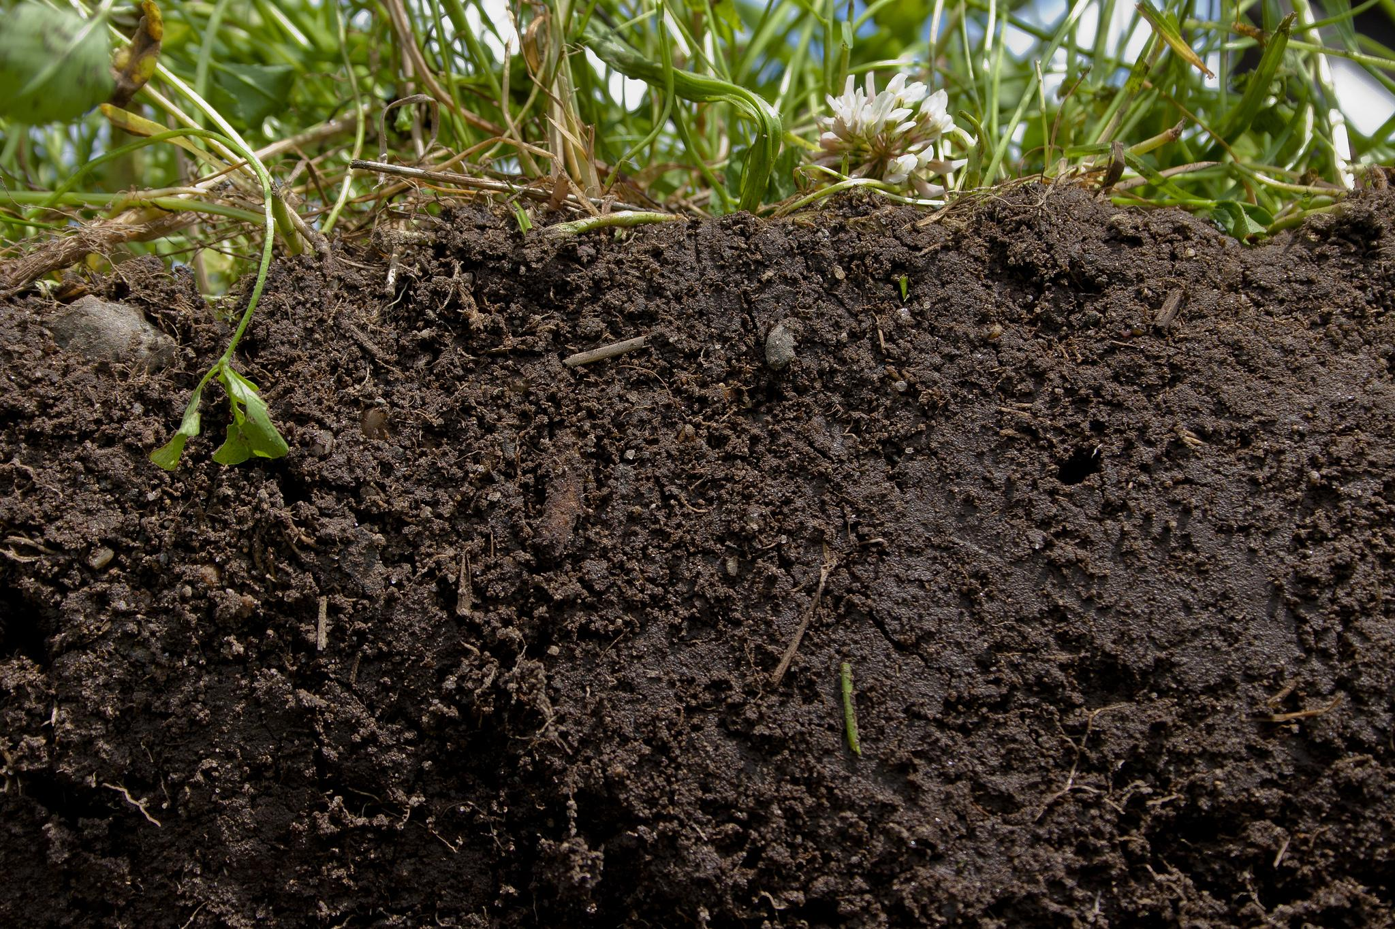
Soil Data
Soil Data
Soil Texture
Soil Composition: %Sand, Silt, and Clay
Soil PH
N, K, Zn, Fe, Mn, Cu, Ca, Na levels

Slide 17
Data Release Timeline and Access

Slide 18
Data Release Timeline
Field Season | Release To Collaborators | Release to Public
N | February of N+1 | March of N+2
2014 | Not Available | https://doi.org/10.7946/P2V888
2015 | February 2017 | https://doi.org/10.7946/P24S31
2016 | February 2017 | https://doi.org/10.7946/P3MW27
2017 | February of 2018 | March of 2019
2018 | February of 2019 | March of 2020

Slide 19
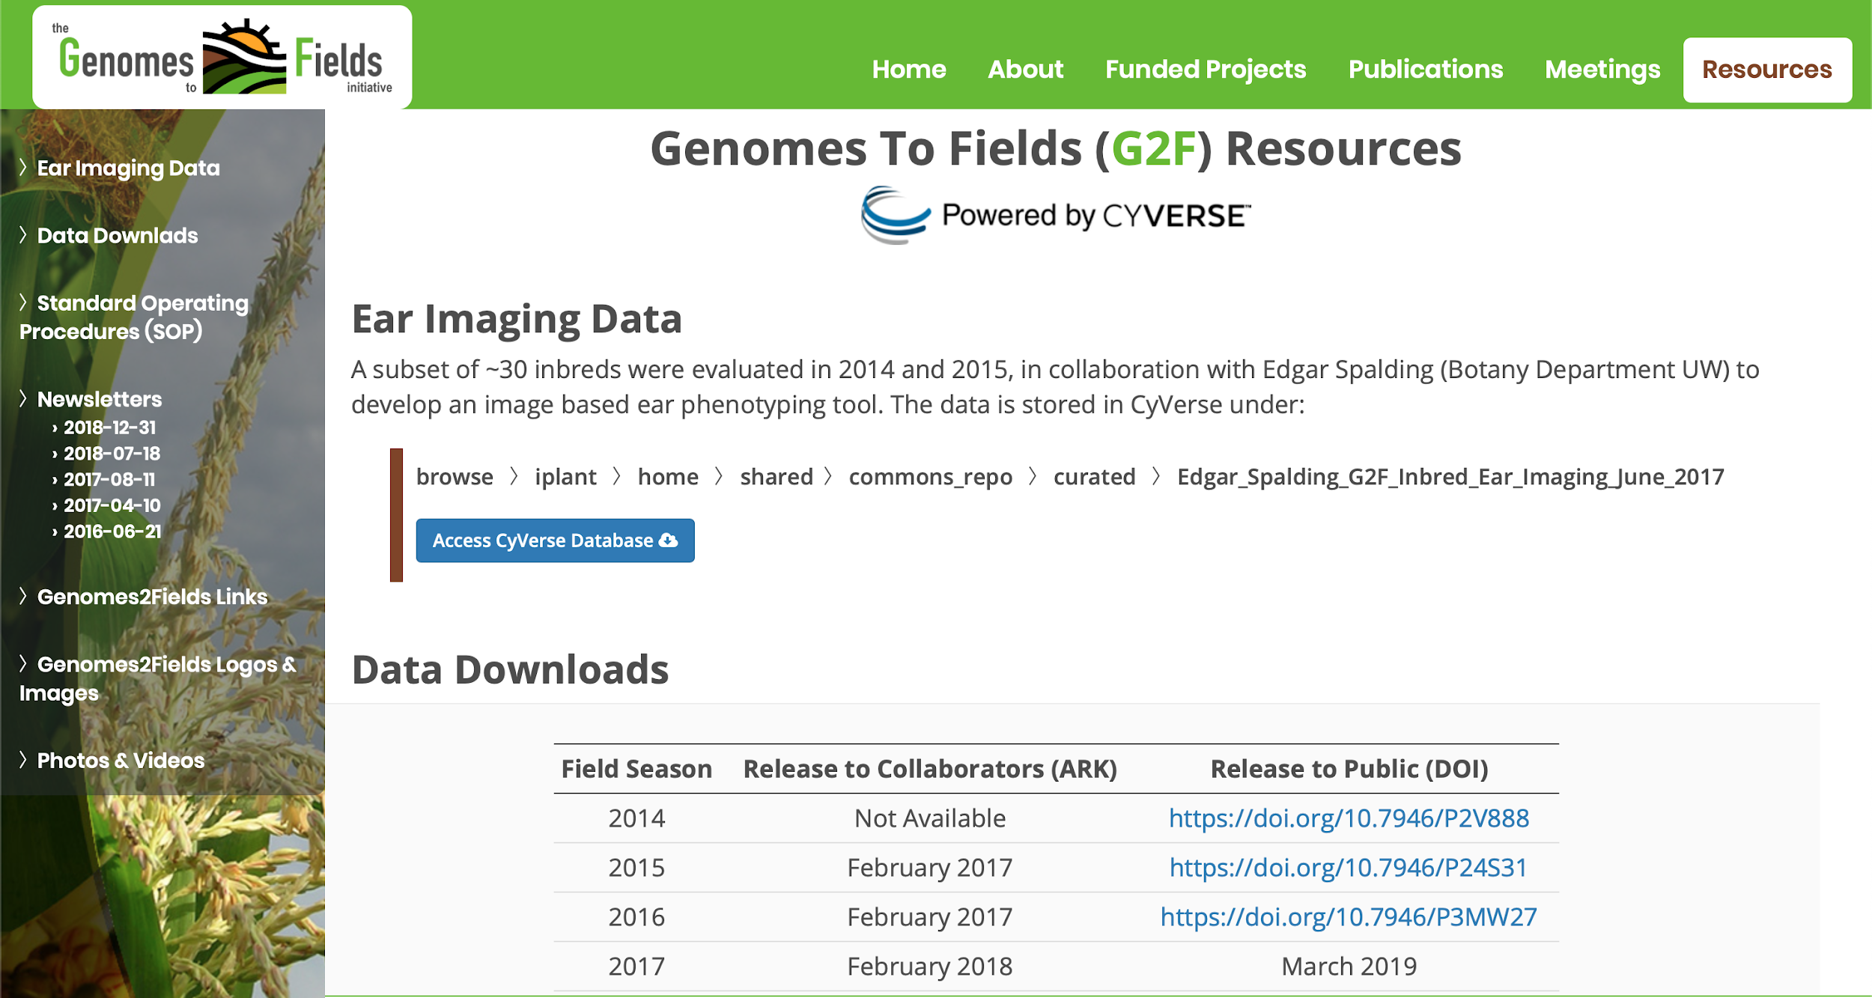
Data Access

Slide 20
Database and Related Resources

Slide 21


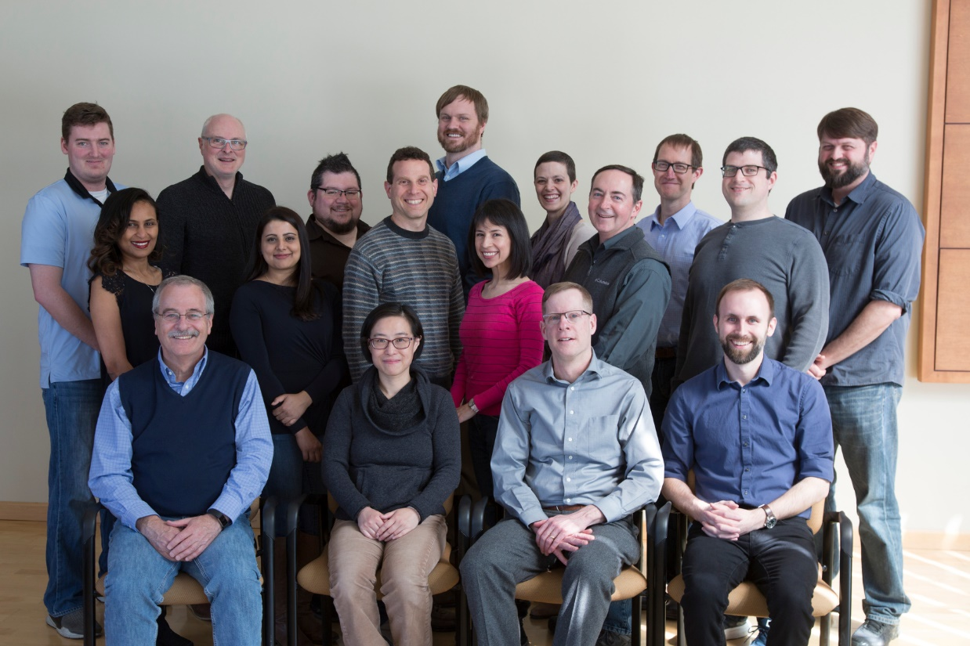
Database Infrastructure:
The Minnesota Supercomputing Institute (MSI) : University of Minnesota
The International AgroInformatics Alliance (IAA):
  A consortium of public and private entities worldwide.
  Driven to improve agricultural productivity & sustainability by minimizing obstacles to combining and analyzing diverse agricultural data sets.
GEMS Platform:
Agroinformatics data discovery and analysis platform.
G
E
M
S
Genomics
Environment
Management
Socio-Economics
Time
Space
Washington.edu

Slide 22
ADDITIONAL PROJECTS
Anthony Filippi and Seth Murrary –Machine Learning
Kelly Robbins and Michael Gore - UAV
Edgar Spalding – UAV
Jessica Bubert and Stephen Moose –Nitrogen Study
Lie Tang – Trait Characterization Study
Jianming Yu –Predictive analytics
Diego Jarquin –Predictive analytics (weather)
Addie Thompson –Modeling and Prediction (weather)
Jonathan Lynch – ARPAe Roots
Pat Schnable – ARPAe Project

Slide 23











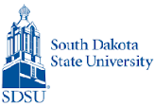







G X E Cooperators
Principal Investigators who grew GxE trials in 2014-2016
Martin Bohn (UIUC)
Ed Buckler (ARS)
Ignacio Ciampitti (KSU)
Jode Edwards (ARS)
Sherry Flint-Garcia (ARS)
Christopher Graham (SDSU)
Candy Hirsch (UMN)
Jim Holland (ARS)
Elizabeth Hood (A-State)
David Hooker (Guelph)
Fiona Goggin (A-State)
Shawn Kaeppler (UW)
Joe Knoll (ARS)
Judith Kolkman (Cornell)
Greg Kruger (UNL)
Nick Lauter (ARS)
Liz Lee (Guelph)
Natalia de Leon (UW)
Argelia Lorence (A-State)
Aaron Lorenz (UMN)
Jonathan Lynch (PSU)
Steve Moose (UIUC)
Seth Murray (TAMU)
Rebecca Nelson (Cornell)
Torbert Rocheford (Purdue)
Oscar Rodriguez (UNL)
Cinta Romay (Cornell)
James Schnable (ISU)
Brian Scully (ARS)
Rajandeep Sekhon (Clemson)
Margaret Smith (Cornell)
Nathan Springer (UMN)
Kurt Thelen (MSU)
Peter Thomison (OSU)
Mitch Tuinstra (Purdue)
Jason Wallace (UGA)
Randy Wisser (UDel)
Wenwei Xu (TAMU)

Slide 24
Genomes To Fields Collaborators
Project planning, data management, phenotyping initiatives, and Executive Committee members
Martin Bohn (UIUC)*
Ed Buckler (ARS)
Darwin Campbell (ISU)*
James Clohessy (Cornell)
Michael Coen (UW)
Carolyn Lawrence Dill (ISU)*
Liang Dong (ISU)
Jode Edwards (ARS)*
David Ertl (IA Corn)*
Sherry Flint-Garcia (ARS)*
Joseph Gage (UW)
Jack Gardiner (ISU)*
Byron Good (Guelph)
Mike Gore (Cornell)
Patricio Grassini (UNL)
Jerry Hatfield (ARS)
Diego Jarquin (UNL)*
Shawn Kaeppler (UW)
Liz Lee (Guelph)*
Natalia de Leon (UW)*†
Zhizhai Liu (TAMU)
Aaron Lorenz (UMN)*
Jonathan Lynch (PSU)
Nathan Miller (UW)
Jane Petzoldt (UW)*
Seth Murray (TAMU)*
Cinta Romay (Cornell)*
James Schnable (UNL)
Pat Schnable (ISU)†
Kevin Silverstein (UMN)
Nathan Springer (UMN)
Edgar Spalding (UW)
Srikant Srinivasan (ISU)*
Yiwei Sun (ISU)*
Kelly Thorp (ARS)
Rod Williamson (IA Corn)
Randy Wisser (UDel)*
Jianming Yu (ISU)
*GxE Coordinating Groups
†G2F co-lead
G2F Executive Committee members

Slide 25
Genomes To Fields Sponsors

Slide 26
Questions?

