Slide 1

&
Progress Toward Real-Time Data Submission and
Analysis for our Breeding Community
Kevin Silverstein, PhD, Operations Manager
GEMS led by: Philip Pardey, Jim Wilgenbusch and Kevin Silverstein
College of Food Agricultural and Natural Resource Science, CFANS
Minnesota Supercomputing Institute, MSI
University of Minnesota
Phenome Meeting
February 6, 2019

Slide 2
What is G.E.M.S?
A novel data sharing and big data analytical platform that enables public-private research collaborations for innovation in food and agricultural production, and other domain areas
G
E
M
S
Genomics
Environment
Management
Socio-Economics
Time
Space
Notes:
A novel data sharing and analysis platform which enables public-private research collaborations for innovation in agricultural production and other domain areas across Genomic, Environment, Management and Socio-economic subject matter disciplines
Platform also explicitly accommodates data that spans time and space, thus linking high throughput experimental data with remote sensed satellite generated data
‹#›

Slide 3
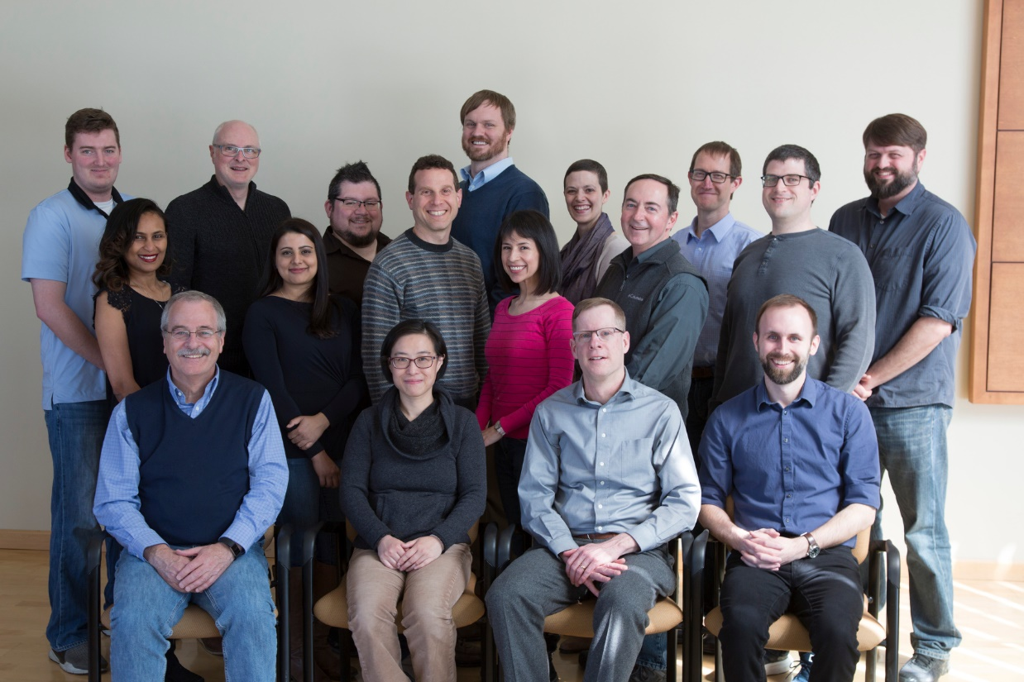
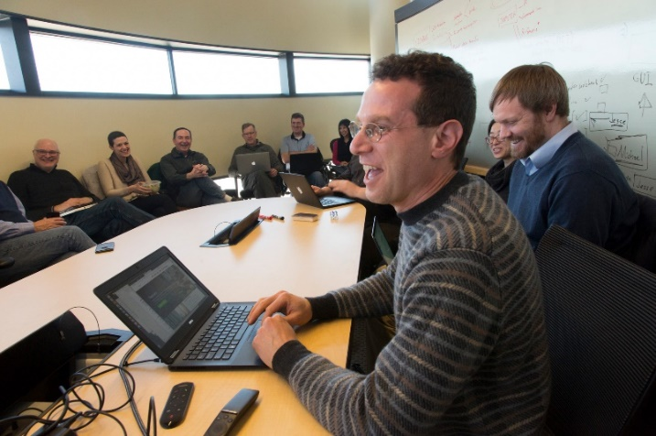

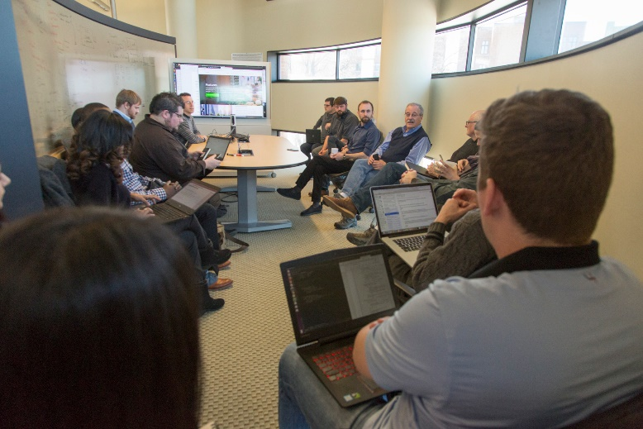
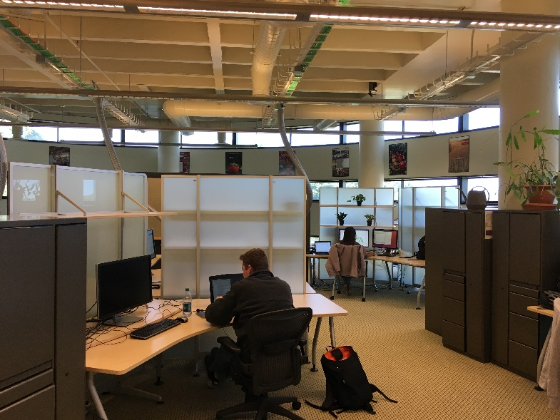
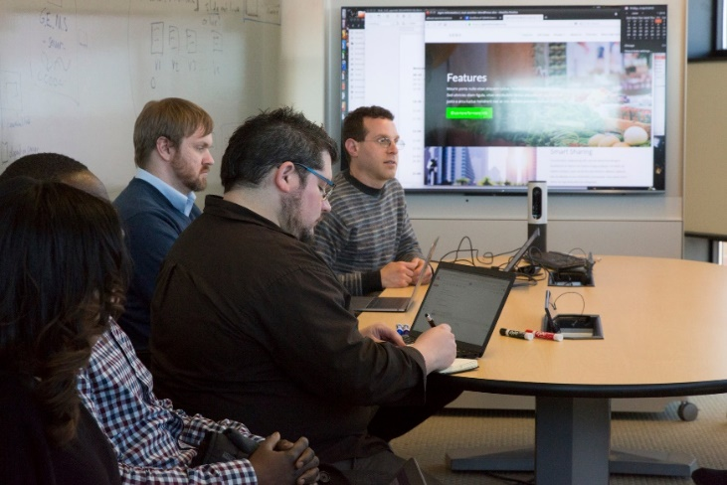
The G.E.M.S Team (more than 20 brains strong!)
Bi-Weekly build meetings
Weekly technical meetings
Numerous ad hoc consultations in the Cargill Branary & MSI

Slide 4


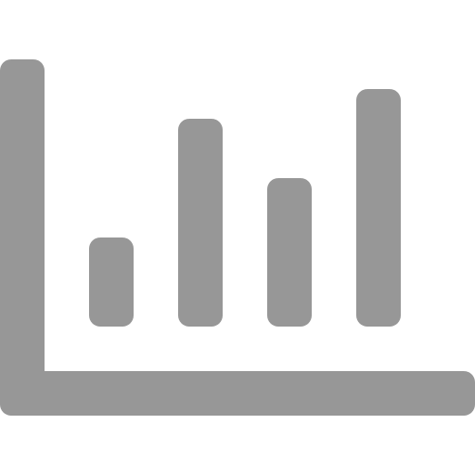

Realizing the Big Data Revolution
Get the data to the tool or get the tool to the data
Reconcile file formats, units, vocabularies, languages, and ontologies
Access to complex software and ability to replicate analyses
Facilitate complex partnerships and respecting data ownership and privacy
Data
Transfer
Data Interoperability
Data
Analysis
Data
Sharing
Notes:
The GEMS team took a different design tack
We set about designing a platform that could overcome Obstacles related to dealing with BIG DATA so that we can realize the benefits of the BIG DATA revolution.
‹#›

Slide 5
Accomplishments for 2018
Field trial data cleaning
Environmental data cleaning
Import of KDSmart phenotyping data
Prototyping data collection and analysis web dashboard

Slide 6

Field trial data cleaning
Supported G2F in cleaning multi-state maize field trial data (2016-DOI, 2017-ARK)
Developed new python modules for cleaning field trial data
Built automated methods to detect errors, missing data and outliers in hybrid phenotypic data
Generated Error Detection report, Summary Statistics report and Pedigree Summary report to detect outliers and provide data summary

Slide 7

Environmental data cleaning
Developed new python modules for cleaning environmental data
Performed cleaning of G2F environmental data (2016,2017)
Built Application Programming Interface (API) to automatically pull weather data from nearest weather station
Developed tools to perform conversion of units from imperial to metric system
Developed algorithms to flag errant observations based on guidelines from World Meteorological Organization (WMO)
Developed tool to detect local outliers

Slide 8
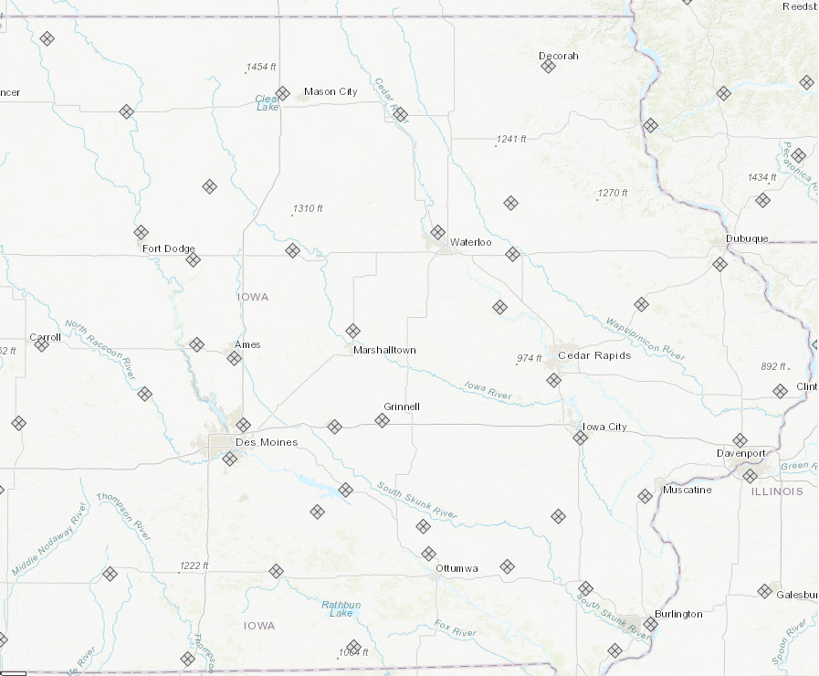
Environmental data cleaning
Developed new python modules for cleaning environmental data
Performed cleaning of G2F environmental data (2016,2017)
Built Application Programming Interface (API) to automatically pull weather data from nearest weather station
Developed tools to perform conversion of units from imperial to metric system
Developed algorithms to flag errant observations based on guidelines from World Meteorological Organization (WMO)
Developed tool to detect local outliers

Slide 9
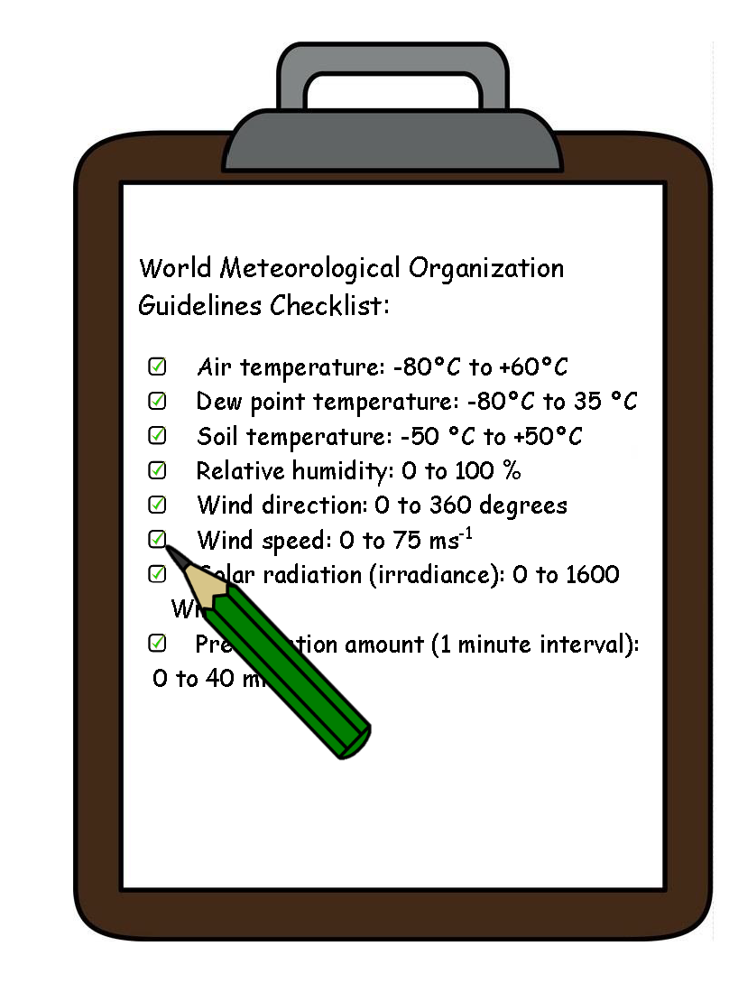
Environmental data cleaning
Developed new python modules for cleaning environmental data
Performed cleaning of G2F environmental data (2016,2017)
Built Application Programming Interface (API) to automatically pull weather data from nearest weather station
Developed tools to perform conversion of units from imperial to metric system
Developed algorithms to flag errant observations based on guidelines from World Meteorological Organization (WMO)
Developed tool to detect local outliers

Slide 10
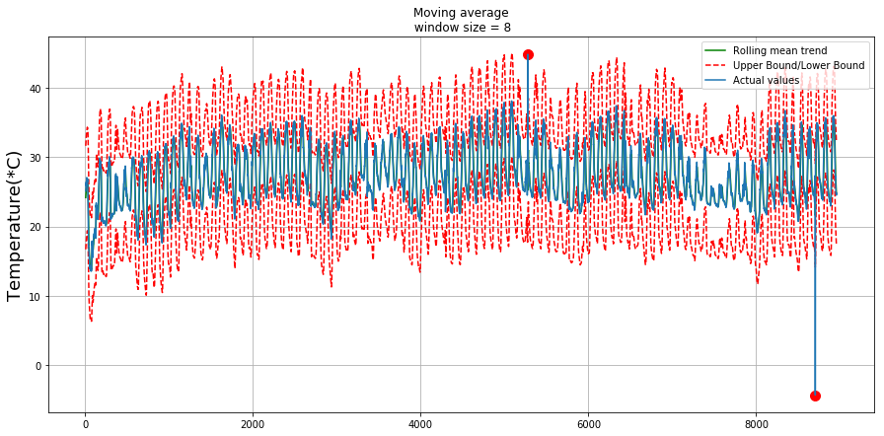
Environmental data cleaning
Developed new python modules for cleaning environmental data
Performed cleaning of G2F environmental data (2016,2017)
Built Application Programming Interface (API) to automatically pull weather data from nearest weather station
Developed tools to perform conversion of units from imperial to metric system
Developed algorithms to flag errant observations based on guidelines from World Meteorological Organization (WMO)
Developed tool to detect local outliers

Slide 11
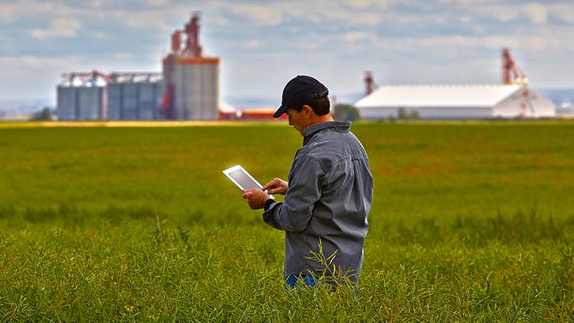
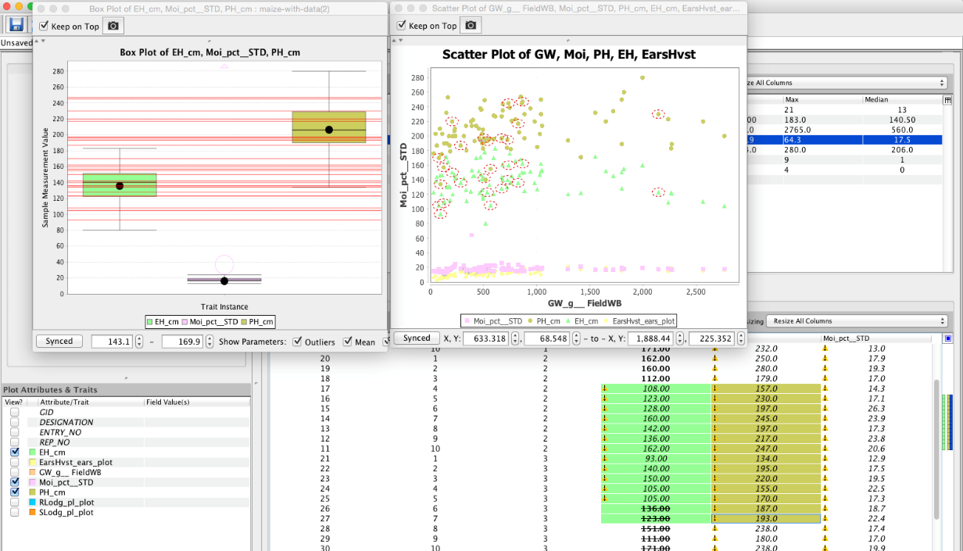
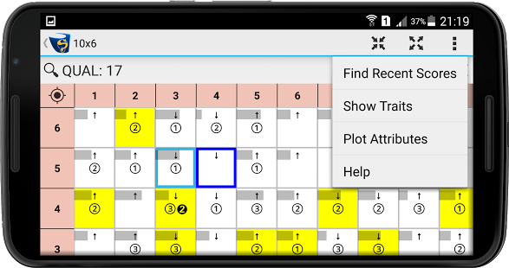
Import of KDSmart phenotyping data
KDSmart Software
KDXplore Software
KDSmart is a software from the Canberra, Australia Company DArT
Allows recording of phenotypic observations using handheld devices (android phones or tablets)
Building a system to automate the import of G2F KDSmart phenotyping data into the GEMS platform (in-progress).

Slide 12
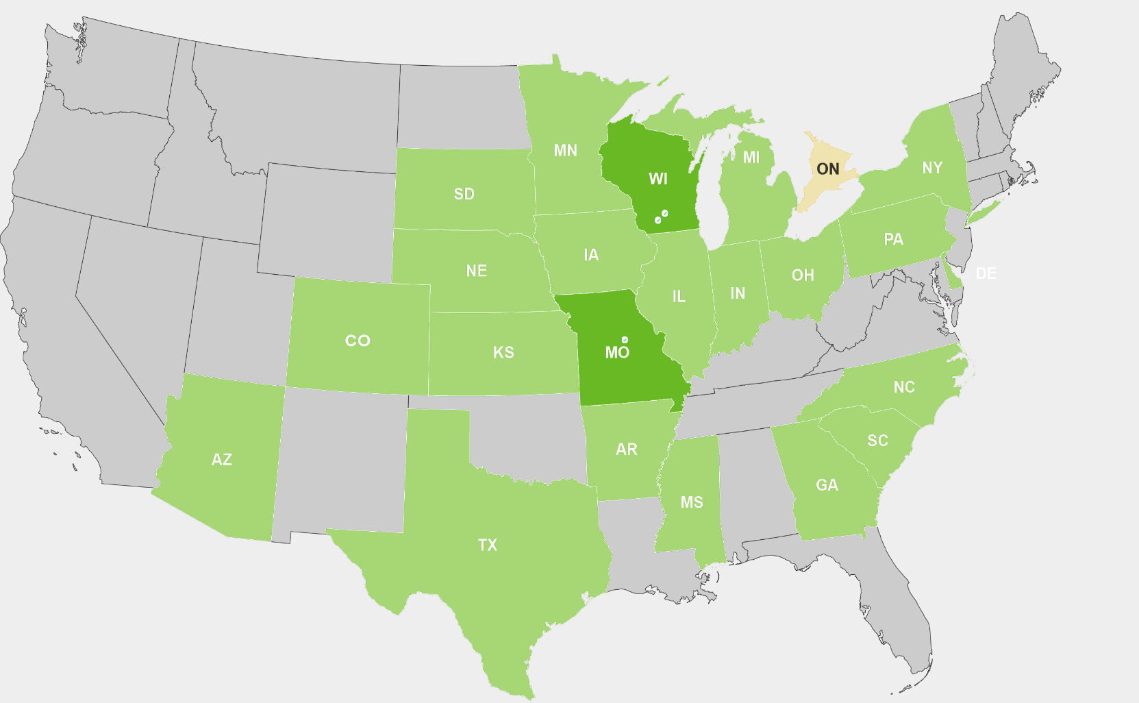
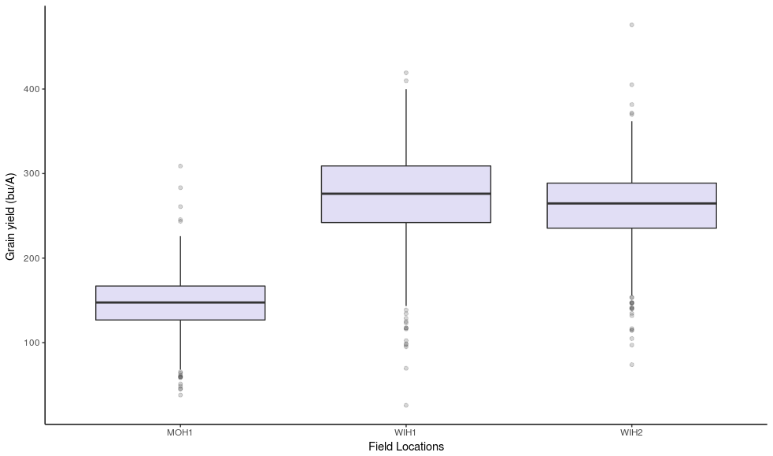
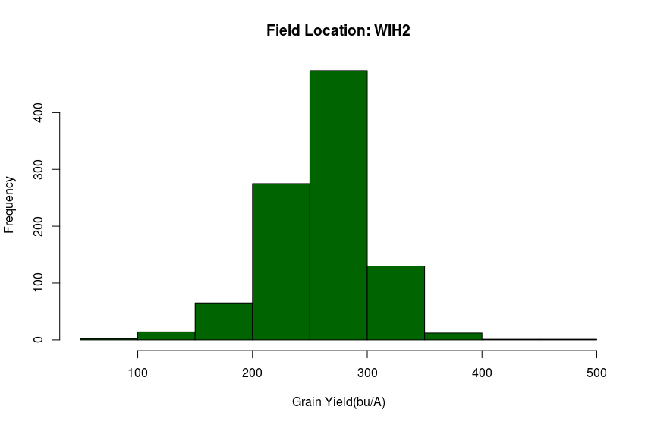
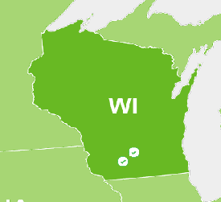
Data collection and analysis web dashboard
Grain Yield across Field Locations
State: Wisconsin
Field Location: WIH2
City: Arlington
Histogram of Grain Yield
Field Location: WIH2
Designing a prototype of a web Dashboard for G2F on the G.E.M.S platform
Provide high level view of multi-state maize trial field data
Prototype will include basic query capabilities and visualization of the data

Slide 13
Proposed activities (2019)
Data Cleaning / Systematizing
Clean 2018 G2F data plus systematize and clean 2014 & 2015 data (Q1-Q2)
Easy-access weather data API for use in R, Python (Q3-Q4)
Real-time data uploads/cleaning for collaborators (Q3-Q4)
APIs to external programs
Support BrAPI and additional G.E.M.S. API components to share with MaizeGDB, CyVerse, GOBii, EIB, KDSmart (Q3-Q4)
Customized Web Dashboard for G2F
Prototype will include basic query capabilities and visualization of the data (Q1-Q4)

Slide 14


Acknowledgments
G.E.M.S:
Christina Poudyal
Philip Pardey
UW Madison:
Naser AlKhalifah
Natalia DeLeon
Iowa Corn:
David Ertl
G2F Consortium Members

Slide 15
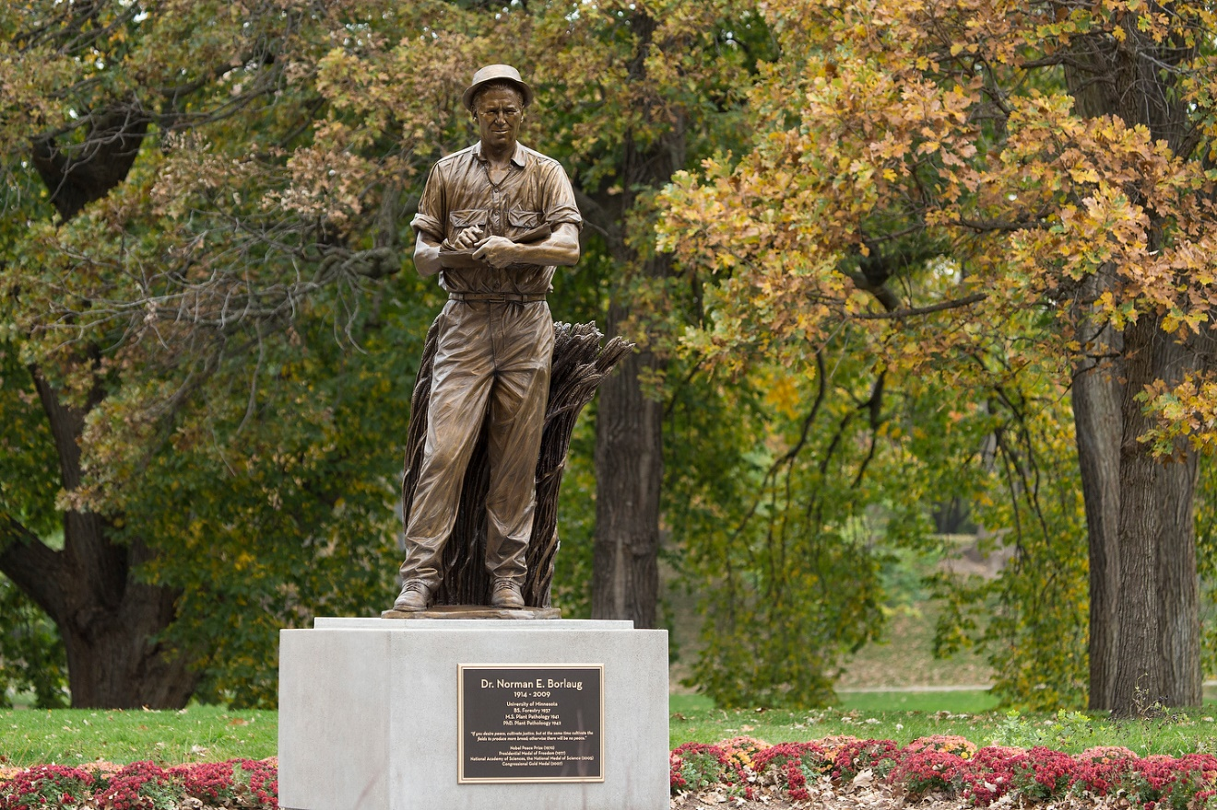
Thanks
G.E.M.S:
https://agroinformatics.org
G2F:
https://www.genomes2fields.org

