Slide 1
Genetic Variation for Maize Grain Yield in the North American Commercial Germplasm Pool
Jode Edwards, USDA ARS
Dustin Mclean, University of Guleph
Yunfei Jiang, University of Guelph
Elizabeth, Lee, University of Guelph
Mark Mikel, University of Illinois
Martin Bohn, University of Illinois

Slide 2
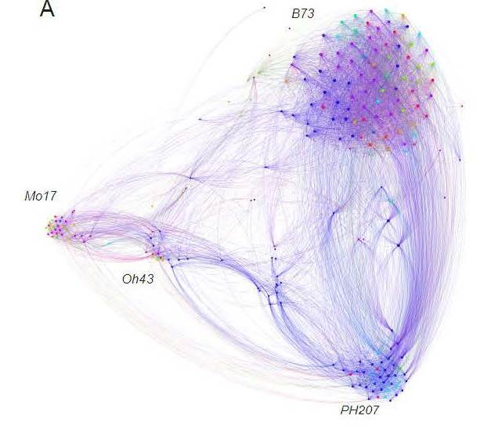
Modern U.S. Maize Germplasm
Romay et al., 2013
Romay et al., 2013

Slide 3
How Does Performance Relate to Genetics?
Much is known about Genetic changes in germplasm from marker data and from pedigree data (PVP pedigrees)
However, less information is available about performance
Specifically
  Does genetic narrowing of maize germplasm correspond directly to reduction in variation in performance?
  What are the best PVP line testers for G2F experiments

Slide 4
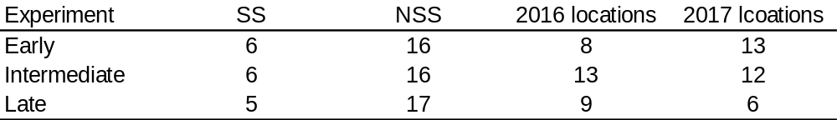
G2F Design II Experiment
SS = Stiff Stalk heterotic group (females), NSS = non-Stiff Stalk (males)
Analyzed with mixed linear model
SS, NSS, SS x NSS fit as random effects along with environmental interactions

Slide 5
Analysis of PVP Pedigrees
Assembled pedigree database of PVP registered lines (Mark Mikel, University of Illinois)
Lines subdivided into bins by decade
The percent genetic contribution by heterotic group and by decade computed from pedigrees for different sets of lines
  SS Heterotic group founders
  NSS Heterotic group founders
  G2F males (NSS)
Percent genetic contribution of a set of lines may not sum to 100 because of overlap of generations

Slide 6
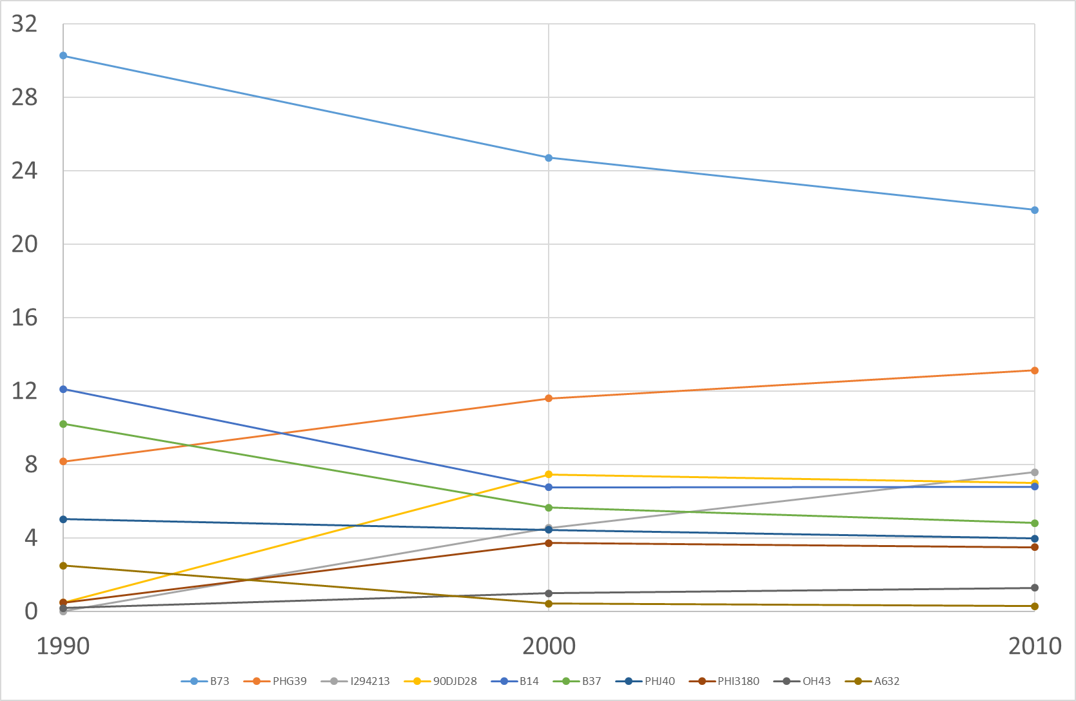
Genetic Contribution of SS Lines by Decade
Percentages do not sum to 100
B73
B37
B14
Percent Genetic Contribution
PHG39
I294213
90DJD28

Slide 7
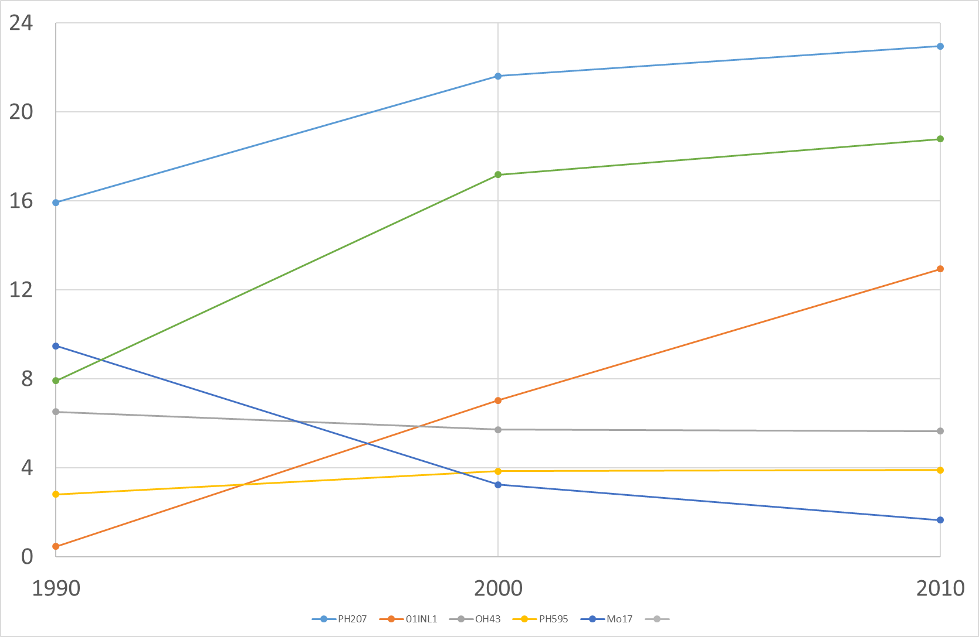
Genetic Contribution of NSS Lines by Decade
Percentages do not sum to 100
PH207
PHI3737
01INL1
Percent Genetic Contribution
Oh43
PH595
Mo17

Slide 8
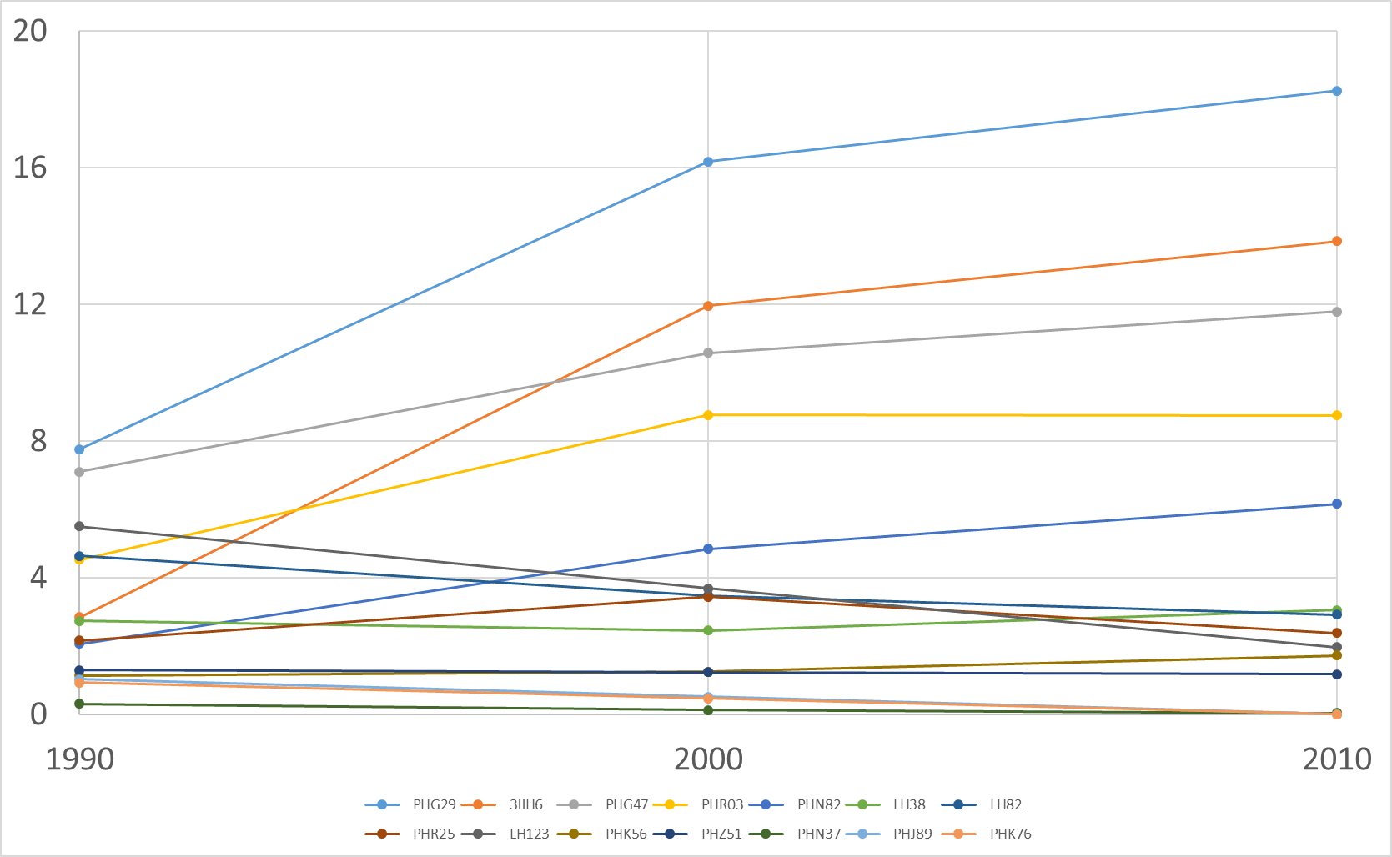
Genetic Contributions of NSS Lines by Decade
Percentages do not sum to 100
PHG29
LH123
3IIH6
PHG47
Percent Genetic Contribution
PHR03
PHN82
LH38
LH82

Slide 9
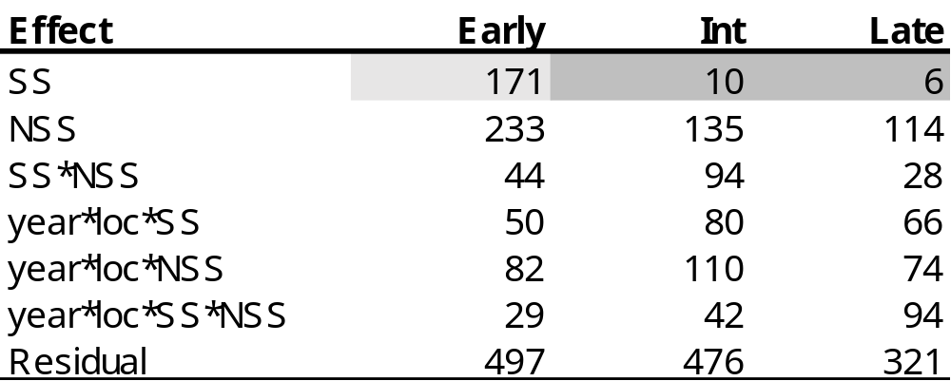
Variances for Grain Yield by Experiment

Slide 10
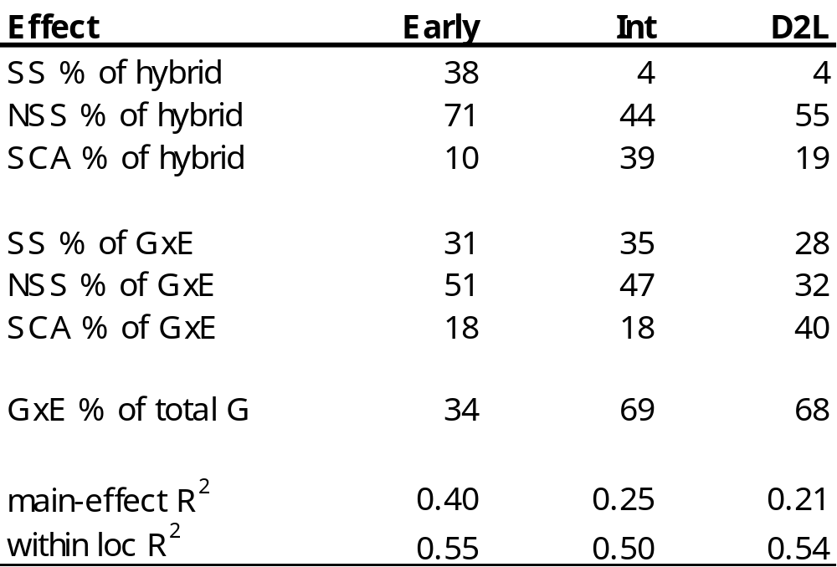
Variance Ratios by Experiment

Slide 11
Early SS GCA
-16.1
4.0
-11.6
17.7
-3.3
9.2

Slide 12
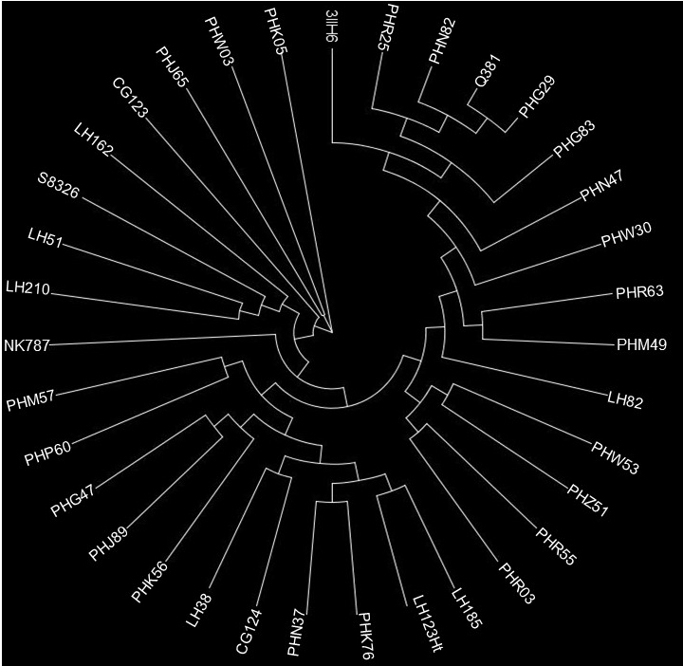
NSS Genetic Contributions 2010 - Present
13.9
2.4
6.2
18.2
2.9
11.8
1.2
0.0
1.7
8.8
3.1
0.0
0.0
2.0

Slide 13
NSS Early GCA Effects (bu/A)
LSD (<0 or >0) = 10
-0.6
-35.3
9.9
-11.9
21.5
-11.7
10.1
-19.5
3.8
-3.0
5.9
-3.2
10.7
14.1
16.7
-7.4

Slide 14
NSS Intermediate GCA Effects (bu/A)
LSD (<0 or >0) = 10
9.0
-10.5
-1.6
-28.2
1.2
12.6
-3.1
-4.2
-2.1
12.0
7.6
-0.9
13.7
-0.8
-10.9
6.2

Slide 15
NSS Late GCA Effects (bu/A)
LSD (<0 or >0) = 8
5.8
-3.0
-23.1
2.4
5.9
8.4
-8.9
13.6
-4.6
1.8
1.9
-14.1
-7.7
14.5
11.4
-4.7
0.3

Slide 16
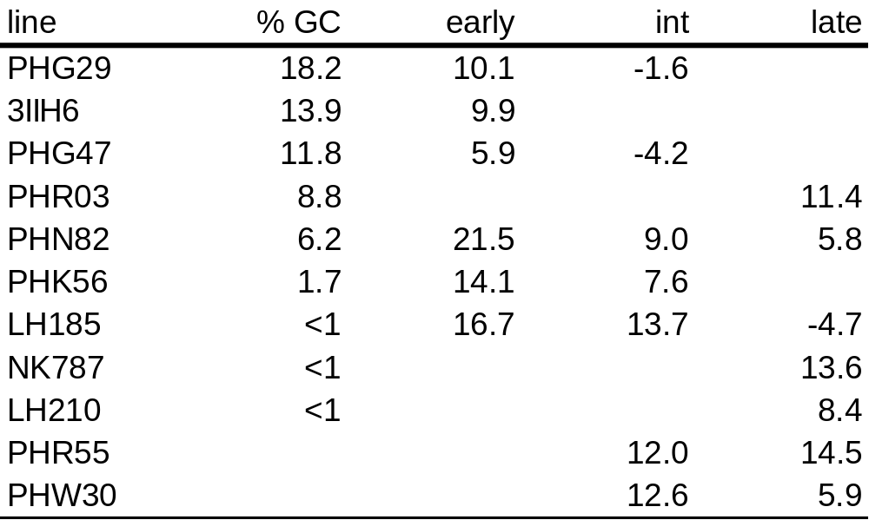
Best NSS testers

Slide 17
Conclusions
PVP Pedigrees support rapid narrowing of germplasm base in both SS and NSS germplasm
Phenotypic data suggested almost no variation in GCA in SS germplasm
  There is environmentally dependent variation in GCA
  More SCA in intermediate maturity than early and late
Subset of very closely related NSS materials still has high variation in GCA

