Slide 1




Environmental Data Generation, Collection, and Storage for Cross-Scale Phenotype Predictability in the G2F Initiative
Parisa Sarzaeim¹
Alessandro Amaranto¹
Gabriel Lopez-Morteo²
Diego Jarquin³
Francisco Munoz-Arriola,^{1,4}
¹ Department of Biological Systems Engineering, UNL
² Universidad Autonoma de Baja California
³ Department of Agronomy and Horticulture, UN
⁴ School of Natural Resources, UNL
2019 G2F Collaborator’s Meeting, Phenome 2019 Meeting

Slide 2

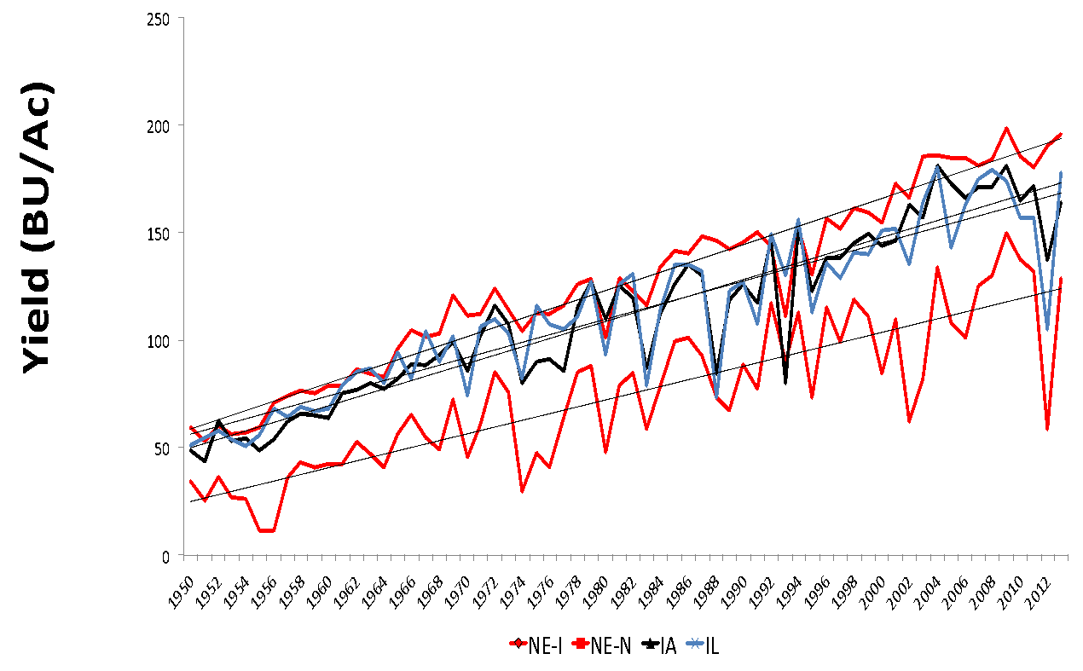
Introduction
Genotypes
Cost of megabase of DNA in 2001 $10,000, in 2012 < $0.1
$13 Billion in losses
Genetics
Water use efficiency
Increase of about 34% in irrigated maize from 1986 to 2009.
Increase of 32% in soybean
Environment
$20 Billion in losses
Y = G + E + M + S + (GxE)
USDA’s NASS

Slide 3
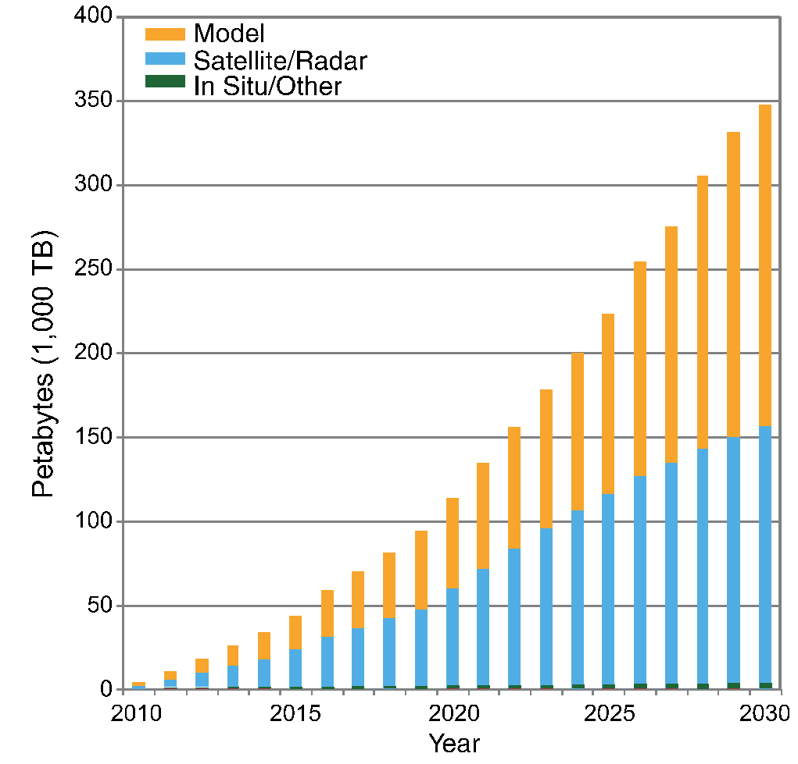
Data availability
Data analytics, and synthesis for water management
Data availability
Algorithm improvement
Computational power
Overpeck et al (2011)

Slide 4
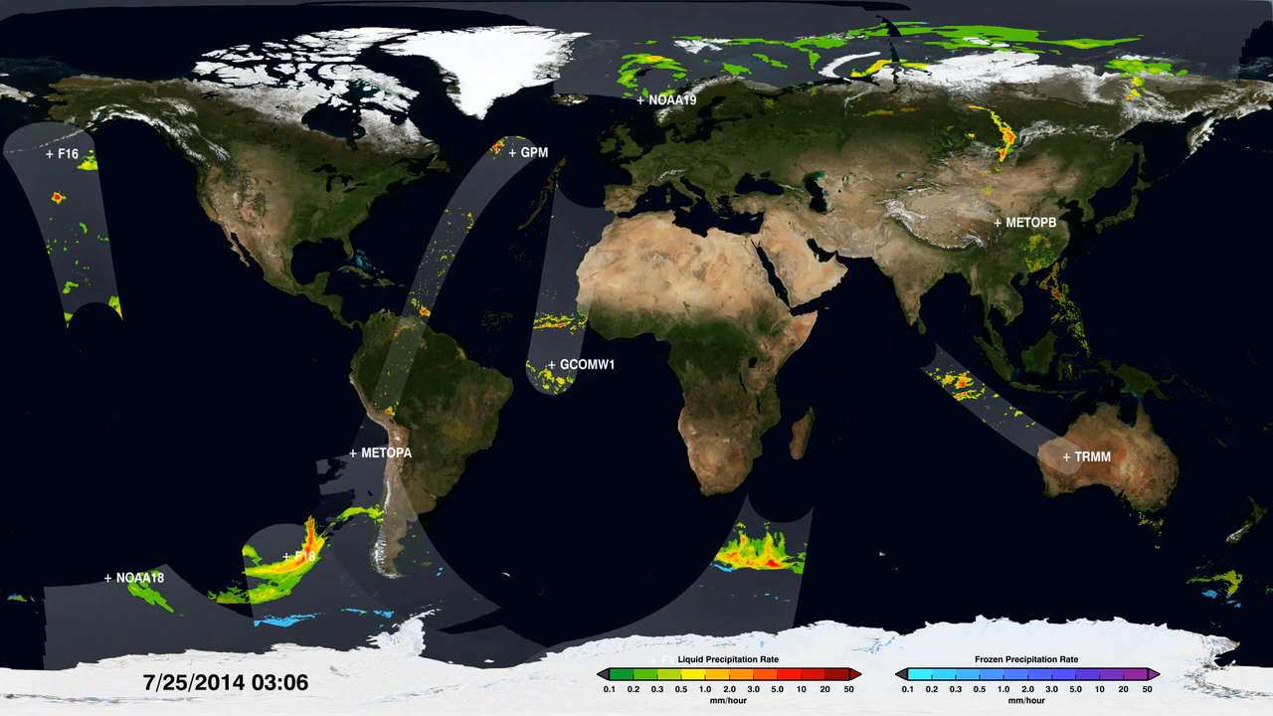
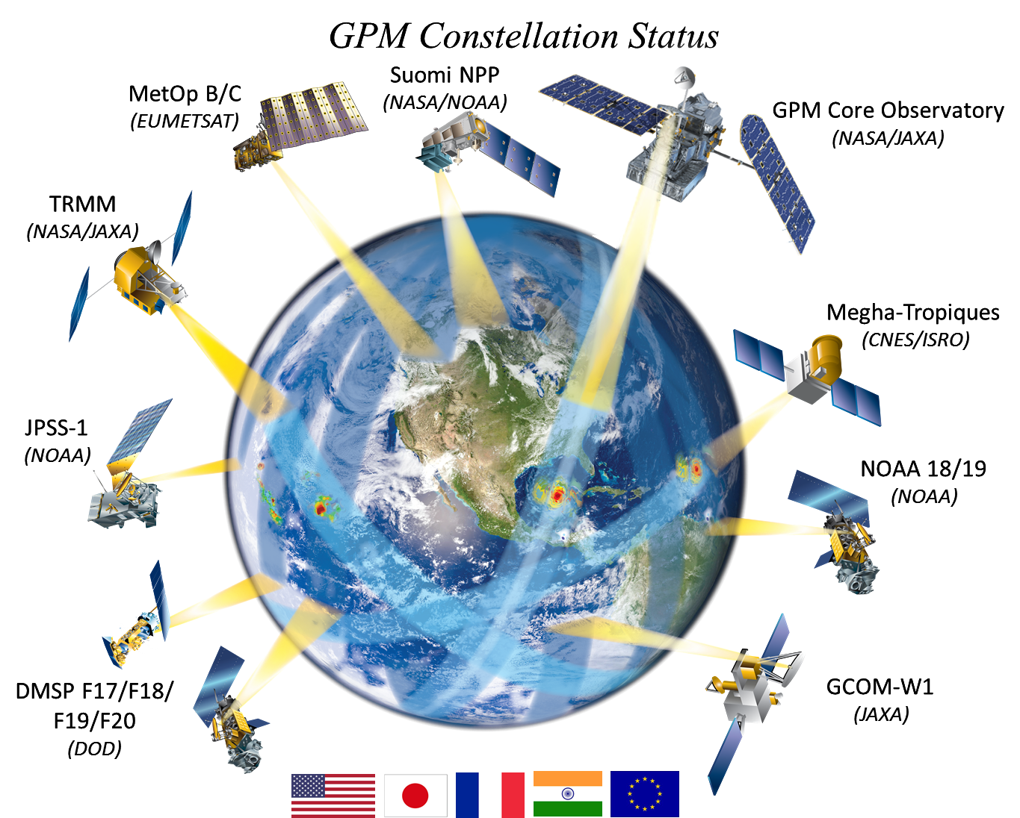
Integration
Spatiotemporal challenges and opportunities
Numerical, statistical and data-driven models
Classification of Environments

Slide 5
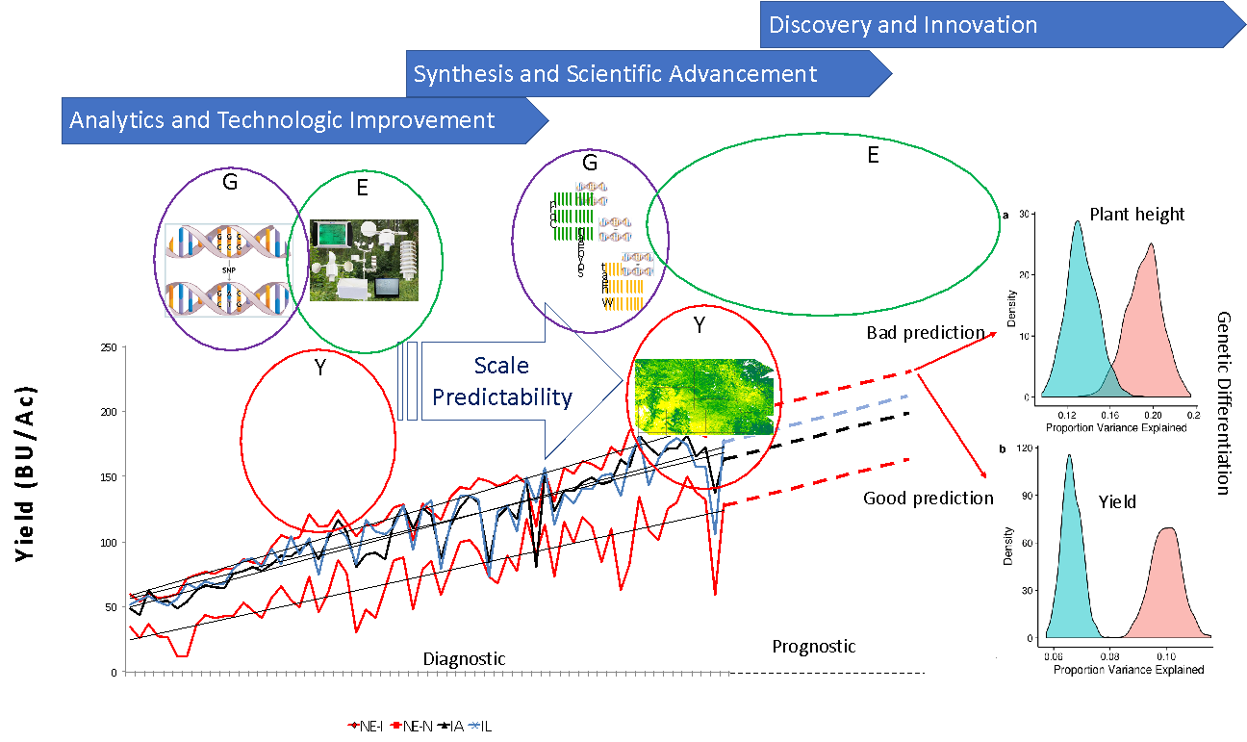
Can we predict maize hybrids?
Genotypes
Environment

Slide 6
Goal and Objectives
Goal
Develop a conceptual framework to collect, store, manage, and use weather/climate data to forecast plant phenotypes
Facilitate hypothesis testing
Objective
2
Engineering predictive analytics
Develop the analytics for data integration and database improvement for G2F
Objective 1
Develop a portable architecture of software for G2F
Design adaptive tools

Slide 7
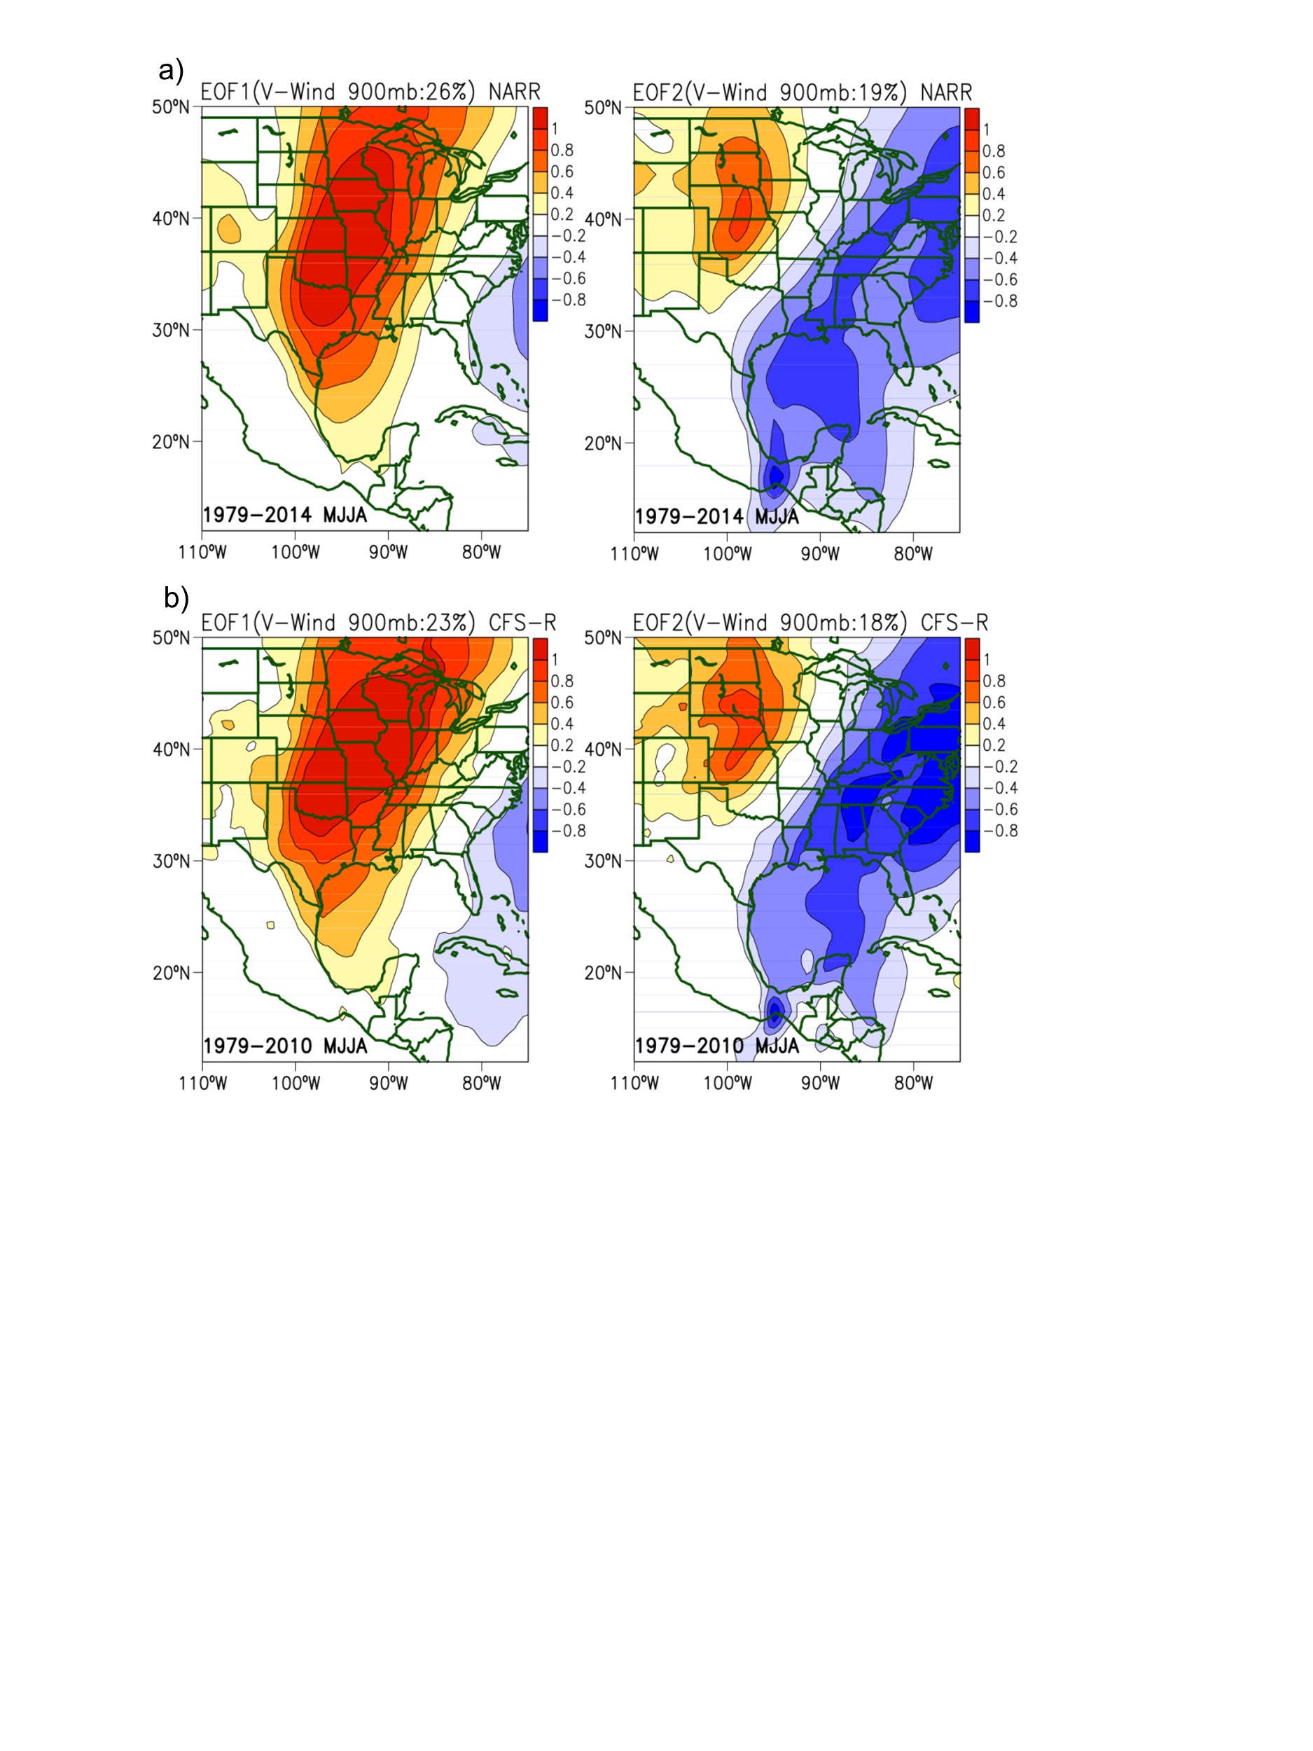
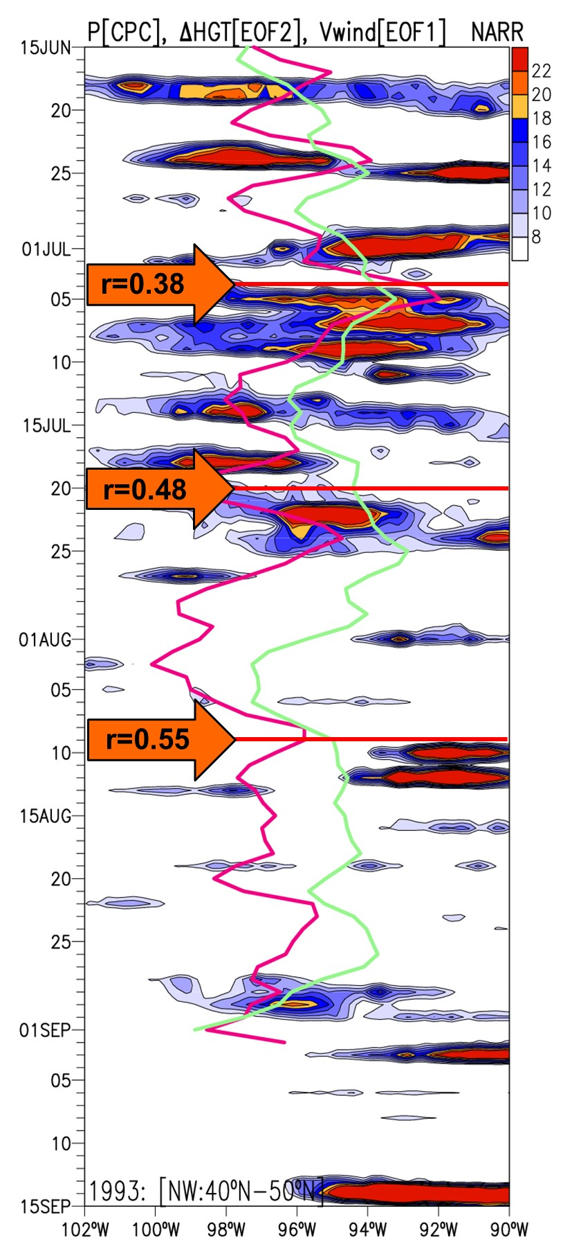
Predictability challenge
Weather forecast:
16 to 20-day lead time
Semi-seasonal to seasonal forecast:
an statistical and data challenge
Weather forecast to climate prediction
Uncertainty
Spatial: resolution and coverage

Slide 8
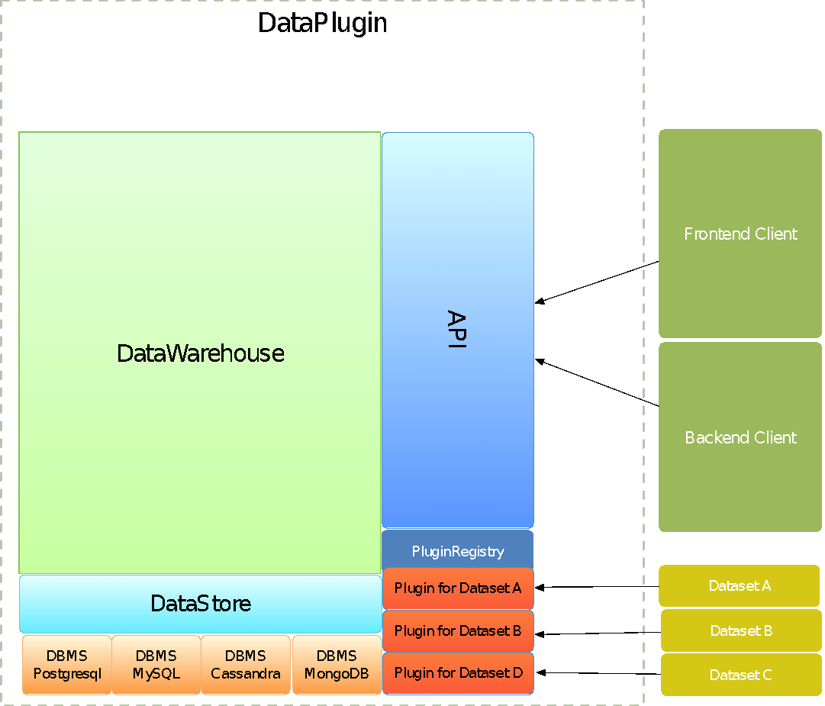
The Data Architecture
DataPlugin
Input from heterogeneous data source via plugins
  csv, tsv, netcdf, sql
Storage on SQL and NoSQL database management systems
  DBMS can be added
  W/O any transformation
Data is available as a service through an API
  Data can be exported in several formats at the moment csv, tsv, netcdf

Slide 9








G2F Data Enhancement
EXPERIMENTS
Year | Total | Complete | Uncompleted
2014 | 42 | 22 | 20
2015 | 49 | 26 | 23
2016 | 30 | 15 | 15
Temperature
Dew Point
Data Sources
Relative Humidity
3-HR
Solar Radiation
Stations
Remote Sensing
Rainfall
HPRCC
NREL
MODIS
GPM
Wind Speed
Forecasts
Wind Direction
NEXRAD
DAYMET
Wind Gust
ECMRF
HRRR
CFS
SMAP
LANDSAT

Slide 10
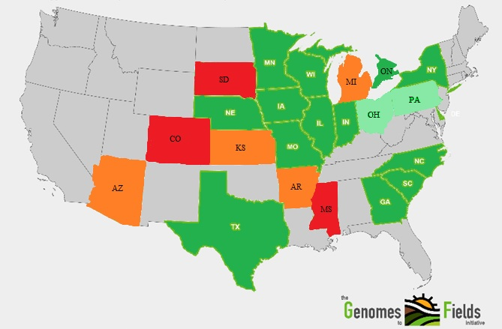
Collected Data
Trials 23 → 43
Locations 19 → 38
States/Prov. 13 → 22
PIs 19 → 32
Plots 12.5 K→ 21.1K
1
Unique inbreeds 300
Hybrids 250
20 to 40 across locations
2
3
4
Years of collected data since 2014

Slide 11

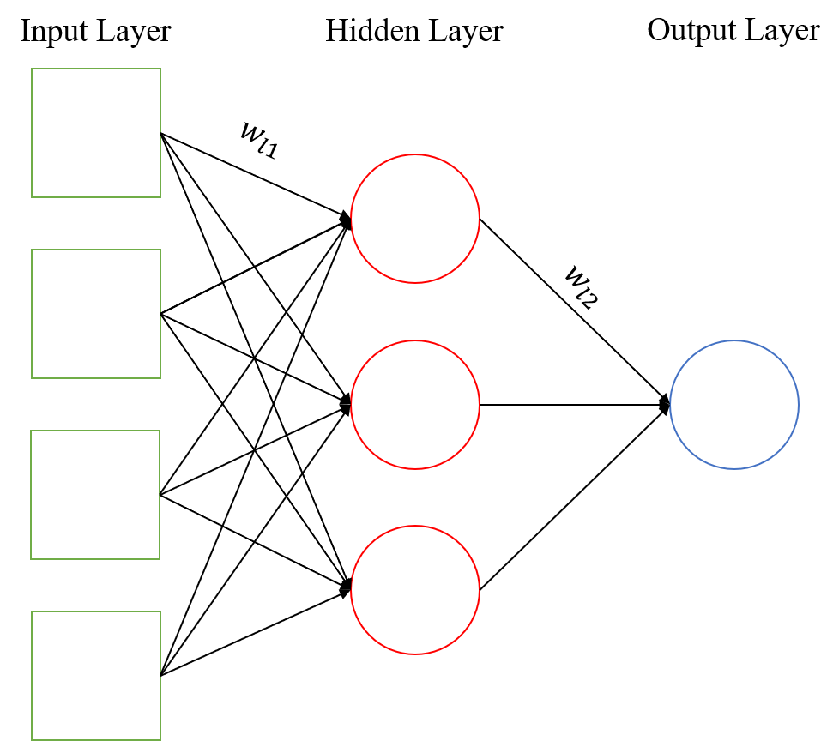
Database Improvement
G2F Data
Error Corrector
RS-HPRCC Data
Missing value,
Instrument error,
Operational error
Integration of various data sources
Correction the data
Data “filling”
Data Gap
ANN
Filled Gap
Data
Source
Corrected
G2F
Amaranto et al., (2018)

Slide 12
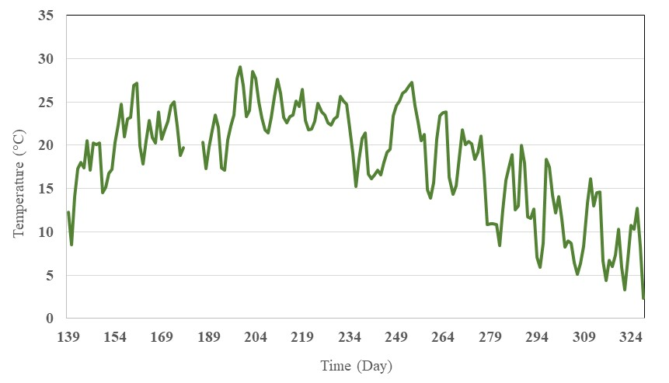




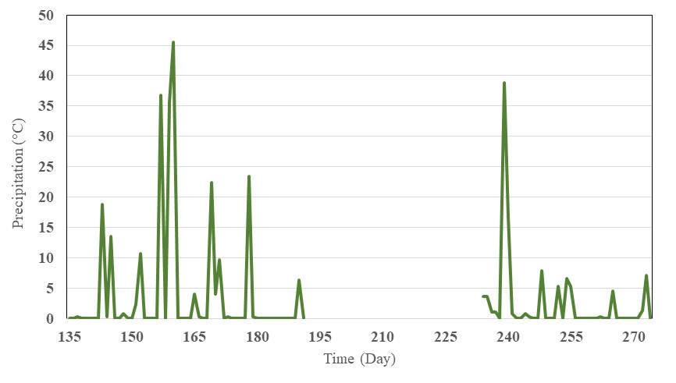
Missing data
Data Source: G2F
Temperature (°C)
IOWA
I3
2015
Precipitation (mm)
NEBRASKA
H2
2014

Slide 13
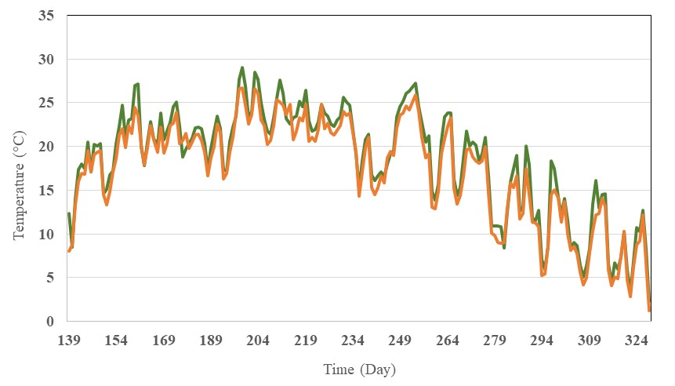
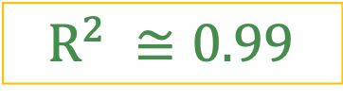
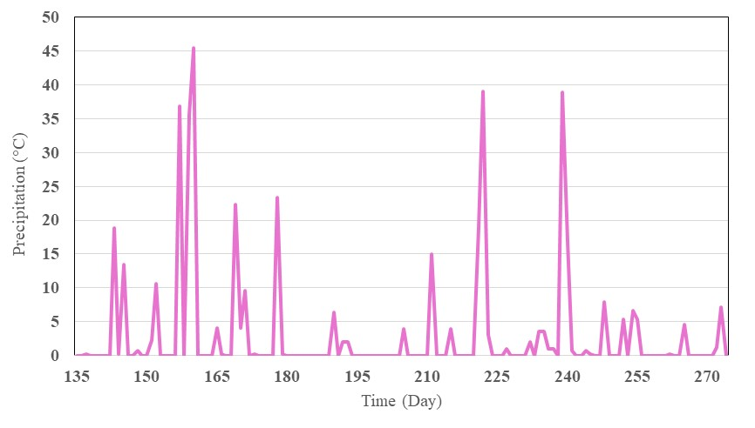
Filling data
Data Source: G2F
Temperature (°C)
IOWA
G2F & NREL
I3
2015
Precipitation (mm)
NEBRASKA
H2
2014

Slide 14
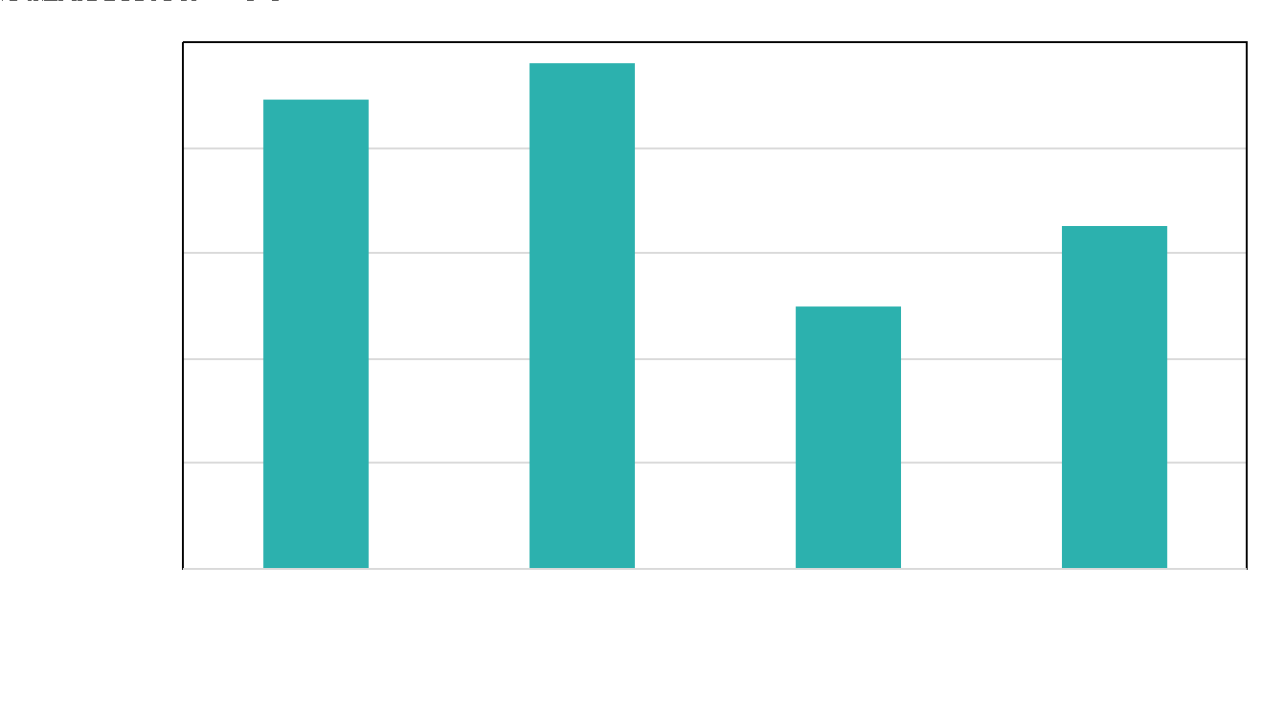

Error Correction
Metric of performance:
Nash–Sutcliffe efficiency (NSE)
It can range from −∞ to 1. An efficiency of 1 (NSE = 1) corresponds to a perfect match of modeled to the observed data.
The error-corrected data improves the accuracy of non-corrected data by 50%.

Slide 15
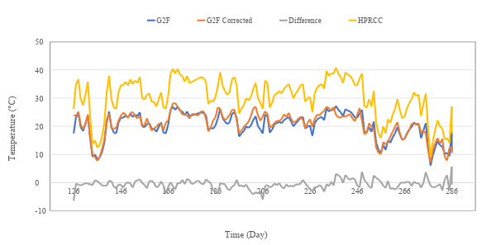
Database Consolidation
NSE increase from 0.1 to 0.87 when using error corrector

Slide 16
TAUS
Tethered Aircraft-Unmanned System
UNL’s robotics NIMBUS lab
UNL’s Hydroinformatics lab
232 - Cross-scale phenotype predictive data analytics using machine learning techniques and long-term persistent monitoring with UAVs: A framework

Slide 17
Conclusions
Building a platform to integrate and store environmental data was the first step towards improving predictability of phenotypes in response to environmental stressors
Twenty different remote-sensing products have been collected and stored in more than 1000 locations (gridded and station data).
Both station and remote sensing gridded data represented reliable alternatives to “fill” missing data from G2F, with peaks of NSE of 0.85 for temperature
The implementation of the error-corrector procedure enabled improvements of 20% in NSE for rainfall and temperature.

Slide 18
Future work
Upscaling-downscaling remote sensing data to reproduce spatial resolution and patterns
Finding the product that, according to the location, the climatic conditions and the land use ensures the maximum “filling” accuracy for each variable
Implement the covariance matrix, and implement the model to accurately predict phenotypic response to a changing environment

Slide 19

Thanks!!
This project was supported by the Agriculture and Food Research Initiative Grant number NEB-21-176 and NEB-21-166 from the USDA National Institute of Food and Agriculture, Plant Health and Production and Plant Products: Plant Breeding for Agricultural Production, A1211).
Accession Nos.1015252 and No.1009760
Google UNL NSF NRT for funding opportunities for permanent residents and citizens

Slide 20
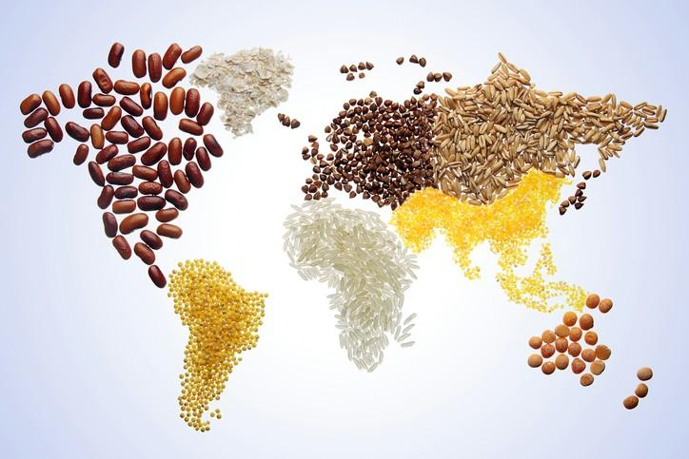
The world’s most valuable resource is no longer oil, but DATA.
The Economist
Image is from www.foodnavigator.com

Slide 21
Can we predict (maize) hybrids?
Genotypes
Environment

