Slide 1
G2F Lobbying Efforts and Funding Status
David Ertl
Iowa Corn Growers Association
February 6, 2019

Slide 2
Sources of Funds for G2F
Corn Board funding
In-Kind Support from Cooperators
NIFA matching grants
Other grants
USDA-GEM
Farm Bill authorization

Slide 3












Genomes To Fields Sponsors
$4.3 million
Contributed
to date

Slide 4



















G X E Cooperators
Principal Investigators who grew GxE trials in 2014-2016
Martin Bohn (UIUC)
Ed Buckler (ARS)
Ignacio Ciampitti (KSU)
Jode Edwards (ARS)
Sherry Flint-Garcia (ARS)
Christopher Graham (SDSU)
Candy Hirsch (UMN)
Jim Holland (ARS)
Elizabeth Hood (A-State)
David Hooker (Guelph)
Fiona Goggin (A-State)
Shawn Kaeppler (UW)
Joe Knoll (ARS)
Judith Kolkman (Cornell)
Greg Kruger (UNL)
Nick Lauter (ARS)
Liz Lee (Guelph)
Natalia de Leon (UW)
Argelia Lorence (A-State)
Aaron Lorenz (UMN)
Jonathan Lynch (PSU)
Steve Moose (UIUC)
Seth Murray (TAMU)
Rebecca Nelson (Cornell)
Torbert Rocheford (Purdue)
Oscar Rodriguez (UNL)
Cinta Romay (Cornell)
James Schnable (ISU)
Brian Scully (ARS)
Rajandeep Sekhon (Clemson)
Margaret Smith (Cornell)
Nathan Springer (UMN)
Kurt Thelen (MSU)
Peter Thomison (OSU)
Mitch Tuinstra (Purdue)
Jason Wallace (UGA)
Randy Wisser (UDel)
Wenwei Xu (TAMU)
In-Kind Support:
Priceless!

Slide 5

Grants
2017 NIFA Matching Grants - $250,000 provided equally by Corn Boards (Nebraska, Iowa, Illinois) and matched by USDA-NIFA
  Resulted in three G2F projects being funded
    $1.5 million total
  Low-cost nitrate sensors to populate genotype-informed yield prediction models for next generation breeders (ISU)
  Genetically-Informed Envirotyping Tools to Better Match Test and Target Environments (UNC-W)
  Aerial and Ground Phenotyping Analytical Tool Development for Plant Breeders Using the Maize G2F Project (TAMU)

Slide 6



Grants
NSF - Development of a PhenoNet - an Integrated Robotic Network for Field-based Studies of Genotype x Environment Interactions (ISU)
USDA - Understanding the Effect of Long-Term Selection on the Genetic Control and Modulation of Genotype-by-Environment Interaction (U Wisc)
USDA - From Gene to Global Hydroclimatic Controls on Hybrid Performance Predictability (UNL)
FFAR - Harnessing Endophytes to Improve Crop Efficiency and Production (UGA)

Slide 7

Other Grants Related to G2F
ARPA-E ROOTS
  High-throughput, High-resolution Phenotyping of Nitrogen Use Efficiency Using Coupled In-plant and In-soil Sensors (ISU)
  DEEPER: An Integrated Phenotyping Platform for Deeper Roots (Penn State)
  Root Genetics in the Field to Understand Drought Adaptation and Carbon Sequestration (CSU)

Slide 8
Legislative Update - Phenotyping
Since 2015, G2F Executive committee, along with several university Government Relations offices and NCGA and ICGA, began talking to federal agencies and key Congressmen and Senators about federal funding for phenotyping

Slide 9
Legislative Update - Phenotyping
Language inserted into FY2017 –FY2019 Federal Senate Budget Report supporting phenotyping through USDA
Language inserted into FY2018 & 2019 Federal House Budget Report supporting phenotyping
Resulted in $1.25 million to Genomes To Fields the past two years coming through USDA GEM program

Slide 10


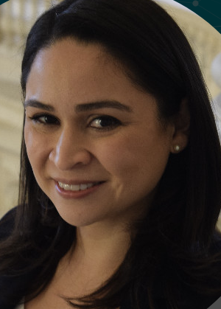





Thanks to those responsible
Sophia Magill Leslee Gilbert Carina Marquez- John Latini, Penn State
ISU Director of VP Van Scoyoc Oberhoffner, Federal Director Federal Relations
Federal Relations (ISU lobbyist) Relations UW-Madison
Channing Riggs Diane Miller Connor Hamburg Kevin Studer
UMN Director of Cornell Director of NCGA ICGA
Federal Relations Federal Relations

Slide 11

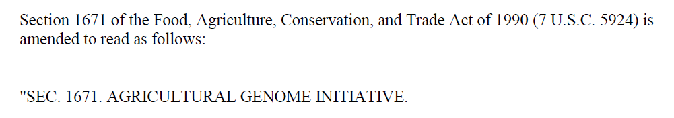
Farm Bill Update - Phenotyping
The ‘Plant Genome Mapping Program’ first appeared in 1990 Farm Bill
Renamed the ‘Agricultural Genome Initiative’ in 1998
  After National Plant Genome Initiative was funded
However, funding never authorized in any Farm Bill

Slide 12
Farm Bill Update - Phenotyping
Last year, House Ag Committee agreed to redraft the ‘Agricultural Genome Initiative’ into the ‘Agricultural Genome To Phenome Initiative’ and was included in House version
Sec. 1671. [7 U.S.C. 5924] AGRICULTURAL GENOME TO PHENOME INITIATIVE
(a) GOALS.—The goals of this section are—

Slide 13
Farm Bill Update - Phenotyping
And importantly, they added a $30 million per year authorization
(f) AUTHORIZATION OF APPROPRIATIONS.—There are authorized to be appropriated to carry out this section $30,000,000 for each of fiscal years 2019 through 2023.

Slide 14
Farm Bill Update - Phenotyping
Senate version also included this new language, with one addition:
  added ‘animals’ as well as ‘crops’
(a) GOALS.—The goals of this section are—
(1) to expand knowledge concerning genomes and phenomes of crops and animals of importance to the agriculture sector of the United States;
(2) to understand how variable weather, environments, and production systems impact the
growth and productivity of specific varieties of crops and species of animals in order to provide greater accuracy in predicting crop and animal performance under variable conditions
(3) to support research that leverages plant and animal genomic information with phenotypic
and environmental data through an interdisciplinary framework, leading to a novel understanding of plant and animal processes that affect growth, productivity, and the ability to predict performance, which will result in the deployment of superior varieties and species to producers and improved crop and animal management recommendations for farmers and ranchers;

Slide 15
Farm Bill Update - Phenotyping
Language included in Farm Bill and signed into law on December 20
Went with the Senate animal language
Includes $40 million per year authorization!
Will be administered as grants by USDA-NIFA
SEC. 7208. AGRICULTURAL GENOME TO PHENOME INITIATIVE.
Section 1671 of the Food, Agriculture, Conservation, and Trade
Act of 1990 (7 U.S.C. 5924) is amended—
(1) in the section heading, by inserting ‘‘TO PHENOME’’ after
‘‘GENOME’’;
‘‘(f) AUTHORIZATION OF APPROPRIATIONS.—There is authorized
to be appropriated to carry out this section $40,000,000 for each of
fiscal years 2019 through 2023.’’.

Slide 16
Farm Bill Update - Phenotyping
However, we don’t have the money yet…
Now that Farm Bill is signed, immediately begin working on appropriations as authorization is effective immediately
Authorization only establishes the program with a non-binding funding recommendation
Appropriations needed to get those funds built into the federal budgets each year by Congress

Slide 17
GxE Consortium: Data Usage Disclaimer
This presentation includes data analysis and interpretation conducted by the presenter and does not necessarily reflect the observations and conclusions of the GxE Consortium.

