Slide 1


MAIZE STALK LODGING QUANTIFYING COMPLEX MULTI-SCALE PHENOTYPES
AgMEQ Laboratory
danieljr@uidaho.edu
Daniel Robertson
Notes:
Assistant professor, UofI mechanical engineer, AgMEQ labs
Interested in helping breeders address Stalk Lodging (plant can no longer support its weight breaks in wind storms)
So why stalk lodging? Take a step one back

Slide 2

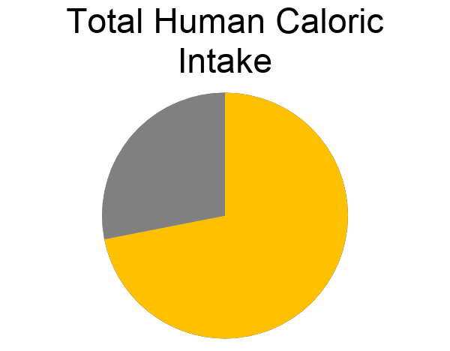
CORN, WHEAT AND RICE ACCOUNT FOR TWO THIRDS OF HUMAN CALORIC INTAKE
AgMEQ Laboratory
danieljr@uidaho.edu
Notes:
10-20% worldwide – multiple billions of loses each year – 1% reduction = 2 billion a year in corn
Started 5-6 years ago
Breeders needed a way to measure strength accurately.
Current methods were incorrect, no shear stress, wrong loading conditions, produced incorrect failure patterns
Weren't measuring lodging resistance (transverse compression strength, or tensile strength, or youngs modulus)
Posthoc analysis and correlations not ground up science built on physics and theory

Slide 3
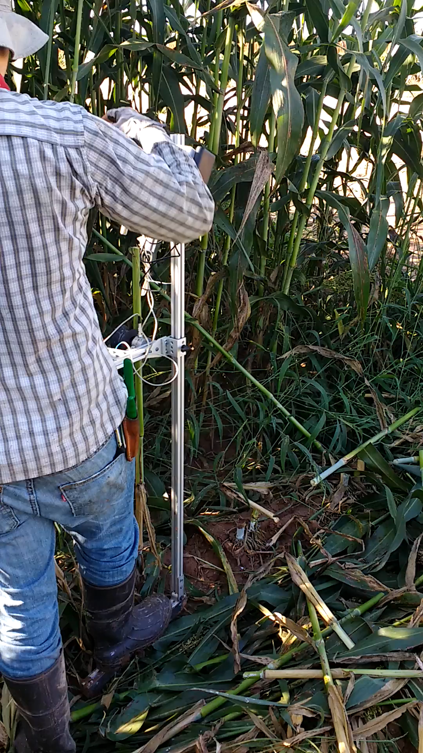
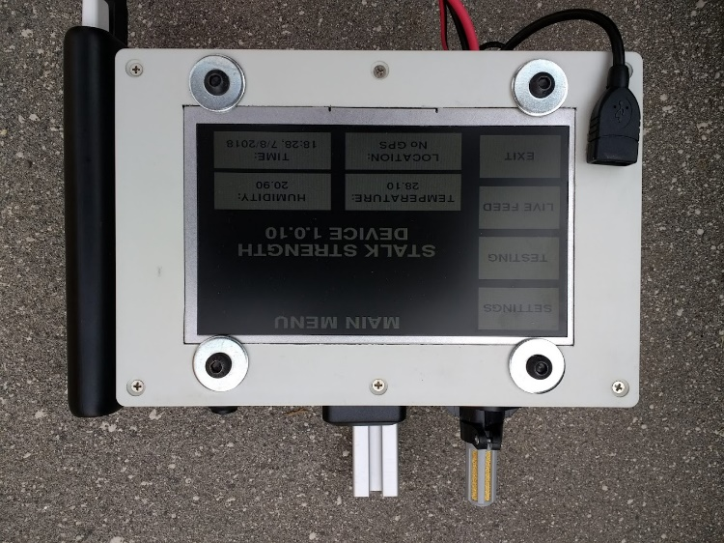
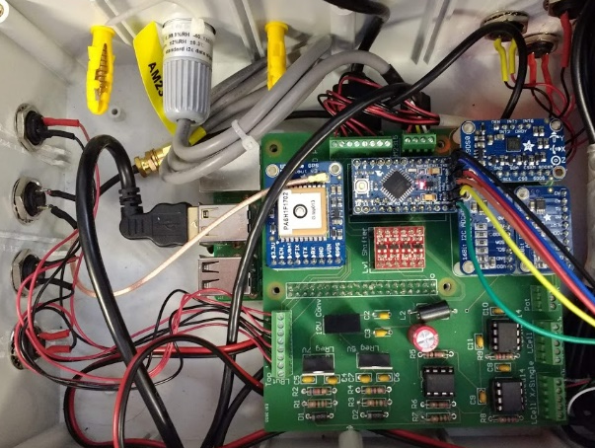
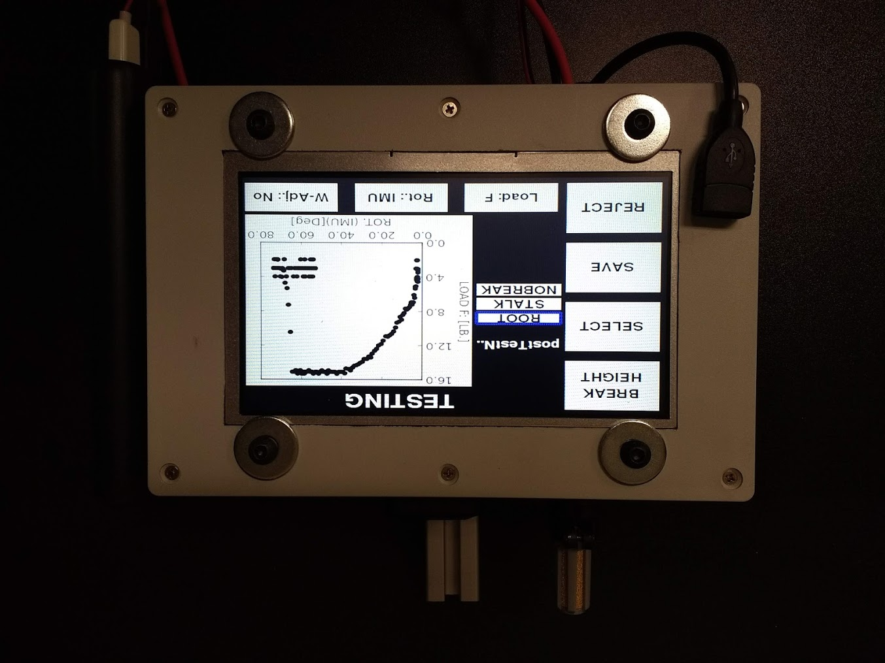
BREEDERS NEED RELIABLE / EFFICIENT MEASUREMENTS OF STALK STRENGTH
GPS Sensor
Temperature / Humidity Sensor
Battery
Pack
USB Data Export
AgMEQ Laboratory
danieljr@uidaho.edu
Notes:
Started 5-6 years ago
Breeders needed a way to measure strength accurately.
Current methods were incorrect, no shear stress, wrong loading conditions, produced incorrect failure patterns
Weren't measuring lodging resistance (transverse compression strength, or tensile strength, or youngs modulus)
Posthoc analysis and correlations not ground up science built on physics and theory

Slide 4
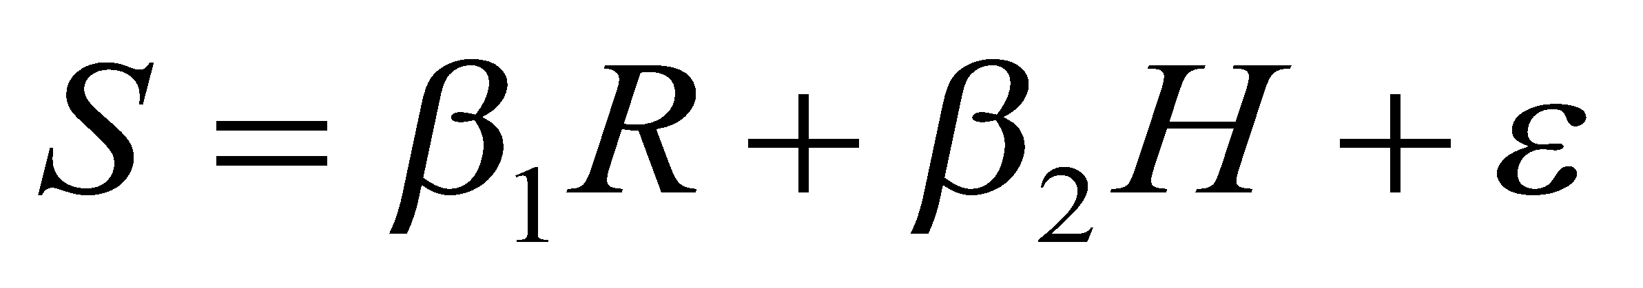
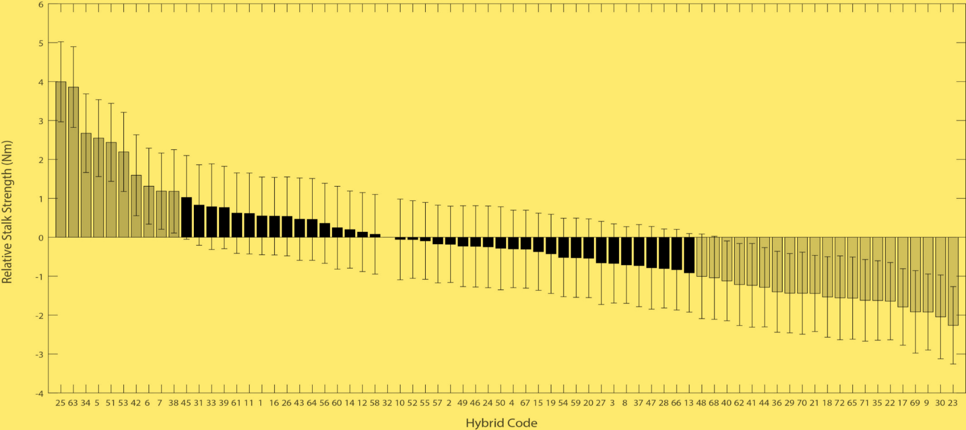
WE CAN STATISTICALLY DISTINGUISH STRENGTH AMONG ELITE HYBRIDS
72 hybrids at 8 locations
Categorical regression model:
Stalk strength
Hybrid
Location
21 weakest
10 strongest
AgMEQ Laboratory
danieljr@uidaho.edu
Notes:
Categorical regression model, location = rep,
Sample size of 5-10 per plot
A lot of work but in end we now have a method that can statistically distinguish strength among elite varities of maize and sorghum.

Slide 5
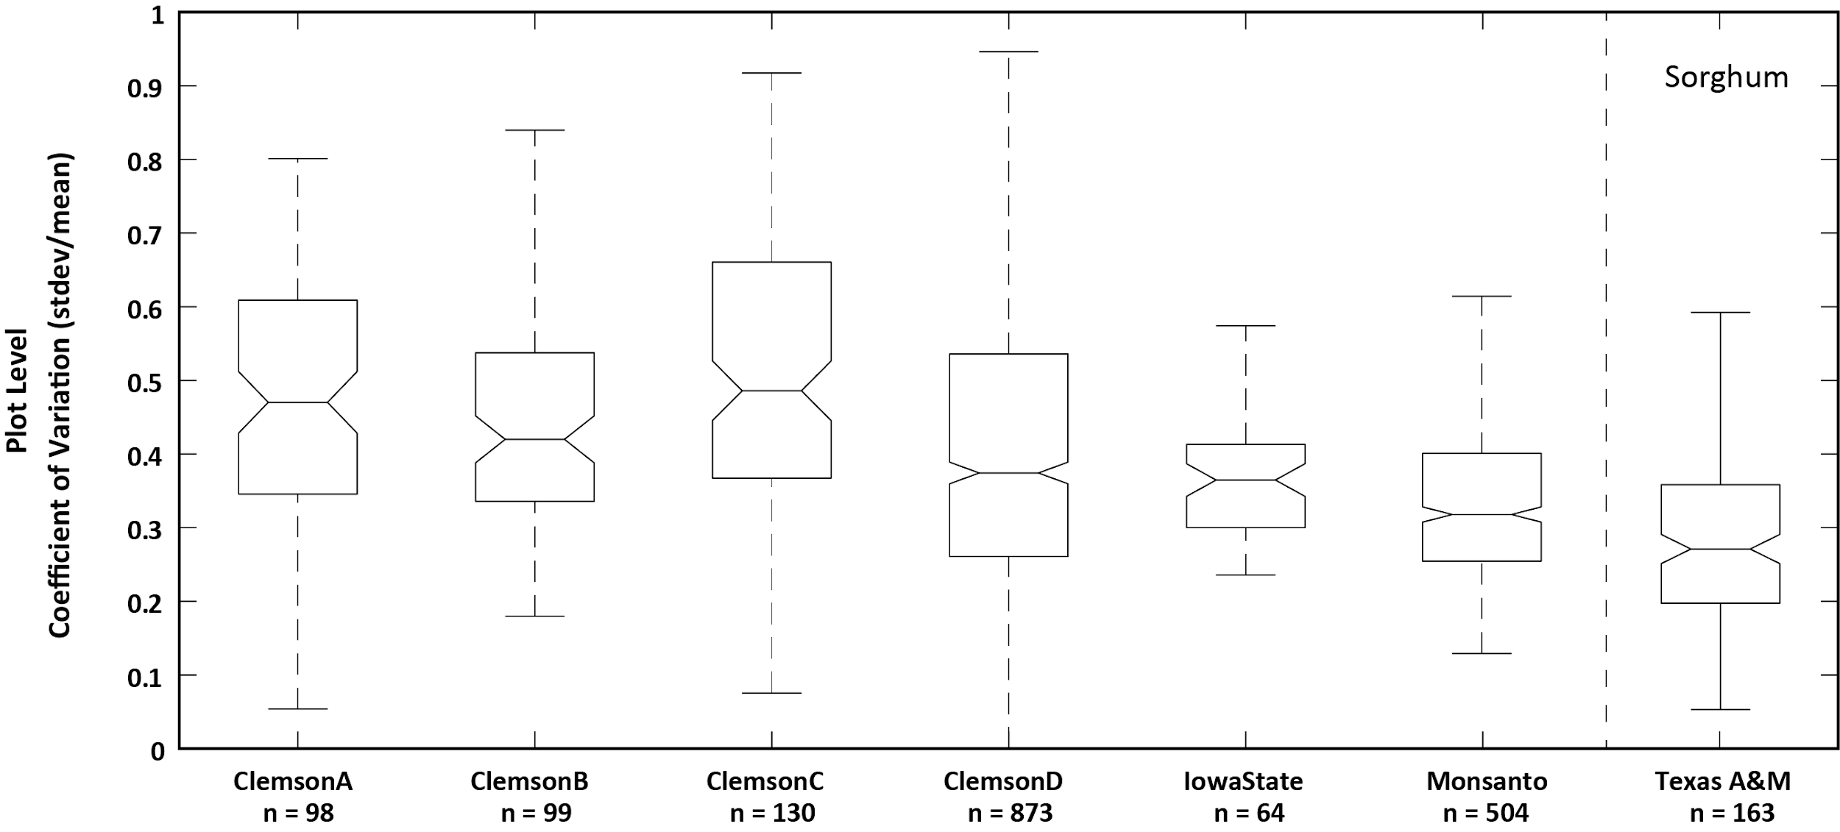
HYBRIDS DEMONSTRATE LARGE AMOUNTS OF WITHIN PLOT VARIATION
AgMEQ Laboratory
danieljr@uidaho.edu
Notes:
Box plots of CV of different experiments we have ran
Association panels (extremes of genetic diversity and still get High variability)
But look at the tails – certain hybrids are robust to micro-environmental factors
Been under sampling in many cases.
These are hybrids in well maintained fields. You are not going to get a lot more consistent environmental factors

Slide 6
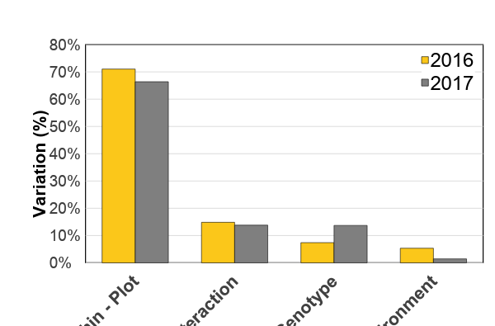
VARIATION WITHIN A SINGLE PLOT IS THE LARGEST SOURCE OF VARIATION
AgMEQ Laboratory
danieljr@uidaho.edu
Notes:
Genetically similar all Monsanto
But grown in 7 different states

Slide 7
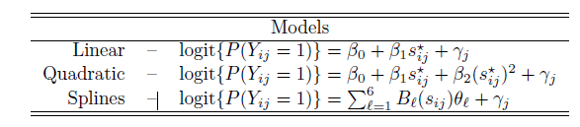
DOES STALK STRENGTH PREDICT LODGING RESISTANCE?
Historical Lodging Data
    57 varieties
    4 years (2014 – 2017)
    107 fields total
    ~38 fields with 60 plants
Bending Strength Data
    57 Varieties
    2 years (2017 – 2018)
    3 fields total
    ~20 plants per field
Random effect
Imputed Strength Values
Imputed strength vs lodging
Repeated 100 times
AgMEQ Laboratory
danieljr@uidaho.edu
Notes:
Two imputation schemes random sampling + mean

Slide 8
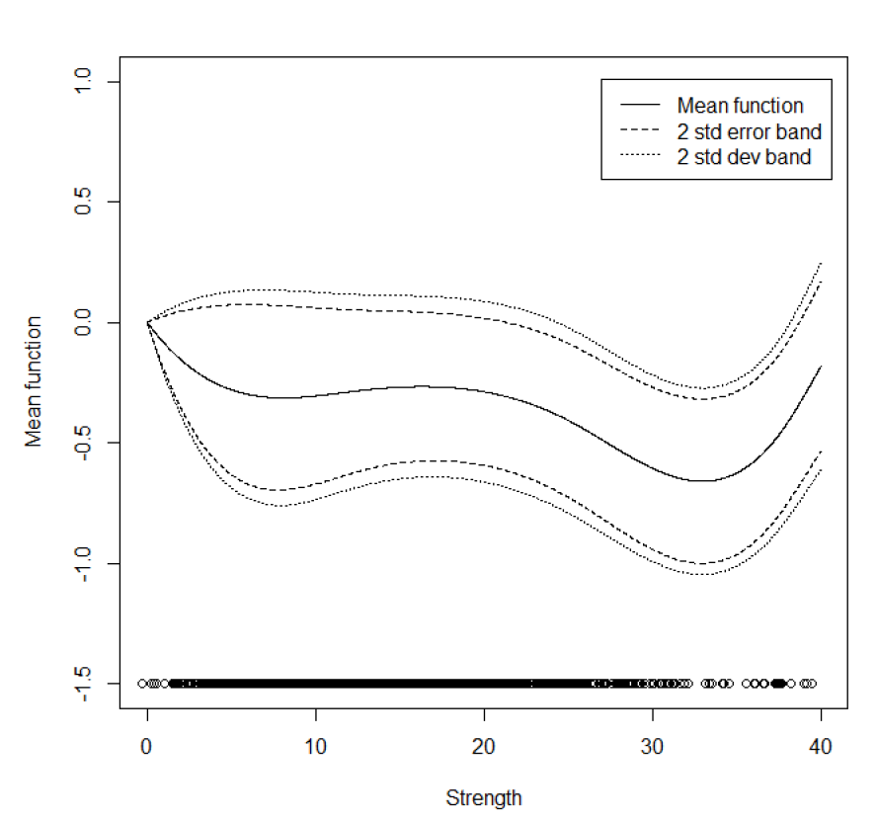

BENDING STRENGTH IS A STRONG PREDICTOR OF HISTORICAL LODGING RATES
Notes:
Still significant for all 100 imputations even though strength is imputed.
Largest source of variation is whithin plot
These were all viable hybrids – not notoriously weak and notoriously strong.
Improve g2f if we had disease pest pressure – plant level data not stalk level data.

Slide 9







Monsanto Company
Clemson University
Brian Gardunia
Ty Barten
Stephen Kresovich
Zach Brenton
Rajandeep Sekhon
Chris McMahan
Chase Joyner
Brigham Young University
Douglas Cook
National Science Foundation
University of Kentucky
NSF EPSCOR Track II - 1826715
CMMI-1400973
Seth Debolt
US Department of Agriculture
NIFA-AFRI #100802
AgMEQ Laboratory
danieljr@uidaho.edu

