Slide 1

Crop Growth Model Simulation of G2F Common Hybrids
Cassandra Winn
Department Of Agronomy, Iowa State University
Dr. Jode Edwards
USDA-ARS Corn Insects And Crop Genetics Research Unit, Iowa State University

Slide 2
“…Integrate knowledge from field and laboratory research in the form of mathematical equations, and attempt to represent a real world system.”
  Dr. Sotirios Archontoulis, Iowa State University
Systems: Organ, Plant, Soil, Field, Farm, Region
Notes:
Crop simulators are computer programs that mimic the growth and development of crops. Data on weather, soil, and crop management are processed to predict crop yield, maturity date, efficiency of fertilizers and other elements of crop production. The calculations in the crop models are based on the existing knowledge of the physics, physiology and ecology of crop responses to the environment. https://www.ars.usda.gov/northeast-area/beltsville-md-barc/beltsville-agricultural-research-center/adaptive-cropping-systems-laboratory/docs/what-are-crop-simulation-models/
Crop models use mathematical equations to simulate growth, development and yield as a function of weather, soil conditions and crop management. Such models integrate scientific knowledge from diverse agronomic disciplines, ranging from plant breeding to soil physics. https://www.sciencedirect.com/science/article/pii/S0378429004001662?via%3Dihub

Slide 3

Agricultural Production Systems sIMulator (APSIM)
Inputs Outputs
Weather
(temperature, rainfall, radiation)
Soil Parameters
(soil water supply, soil nitrogen, etc.)
Crop Parameters
(phenology, leaf development, biomass production, etc.)
Management
(irrigation, tillage, fertilizer, planting date, planting density, etc.)
Plant growth
Crop staging
Grain yield
Biomass yield
Soil water
Water balance
Soil Nitrogen
N cycling
crop growth model
BLACK
BOX

Slide 4
APSIM Maize Crop Model version 7.10 (new maize model – Hammer et al.)
Phenology – HOW MANY DAYS
Biomass Production – HOW MUCH PER DAY
  Model simulates potential, water limited, and N limited situations
    Leaf development and senescence
    Biomass partitioning

Slide 5
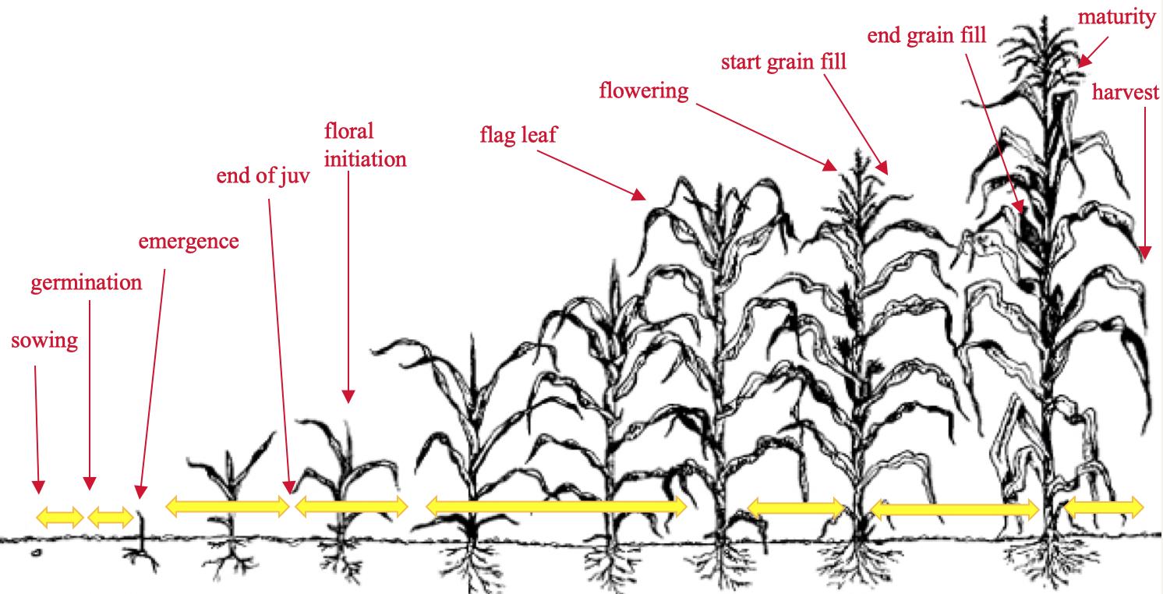
Phenology
11 stages
calculated as a function of temperature and photoperiod
water and N stresses included
cultivar specific information
Notes:
Sowing to germination is driven by soil moisture
Germination to emergence the depth of sowing has an effect on thermal time target
Emergence to floral initiation is composed of a cultivar-specific period of fixed thermal time, commonly called the juvenile phase
End of the juvenile phase to floral initiation the thermal development rate is sensitive to photoperiod (calculated as a function of day of year and latitude) if the cultivar is photoperiod sensitive. The model assumes that maize, as a short day plant, will have a longer phase (dependent upon cultivar) between the end of the juvenile phase and initiation if photoperiods exceed 12.5 hours
Emergence to flag leaf appearance duration is determined by the total number of leaves destined to appear on the plant, and the rate at which they appear, which is determined by temperature
Emergence to flowering the calculated daily thermal time is reduced by water or nitrogen stresses, resulting in delayed phenology when the plant is under stress
There are cultivar-specific fixed thermal time durations for the subsequent phases between flowering and the start of grain fill, between the start and end of grainfill, between the end of grainfill and maturity, and between maturity and harvest ripe.
Date of emergence = f(tt, sowing depth) * water stress
Date of end of juvenile = fixed
Date of floral initiation = f(tt, photoperiod), critical photoperiod = 12.5h
Date of flag leaf = f(tt, leaf appearance rate, final leaf number)
Date of flowering, grain filling, maturity, … = f(tt)

Slide 6
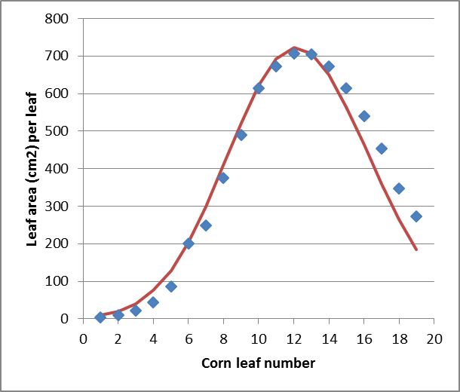
Canopy Leaf Development
Leaf area per plant – using a predicted “bell curve”
Leaf number per plant is simulated using temperature (photoperiod optional) and leaf appearance rates
  Until leaf 9, 65 °C days per leaf
  After that, 36 ° C days per leaf
LAI = leaf area/plant * number of plants
  This estimate is also limited by water, nitrogen and carbon availability
Ames 2015 (FACTS plots)
Notes:
The total number of leaves is equal to the number in the seed at germination (7) plus the number subsequently initiated at a rate of 21 o Cdays per leaf, until floral initiation is reached
Potential LAI is a product of leaf number, leaf size, number of plants per m2 and the water stress factor for expansion (see water deficits section below).
An adjustment factor is used to account for the area of currently expanding leaves.
Leaf size is calculated from final leaf number assuming that it follows a bell-shaped distribution with leaf position along the stalk (Keating and Wafula, 1992).
Early in crop development, before floral initiation is reached and hence before final leaf number is known, an estimated date of floral initiation is used to calculate a provisional final leaf number for the purposes of simulating leaf size.
Actual LAI is less than the potential LAI if there is not sufficient biomass partitioned to leaf on that day.
Maximum specific leaf area (SLA_MAX) defines the maximum leaf area (m 2 ) that can be expanded per gram of biomass.
SLA_MAX declines with increasing LAI i.e. smaller, younger crops have larger thinner leaves.
SLA_MAX = maximum leaf area (m²) that can be expanded per gram of biomass

Slide 7
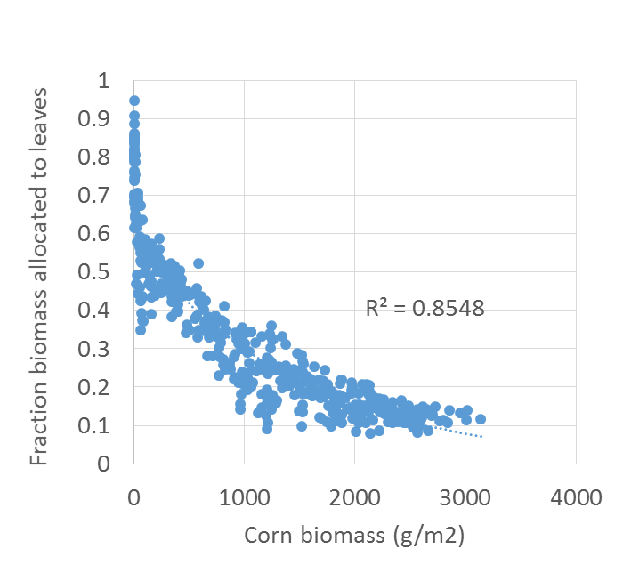
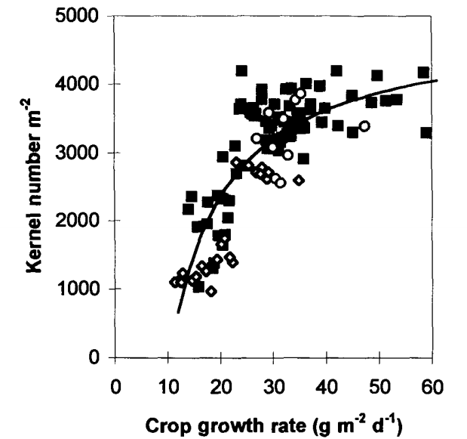
Biomass Production and Partitioning
Daily crop growth rate = minimum (RUE * radiation interception, transpiration efficiency * soil water supply)
Partitioning of dry matter is stage dependent.
Before flowering, dry matter goes to roots, leaves and stems.
After flowering dry matter goes to grains and remaining to stems/roots
Flowering
grain dry matter:
kernel number * kernel size * # plants * stress of (heat, water, nitrogen) calculated on a daily basis
Data from FACTS 2017
Andrade et al. Crop Science (1999)

Slide 8



CALIBRATION & SIMULATION

Slide 9
Objective
Determine which parameters differentiate 12 PVP hybrids part of G2F
Determine if differences in yield, phenology, biomass accumulation and partitioning, and nitrogen uptake can be accurately simulated from a limited set of parameters

Slide 10
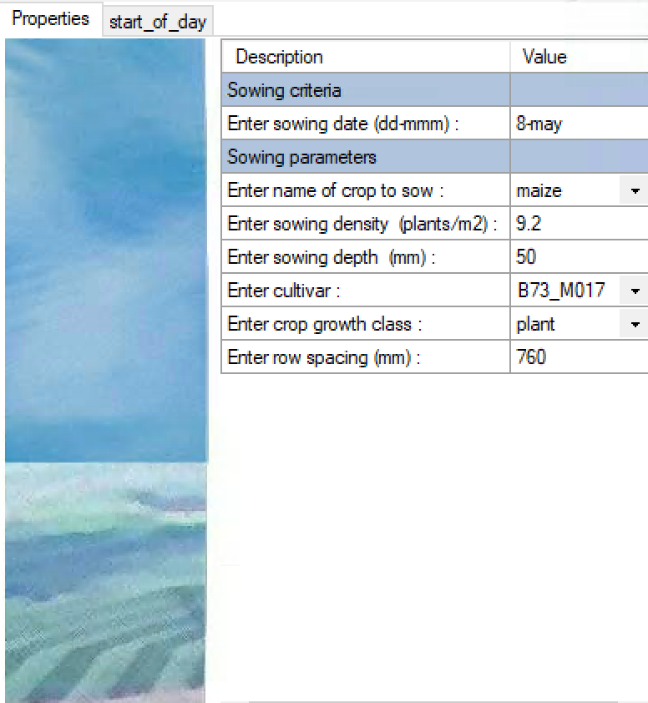
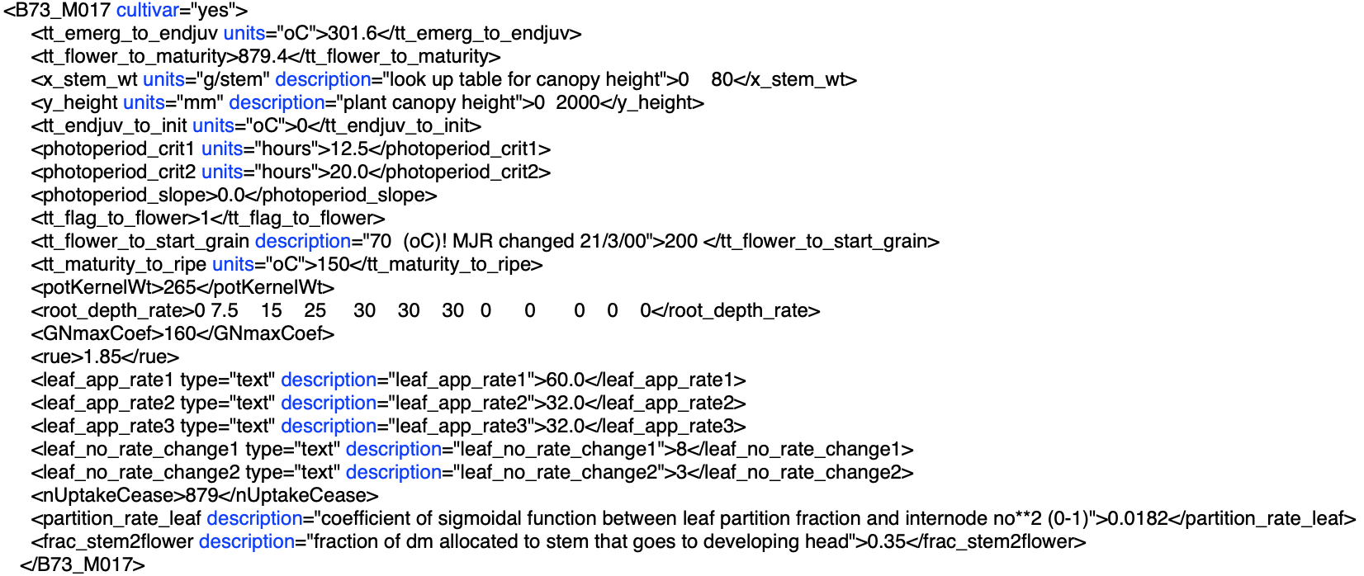
What Does a Maize Hybrid Look Like in APSIM?
APSIM contains ~70 maize hybrids, which are primarily generic and based off of relative maturity groups
The example above is a G2F hybrid (B73 x Mo17) that was manually created by calibrating the above parameters.

Slide 11
Cultivar Specific Parameters of Two Maize Hybrids Used in This Study
Parameter Explanation |  | B73xMo17 | PHW52xPHM49
Emergence to End of Juvenile | thermal time from emergence to end of juvenile stage (gdd) | 302 | 325
Flowering to Physiological Maturity | thermal time from silking to physiological maturity (gdd) | 879 | 990
Flowering to Start Grain Fill | thermal time from silking to start effective grain fill period (gdd) | 200 | 200
Potential Kernel Weight | potential kernel weight per plant in grams | 265 | 285
Coefficient for the relationship between grain number and size | GNmax coefficient = GNmax * potential kernel weight/ 1000 | 160 | 135
Leaf Appearance Rate 1 | How fast does a leaf appear (V1-V9) | 60 | 55
Leaf Appearance Rate 2 | How fast does a leaf appear (V9-V18) | 32 | 30
Leaf and Stem Partition | Coefficient that determines partition fraction between leaves and stems | 0.0182 | 0.016

Slide 12
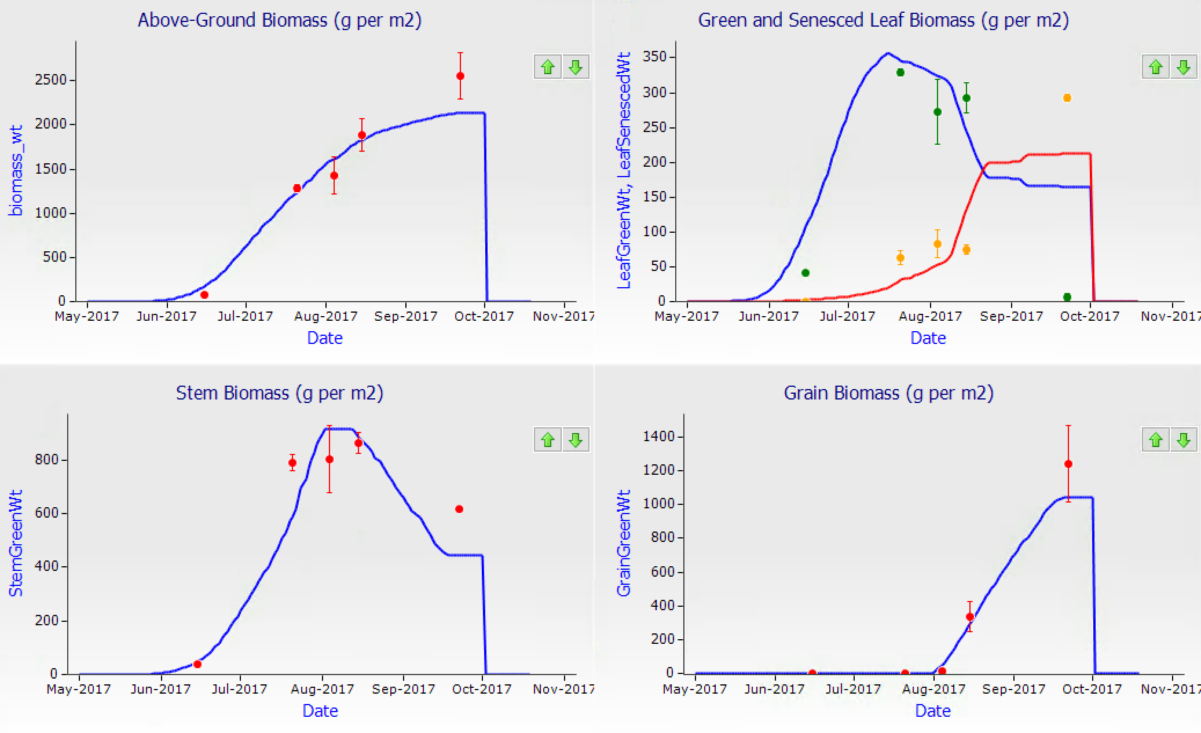
Observed vs. Simulated Biomass B73 x Mo17

Slide 13
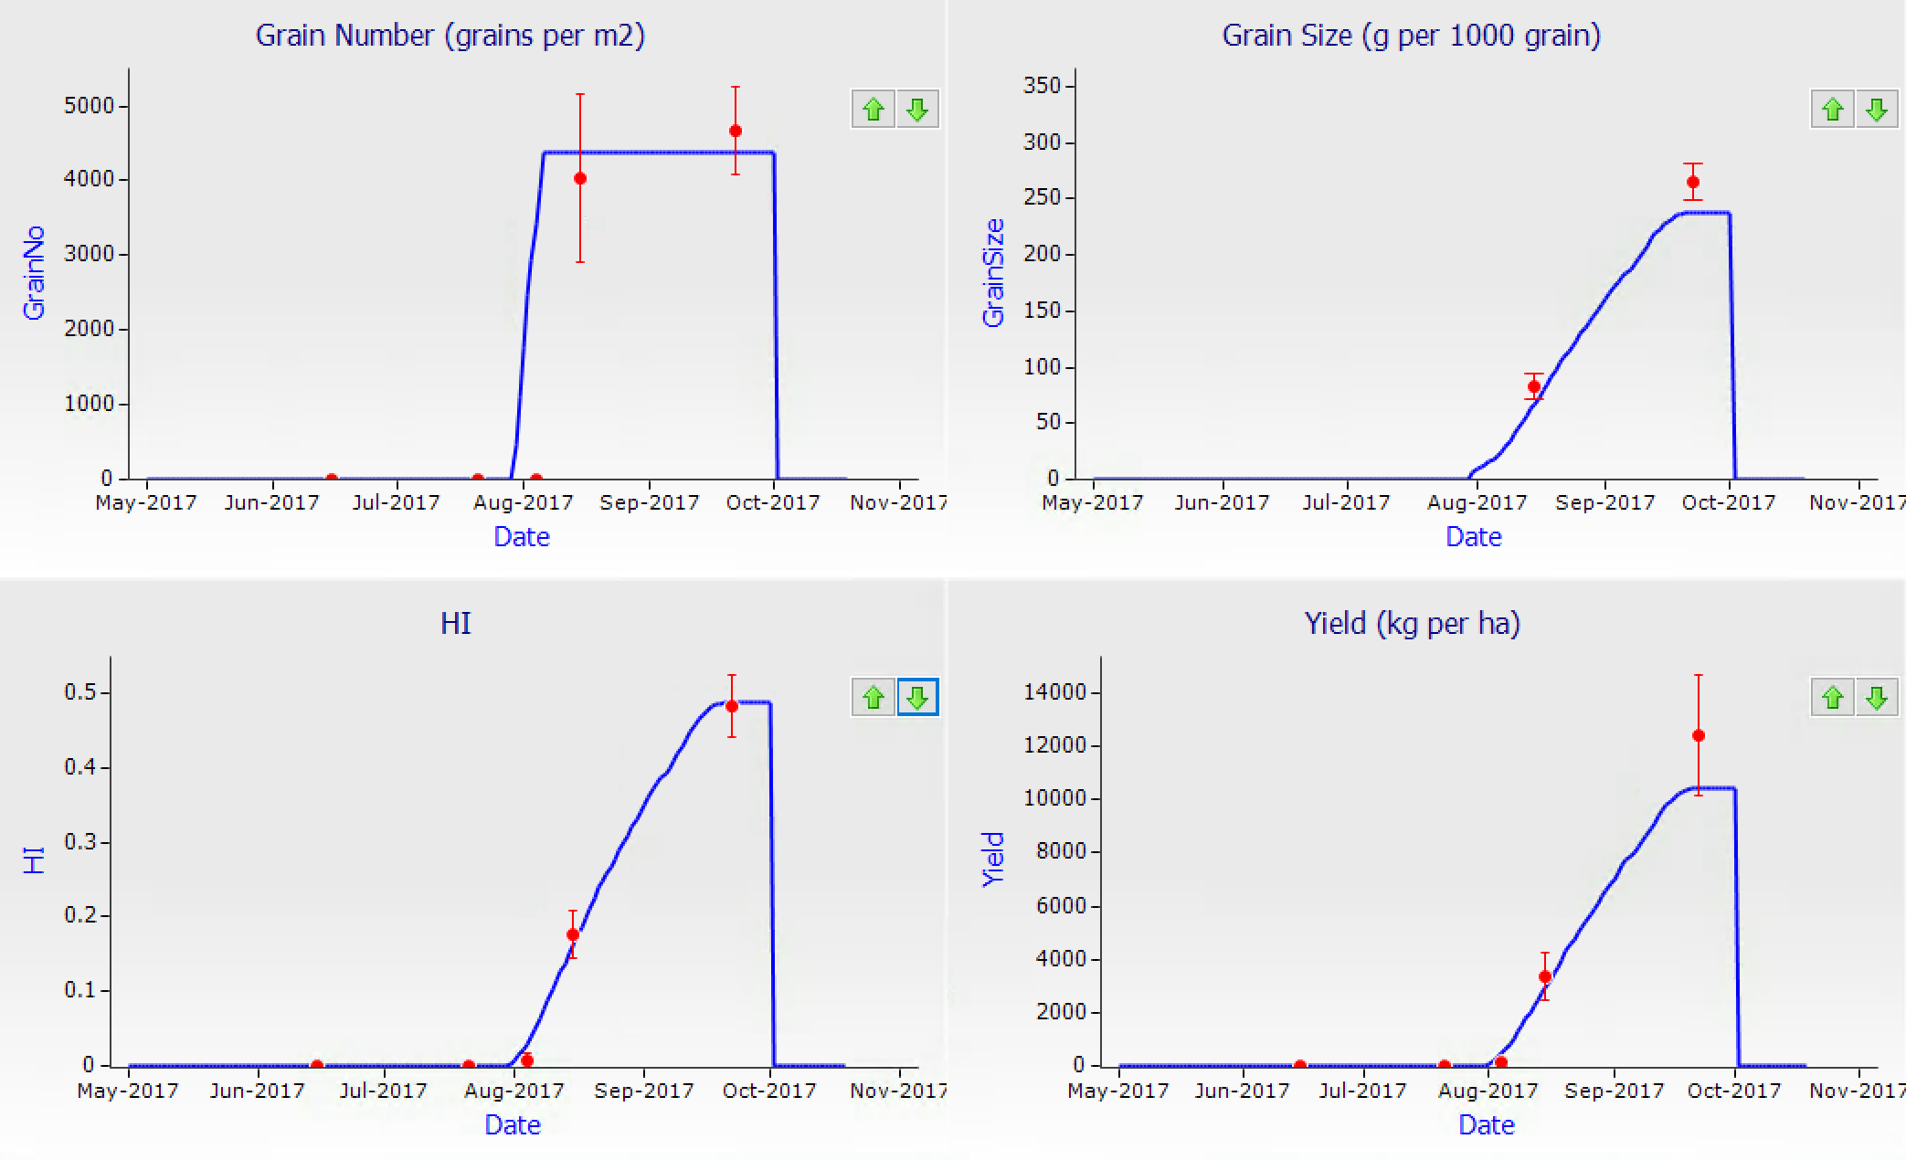
Observed vs. Simulated Grain Component
B73 x Mo17

Slide 14
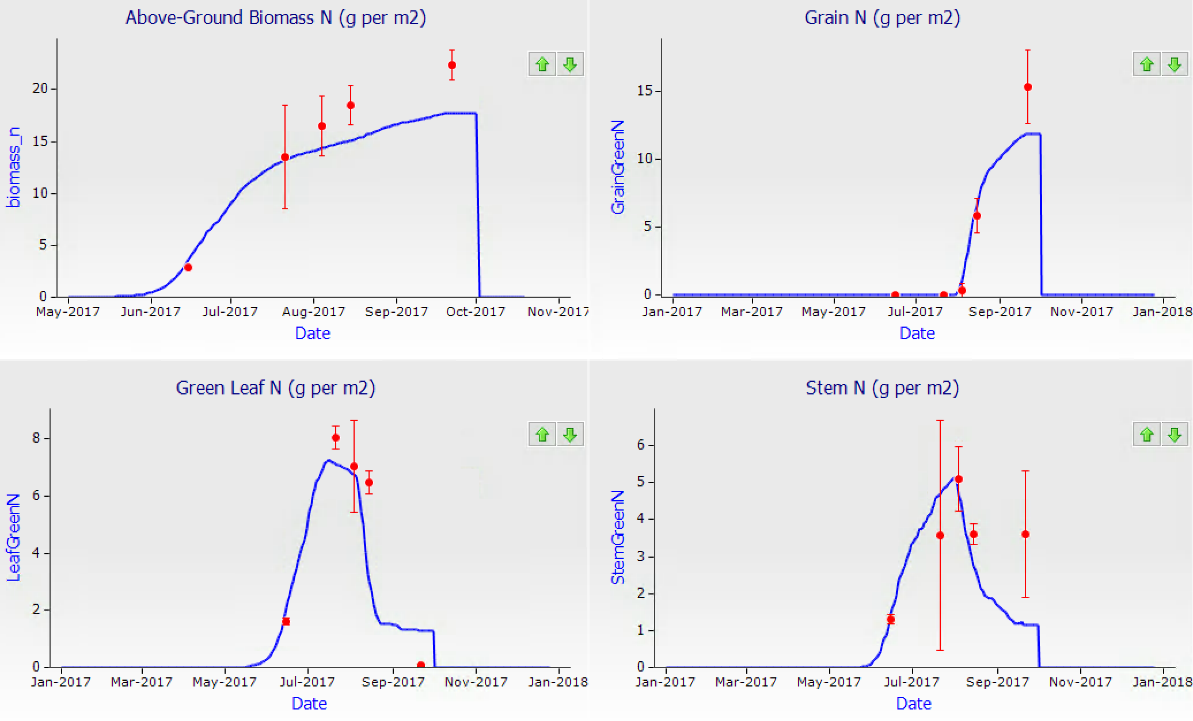
Observed vs. Simulated N Uptake B73 x Mo17

Slide 15
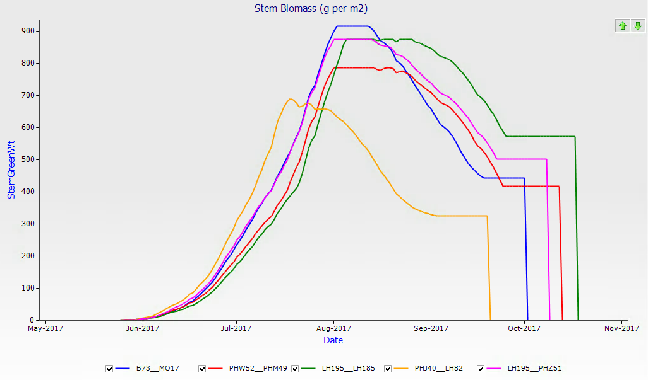
Simulated Stalk Biomass of 5 hybrids

Slide 16
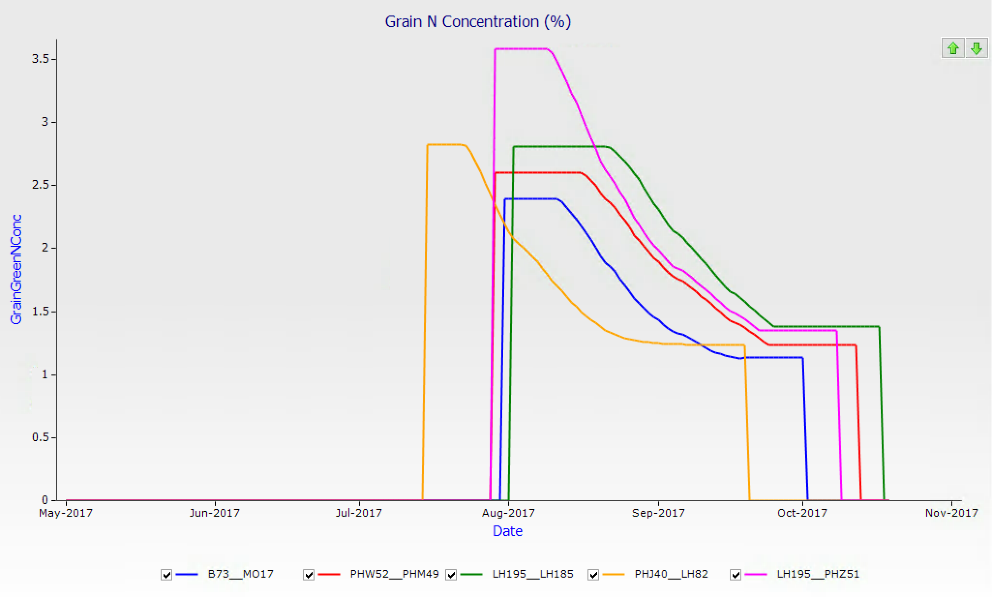
Simulated Grain N Concentration of 5 Hybrids

Slide 17
Challenges and Benefits of Crop Modeling
Large plot work (few hybrids) vs small plot work (many hybrids)
Subjective vs Objective modeling
  Calibration and parameterization is a subjective process
    Fit the model to the data
    Physiological knowledge
  Plant breeders take an objective approach through statistical estimation, but crop models are too mathematically complex for likelihood estimation
    Non-linear relationships
    Too many parameters
Benefit: crop models allow us to further understand how hybrids vary among components of performance such as yield

Slide 18
Future Work
Continue calibration using 2018 and 2019 field data
Optimize sampling
Statistical evaluation of hybrid parameters
  Compute MSEP values for a range of hybrid parameters
Validation by simulation of G2F hybrid yield trial data
  Can we simulate GxE interaction?

Slide 19


Acknowledgements
Dr. Jode Edwards
USDA-ARS, Iowa State University
Dr. Sotirios Archontoulis
Department of Agronomy, Iowa State University
Undergraduate Employees
Department of Agronomy, Iowa State University

Slide 20
Crop Growth Model Simulation of G2F Common Hybrids
Thank You!
Cassie Winn
cwinn@iastate.edu

