Slide 1


An Overview of G2F in 2018
@bridget_mcfar
Bridget A. McFarland, Naser AlKhalifah, Shawn M. Kaeppler and Natalia de Leon

Slide 2
Overview
Background on previous G2F experiments
2018 experiment
  Germplasm used
  Locations and traits collected
  Comparison of 2018 traits to other G2F years
  Data trends
Key takeaways

Slide 3
Previous G2F experiments
Overall GxE project goal: accurate prediction of the phenotypes of corn plants in diverse environments
 | 2014 | 2015 | 2016 | 2017 | 2018
No. of states/provinces | 13 | 16 | 19 | 23 | 22
No. of plots | 12,678 | 13,650 | 19,360 | 21,186 | 27,298
Experiments | -large hybrid trial -small inbred trial | -same materials as 2014, increase overlap and # of locations | -5 sub-experiments | -same materials as 2016 and one new sub-experiment | -PHW65 reference population with 2 testers (LH195-Midwest to South, PHT69-North)
Common set of hybrids grown in all locations

Slide 4
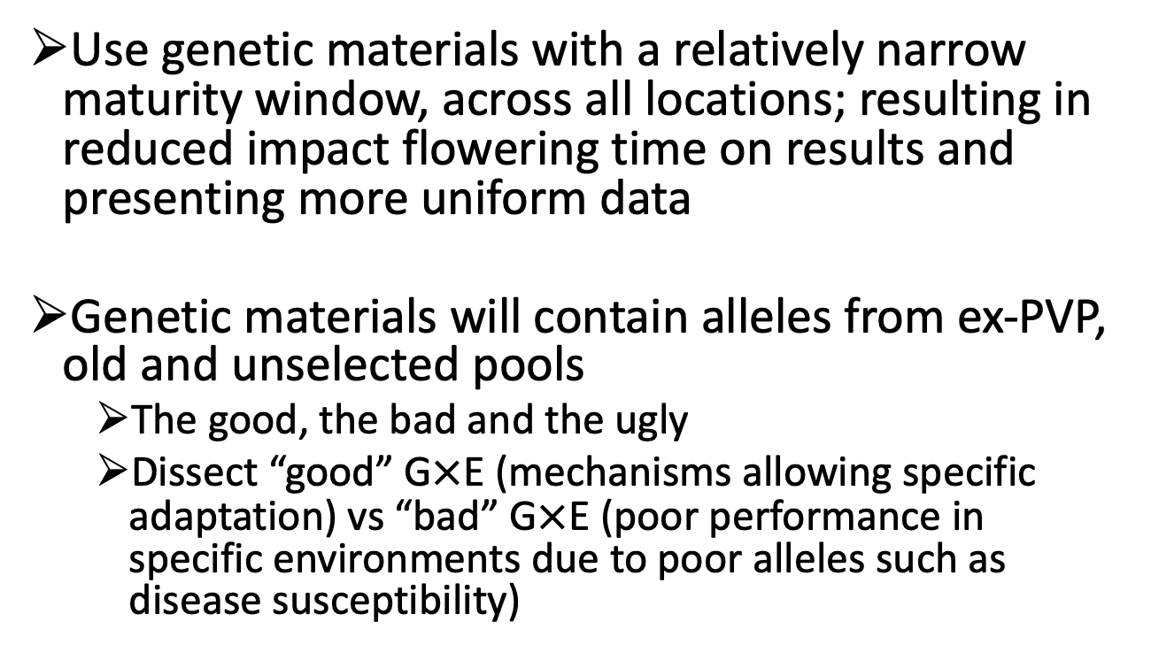
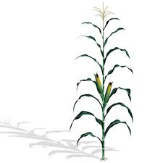
Goals for 2018 Experiment

Slide 5
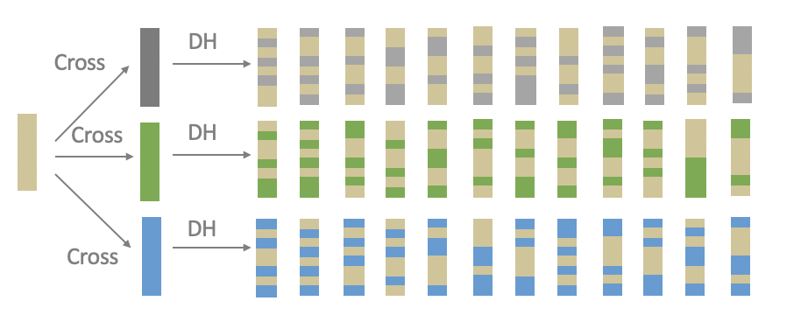
PHW65 mini-NAM Maize Population
PHW65 NAM-type population
  PHW65 reference crossed with Mo44, PHN11 & MoG and DHs were derived from crosses
(Gage JL, White MR, Edwards JW, Kaeppler S, de Leon N (2018) Selection Signatures Underlying Dramatic Male Inflorescence Transformation During Modern Hybrid Maize Breeding. Genetics. 210: 1125-1138)
Notes:
2629 Mo44
4432 PHN11
3101 MoG

Slide 6
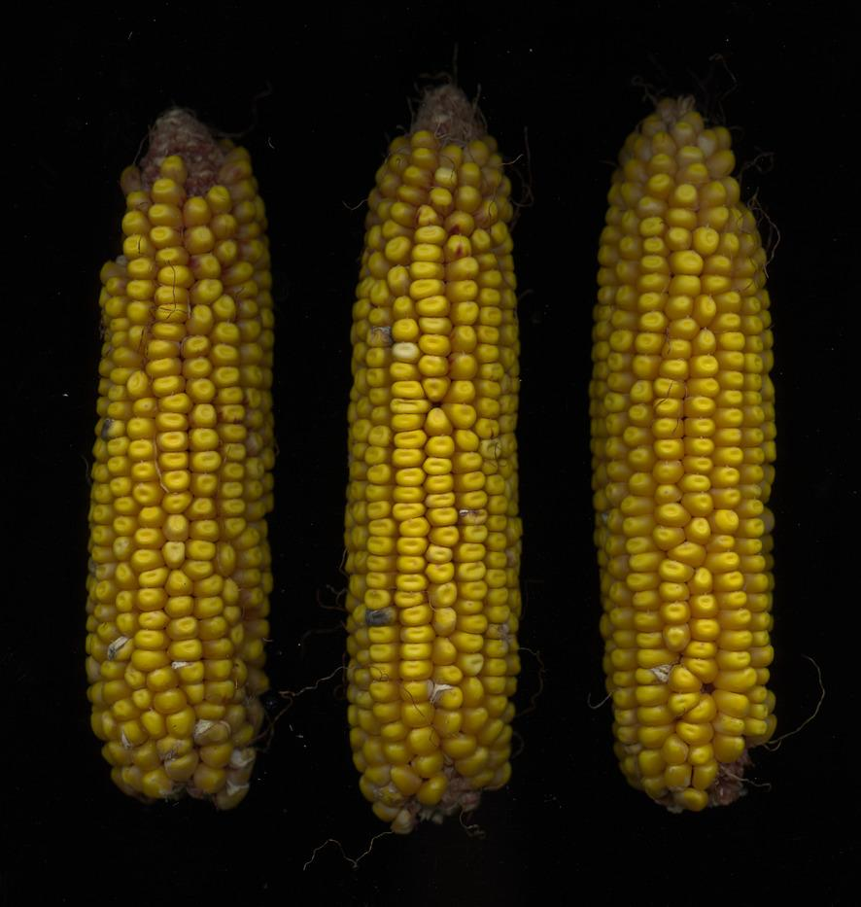
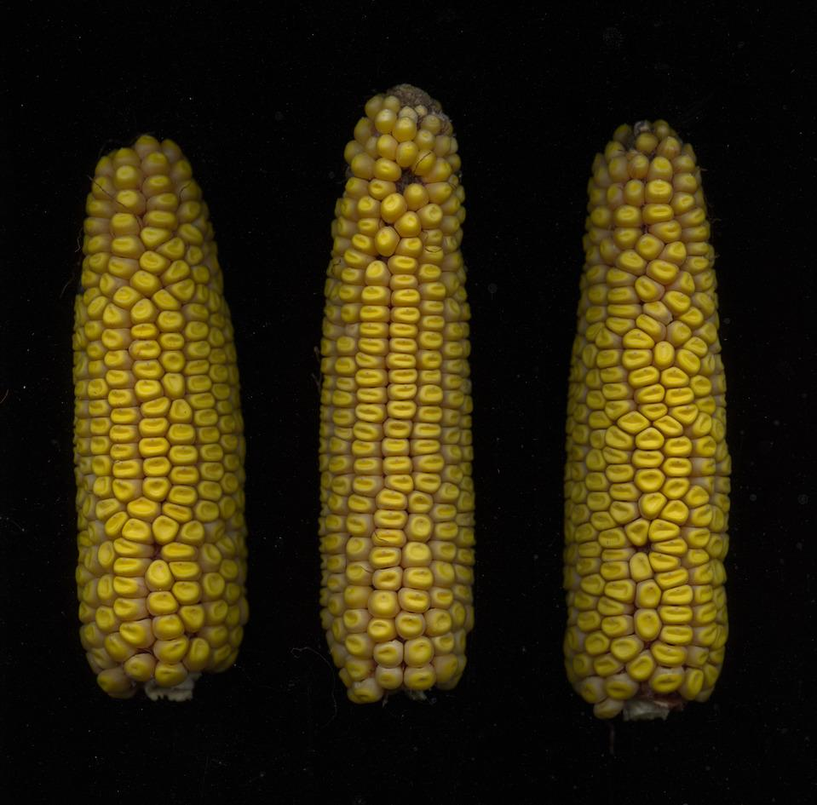
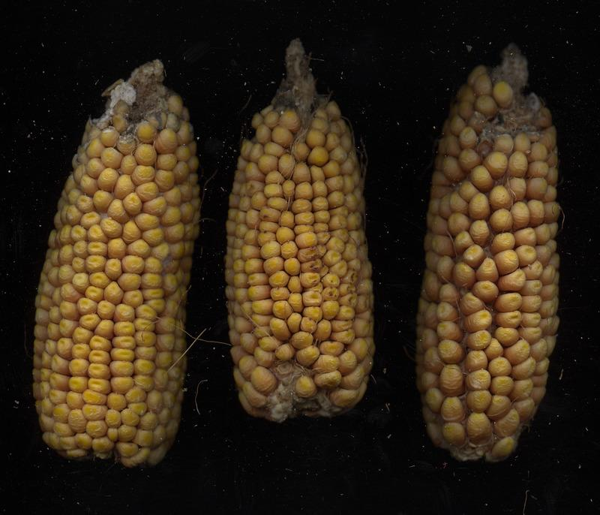
PHW65 mini-NAM Maize Population
Mo44
PHN11
MoG
The bad
(ex-PVP x old)
The good
(ex-PVP x ex-PVP)
The ugly
(ex-PVP x unselected)
Ear images obtained using the HTP ear phenotyping method developed in Dr. Edgar Spalding’s lab (Miller et al., 2017)
Notes:
PHW65 is an Ex-PVP, Lancaster-type
PHN11 is an Ex-PVP, Iodent-type
Mo44 is a Missouri line derived from Mo22 and Pioneer Mexican Synthetic 17
MoG is a Missouri line that has wide leaves, heavy stalk and high pollen production

Slide 7
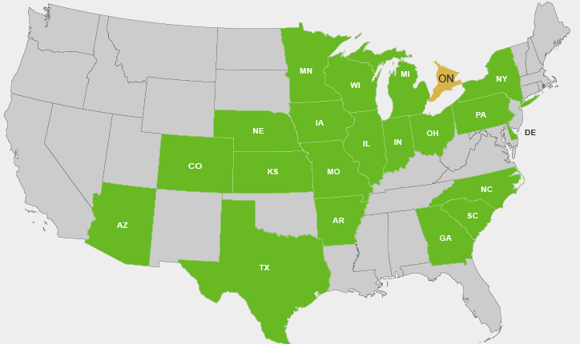
Locations and traits collected
16 locations, 12 states/provinces
9,483 plots total in 2018
RCBD and will be repeated in 2019
Plant Morphology
Plant Height (cm)
Ear Height (cm)
Plant Productivity
Grain moisture (%)
Test weight (lbs/bu)
Grain yield (bu/A)
Agronomic
Stand count (# of plants)
Root lodging (%)
Stalk lodging (%)
Days to silking/anthesis
Data included in presented analysis
Notes:
So let’s think back to the first goal which was to narrow the flowering maturity using 2 testers

Slide 8
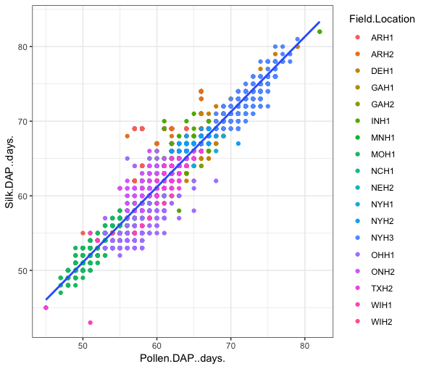
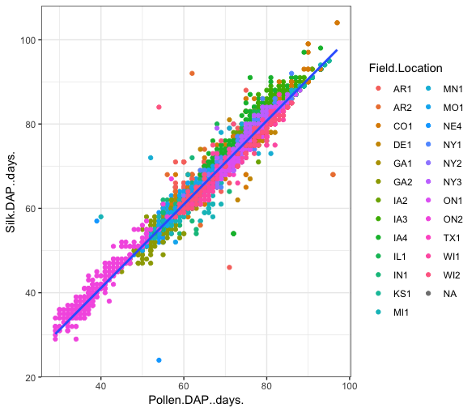
Comparison of flowering to other G2F years
2018 PHW65
2014- 2017 all G2F
Locations
Locations
R²= 0.90
R²= 0.97
Anthesis- DAP
Anthesis- DAP
Silking- DAP
Silking- DAP
Notes:
Multiple hybrids flowered on the same day- why there aren’t many points

Slide 9
Comparison of flowering to other G2F years
2018 PHW65
2014- 2017 all G2F
Locations
Locations
R²= 0.90
R²= 0.97
Anthesis- DAP
Anthesis- DAP
Silking- DAP
Silking- DAP

Slide 10
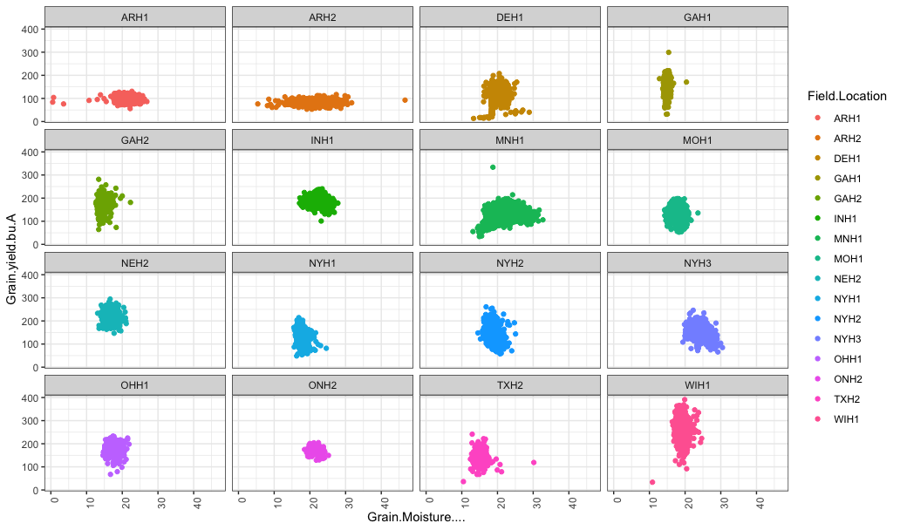
Grain Yield
Mean grain yield across all locations: 152.81 bu/A
Mean grain moisture across all locations: 19.34%
Grain Moisture
Notes:
As you can see by these grain yield by grain moisture plots across locations,
Ideal moisture at harvest is around 22%
Differences could be due to weather, time of harvest, etc.

Slide 11
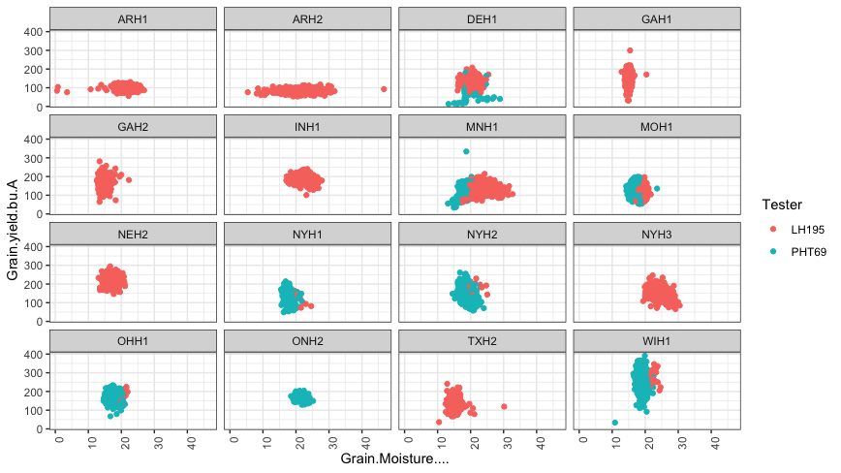
Grain Yield and Moisture- by Tester
Grain Yield
Midwest to South
North
Mean grain yield across all locations: 152.81 bu/A
Mean grain moisture across all
locations: 19.34%
Grain Moisture
Notes:
15 locations had LH195, 8 locations had PHT69, 7 locations with both
Trend that PHT69 results in hybrids with less grain moisture at harvest
We see that tester does influence plant performance, but let’s see how each mini-NAM family differs in traits

Slide 12
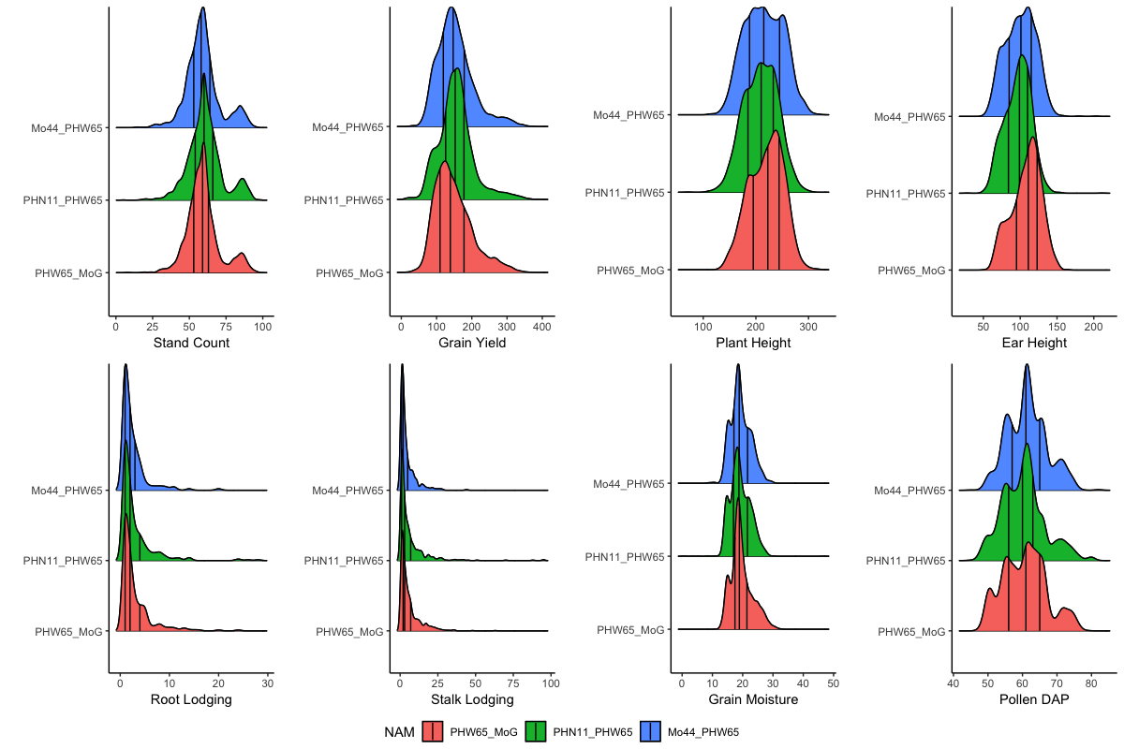
Traits across mini-NAM families
Notes:
Top=good, middle=bad, bottom=ugly
3 lines indicate 1st, 2nd (median) and 3rd quartiles

Slide 13
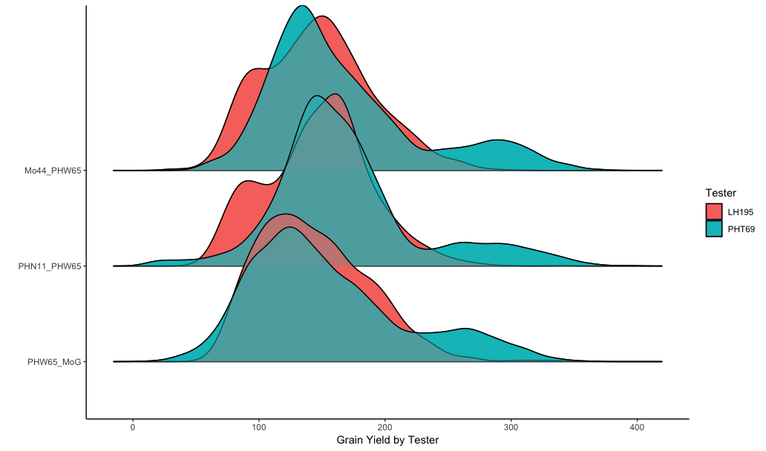
Influence of tester on mini-NAM family grain yield
Avg. Yield
 | LH195 | PHT69
Mo44 | 146.06 | 166.94
PHN11 | 146.77 | 169.08
MoG | 143.45 | 154.26
Mo44
PHN11
MoG
Grain Yield
Notes:
As you can see tester does influence the mini-NAM families differently and this should be considered in future analyses

Slide 14
Key Takeaways
The maturity window has been reduced based on flowering data
  The northern tester, PHT69, typically produces hybrids with less grain moisture at harvest
While the 3 mini-NAM families performed similarly when comparing across traits, the testers show differences between families
  MoG (the ugly) tended to perform worse
  PHN11 (the good) had consistent high performance
Repeating experiment in 2019

Slide 15











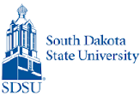







G X E Cooperators
Principal Investigators who grew GxE trials in 2014-2016
Martin Bohn (UIUC)
Ed Buckler (ARS)
Ignacio Ciampitti (KSU)
Jode Edwards (ARS)
Sherry Flint-Garcia (ARS)
Christopher Graham (SDSU)
Candy Hirsch (UMN)
Jim Holland (ARS)
Elizabeth Hood (A-State)
David Hooker (Guelph)
Fiona Goggin (A-State)
Shawn Kaeppler (UW)
Joe Knoll (ARS)
Judith Kolkman (Cornell)
Greg Kruger (UNL)
Nick Lauter (ARS)
Liz Lee (Guelph)
Natalia de Leon (UW)
Argelia Lorence (A-State)
Aaron Lorenz (UMN)
Jonathan Lynch (PSU)
Steve Moose (UIUC)
Seth Murray (TAMU)
Rebecca Nelson (Cornell)
Torbert Rocheford (Purdue)
Oscar Rodriguez (UNL)
Cinta Romay (Cornell)
James Schnable (ISU)
Brian Scully (ARS)
Rajandeep Sekhon (Clemson)
Margaret Smith (Cornell)
Nathan Springer (UMN)
Kurt Thelen (MSU)
Peter Thomison (OSU)
Mitch Tuinstra (Purdue)
Jason Wallace (UGA)
Randy Wisser (UDel)
Wenwei Xu (TAMU)

Slide 16
Genomes To Fields Collaborators
Project planning, data management, phenotyping initiatives, and Executive Committee members
Martin Bohn (UIUC)*
Ed Buckler (ARS)
Darwin Campbell (ISU)*
James Clohessy (Cornell)
Michael Coen (UW)
Carolyn Lawrence Dill (ISU)*
Liang Dong (ISU)
Jode Edwards (ARS)*
David Ertl (IA Corn)*
Sherry Flint-Garcia (ARS)*
Joseph Gage (UW)
Jack Gardiner (ISU)*
Byron Good (Guelph)
Mike Gore (Cornell)
Patricio Grassini (UNL)
Jerry Hatfield (ARS)
Diego Jarquin (UNL)*
Shawn Kaeppler (UW)
Liz Lee (Guelph)*
Natalia de Leon (UW)*†
Zhizhai Liu (TAMU)
Aaron Lorenz (UMN)*
Jonathan Lynch (PSU)
Nathan Miller (UW)
Jane Petzoldt (UW)*
Seth Murray (TAMU)*
Cinta Romay (Cornell)*
James Schnable (UNL)
Pat Schnable (ISU)†
Kevin Silverstein (UMN)
Nathan Springer (UMN)
Edgar Spalding (UW)
Srikant Srinivasan (ISU)*
Yiwei Sun (ISU)*
Kelly Thorp (ARS)
Rod Williamson (IA Corn)
Randy Wisser (UDel)*
Jianming Yu (ISU)
*GxE Coordinating Groups
†G2F co-lead
G2F Executive Committee members

Slide 17

Genomes To Fields Sponsors

Slide 18
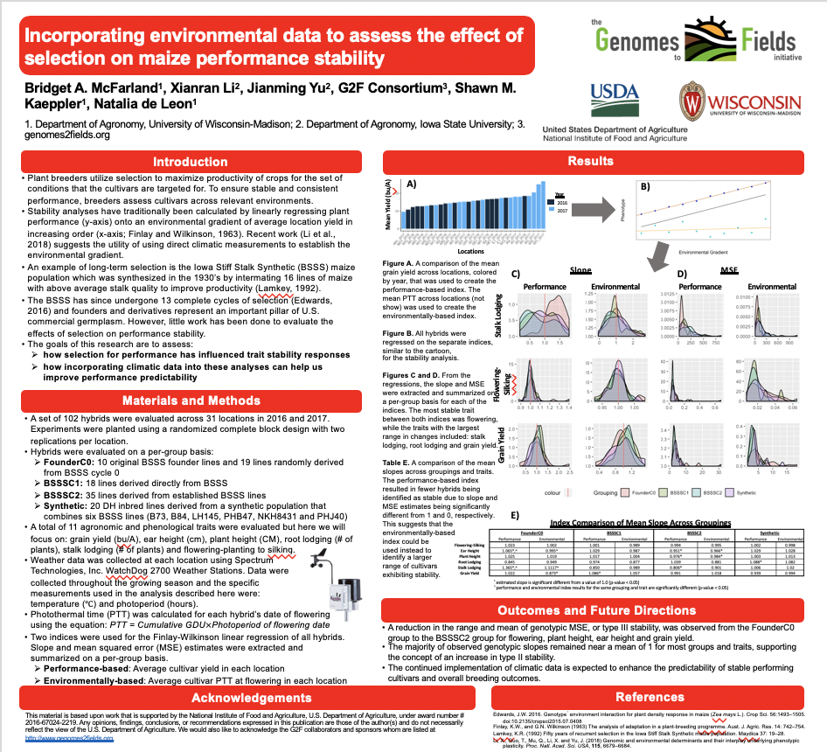
Want to learn more about other G2F projects?
Stop by poster #104- Incorporating environmental data to assess the effect of selection on maize performance stability

Slide 19
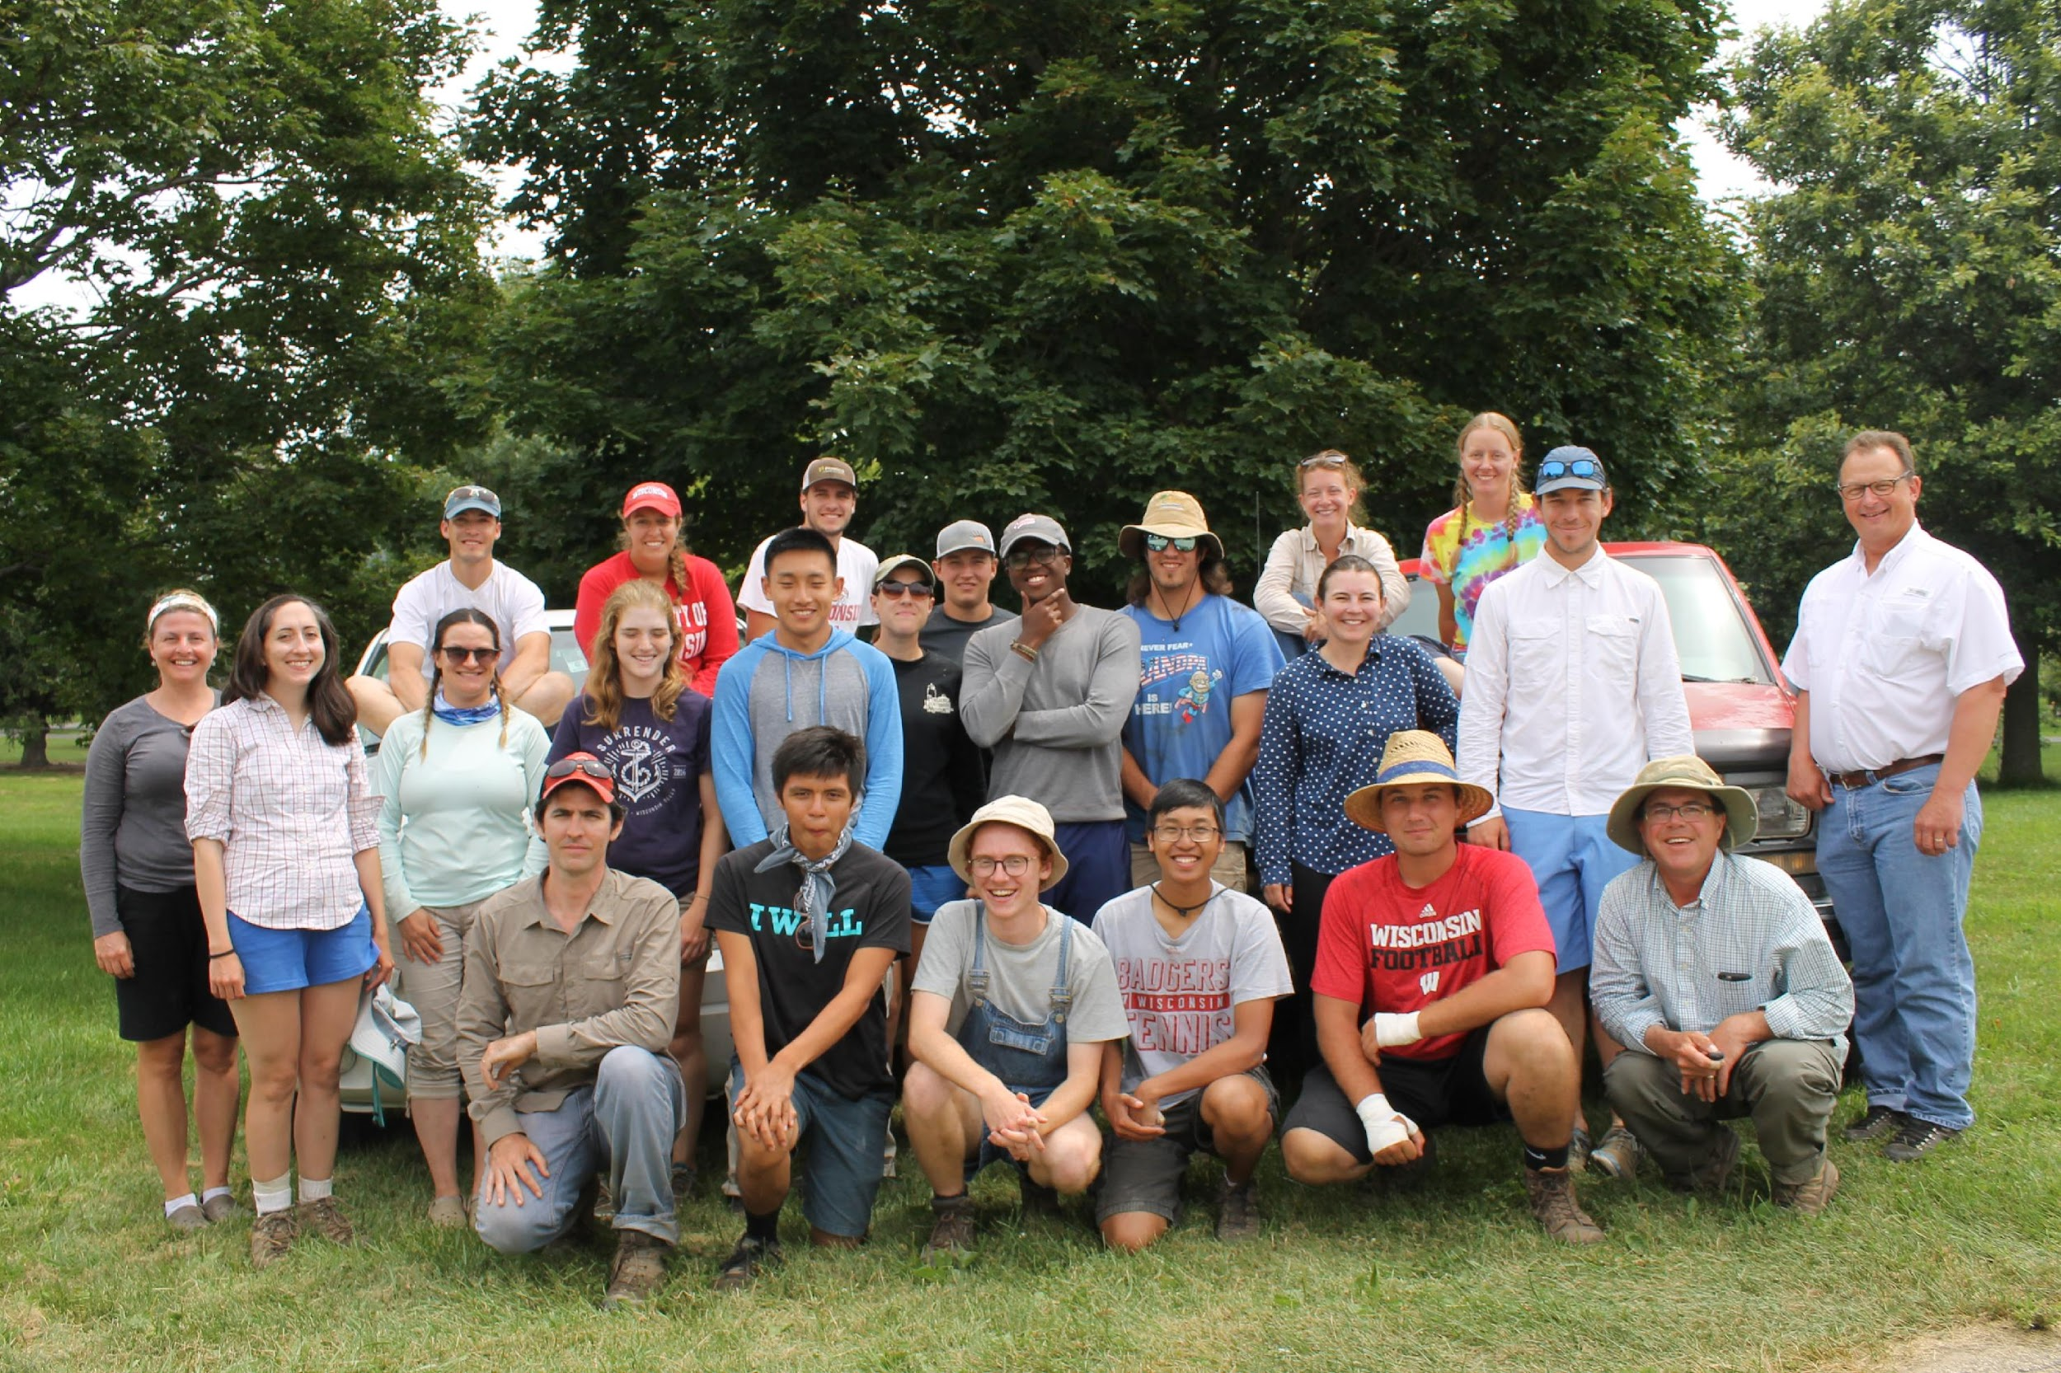
Questions?

