Slide 1
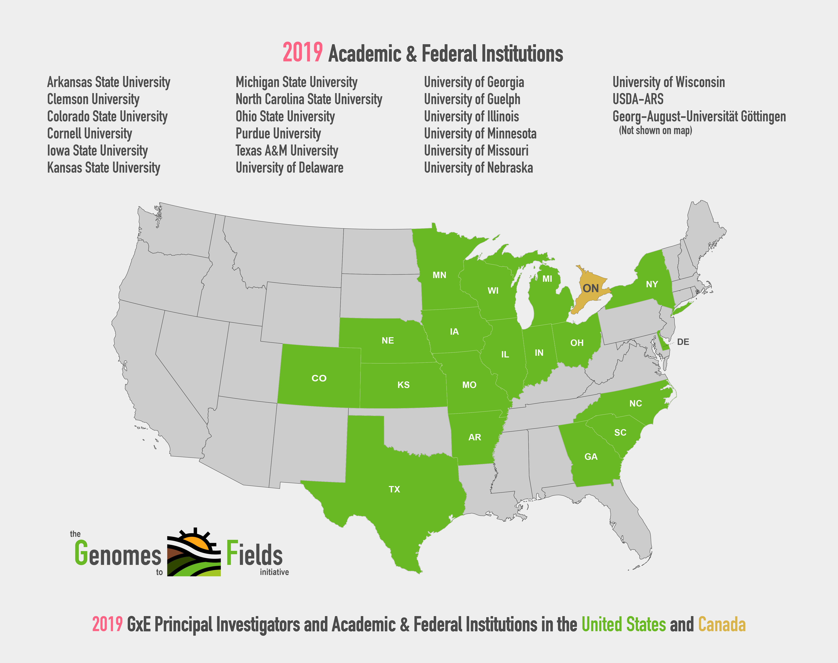

Slide 2
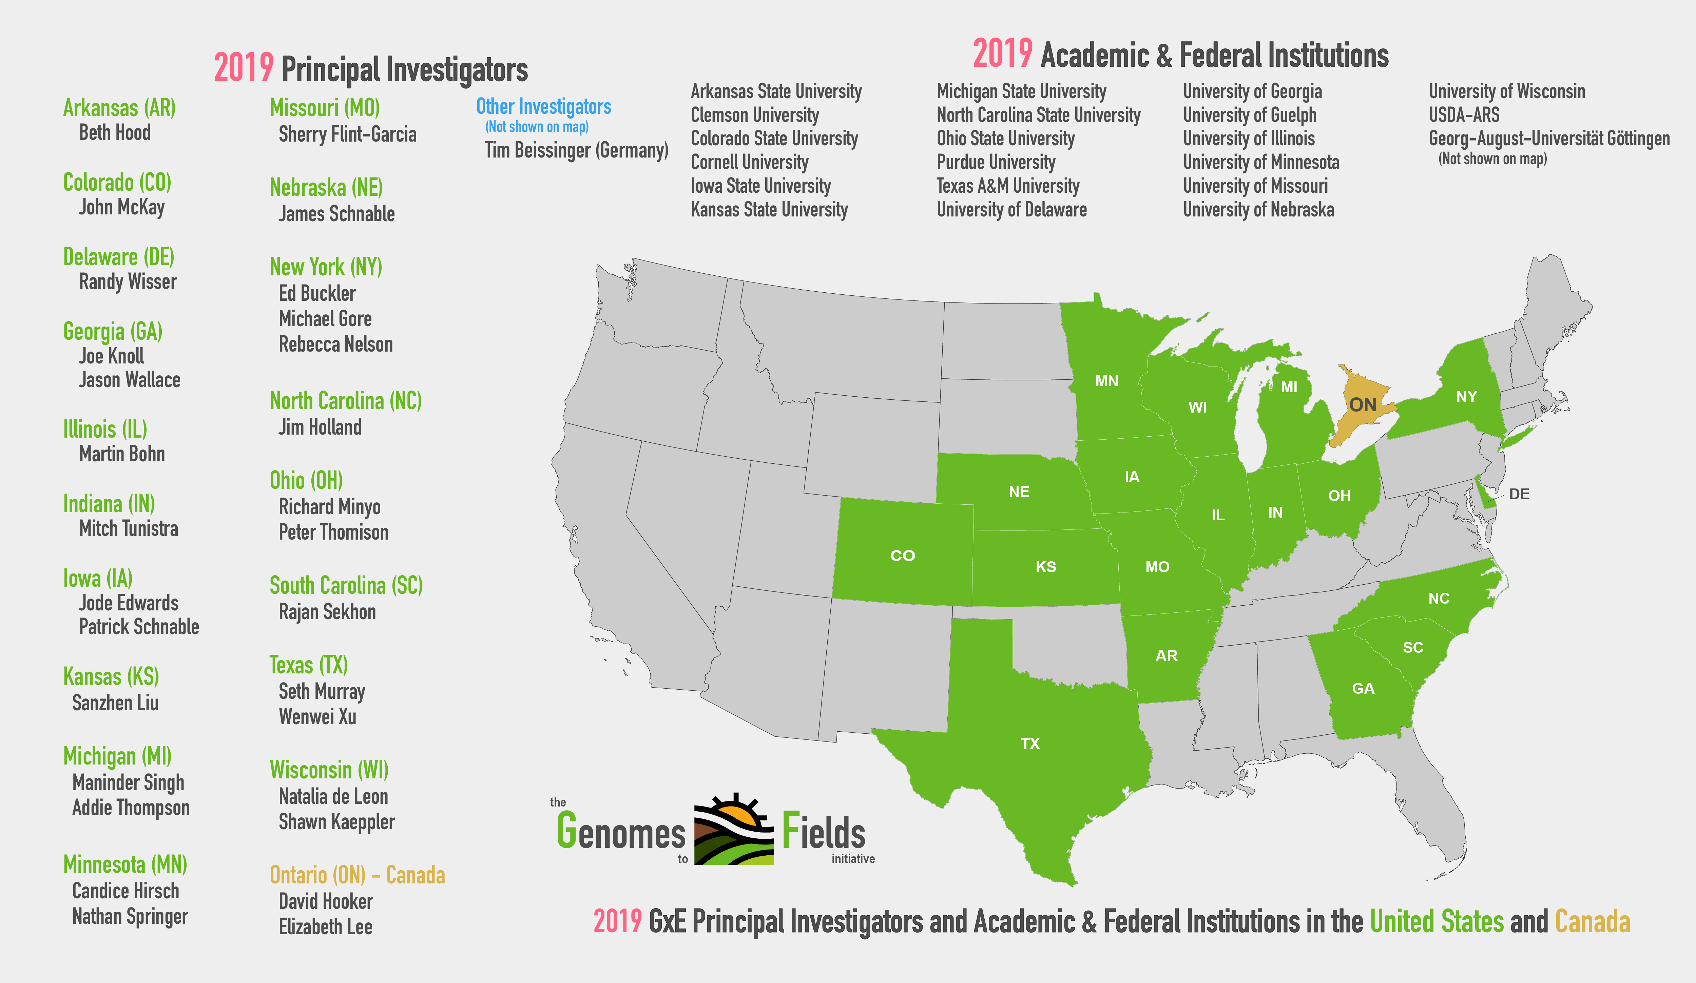

Slide 3











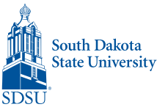






Genomes To Fields Collaborators and Cooperators
Tim Beissinger (Göttingen)
Martin Bohn (UIUC)
Ed Buckler (ARS)
Darwin Campbell (ISU)
Alejandro Castro (UW)
Ignacio Ciampitti (KSU)
Liang Dong (ISU)
Jode Edwards (ARS)
David Ertl (IA Corn)
Sherry Flint-Garcia (ARS)
Christopher Graham (SDSU)
Candy Hirsch (UMN)
Jim Holland (ARS)
Elizabeth Hood (AR State)
David Hooker (Guelph)
Joseph Gage (Cornell)
Jack Gardiner (ISU)
Fiona Goggin (AR State)
Byron Good (Guelph)
Mike Gore (Cornell)
Patricio Grassini (UNL)
Jerry Hatfield (ARS)
Diego Jarquin (UNL)
Shawn Kaeppler (UW)
Joe Knoll (ARS)
Greg Kruger (UNL)
Nick Lauter (ARS)
Carolyn Lawrence-Dill (ISU)
Liz Lee (Guelph)
Natalia de Leon (UW)
Sanzchen Liu (Kansas)
Argelia Lorence (AR State)
Aaron Lorenz (UMN)
Jonathan Lynch (PSU)
Bridget McFarland (UW)
John McKay (Colorado)
Nathan Miller (UW)
Steve Moose (UIUC)
Seth Murray (TAMU)
Rebecca Nelson (Cornell)
Torbert Rocheford (Purdue)
Oscar Rodriguez (UNL)
Cinta Romay (Cornell)
James Schnable (UNL)
Pat Schnable (ISU)
Brian Scully (ARS)
Rajandeep Sekhon (Clemson)
Kevin Silverstein (UMN)
Maninder Singh (MI State)
Margaret Smith (Cornell)
Edgar Spalding (UW)
Nathan Springer (UMN)
Srikant Srinivasan (ISU)
Yiwei Sun (ISU)
Kelly Thorp (ARS)
Kurt Thelen (MSU)
Peter Thomison (OSU)
Addie Thompson (MI State)
Mitch Tuinstra (Purdue)
Jason Wallace (UGA)
Rod Williamson (IA Corn)
Randy Wisser (UDel)
Wenwei Xu (TAMU)
Jianming Yu (ISU)

Slide 4


Genomes To Fields Sponsors
Notes:
And especially you all and Senator Baldwin for helping get the Genome to Phenome Initiative authorized at $40 million/year

